Slide 1
Ditch Easements
January 16, 2026
Kendall Burgemeister
Law of the Rockies

Slide 2
Presentation Outline
How easements are created
Scope of Easement
  Ditch owners’ rights
  Burdened property owners’ rights
Alteration and Relocation of Easements

Slide 3
C.R.S. § 37-86-102
“Any person owning a water right or conditional water right shall be entitled to a right-of-way through the lands which lie between the point of diversion and point of use…”
Does not mean what you might be thinking

Slide 4
How Ditch Easements Are Created
Condemnation
Express Conveyance or Reservation
Implied
  Prescription
  Estoppel / Acquiescence
  Easement by Prior Use

Slide 5
Condemnation
Colorado Constitution Art. XVI, § 7
  All persons and corporations shall have the right-of-way across public, private and corporate lands for the construction of ditches, canals and flumes…upon payment of just compensation
Colorado Constitution Art. II, § 14
  Private property shall not be taken for private use …except for reservoirs, drains, flumes or ditches on or across the lands of others, for agricultural, mining, milling, domestic or sanitary purposes.

Slide 6
Express Conveyance or Reservation
Deed
Easement Agreement
Other
  1866 Act Right of Way (Public Domain)

Slide 7
Easement by Prescription
Open and notorious use
Continuous (without interruption) for 18 years
Adverse or pursuant to an ineffective grant

Slide 8
Estoppel / Acquiescence / Irrevocable License
Landowner consents to construction
+
Action taken in reliance on the consent
Existence of ditch for “any appreciable time” → consent is presumed

Slide 9
Implied Easement by Prior Use
(1) unity and subsequent separation of title;
(2) benefit to the dominant tenement and a burden to the servient tenement at the time of the conveyance;
(3) evidence that the use was intended to be permanent; and
(4) continued use of the easement is reasonably necessary for enjoyment of the benefitted parcel.

Slide 10
Scope of the Easement
For an express easement, the terms of the instrument will control
For implied easements, or when the express easement is silent, many common law and statutory rules come into play.

Slide 11
Scope of Easement
Ditch owner cannot place greater burden on land than existed at time ditch was constructed or was reasonably necessary to operate it properly
Ditch easement generally non-exclusive: burdened property owner can use the ditch easement area if it does not unreasonably interfere with the easement owner’s use

Slide 12
C.R.S. § 37-86-103
“a ditch right-of-way includes the right to construct, operate, clean, maintain, repair, and replace the ditch and appurtenant structures, to improve the efficiency of the ditch, including by lining or piping the ditch, and to enter onto the burdened property for such purposes, with access to the ditch and ditch banks, as the exigencies then existing may require, for all reasonable and necessary purposes related to the ditch”

Slide 13
What is reasonably necessary?
Leaving spoils on the ditch bank?
Using explosives?

Slide 14
Unilateral Alterations by Ditch Owner
C.R.S. § 37-86-103 authorizes some changes (like piping)
But, cannot relocate the ditch or expand burden without landowner consent
C.R.S.§ 37-86-111(1) authorizes relocating headgate in response to changing stream conditions, but recognizes condemnation may be required

Slide 15
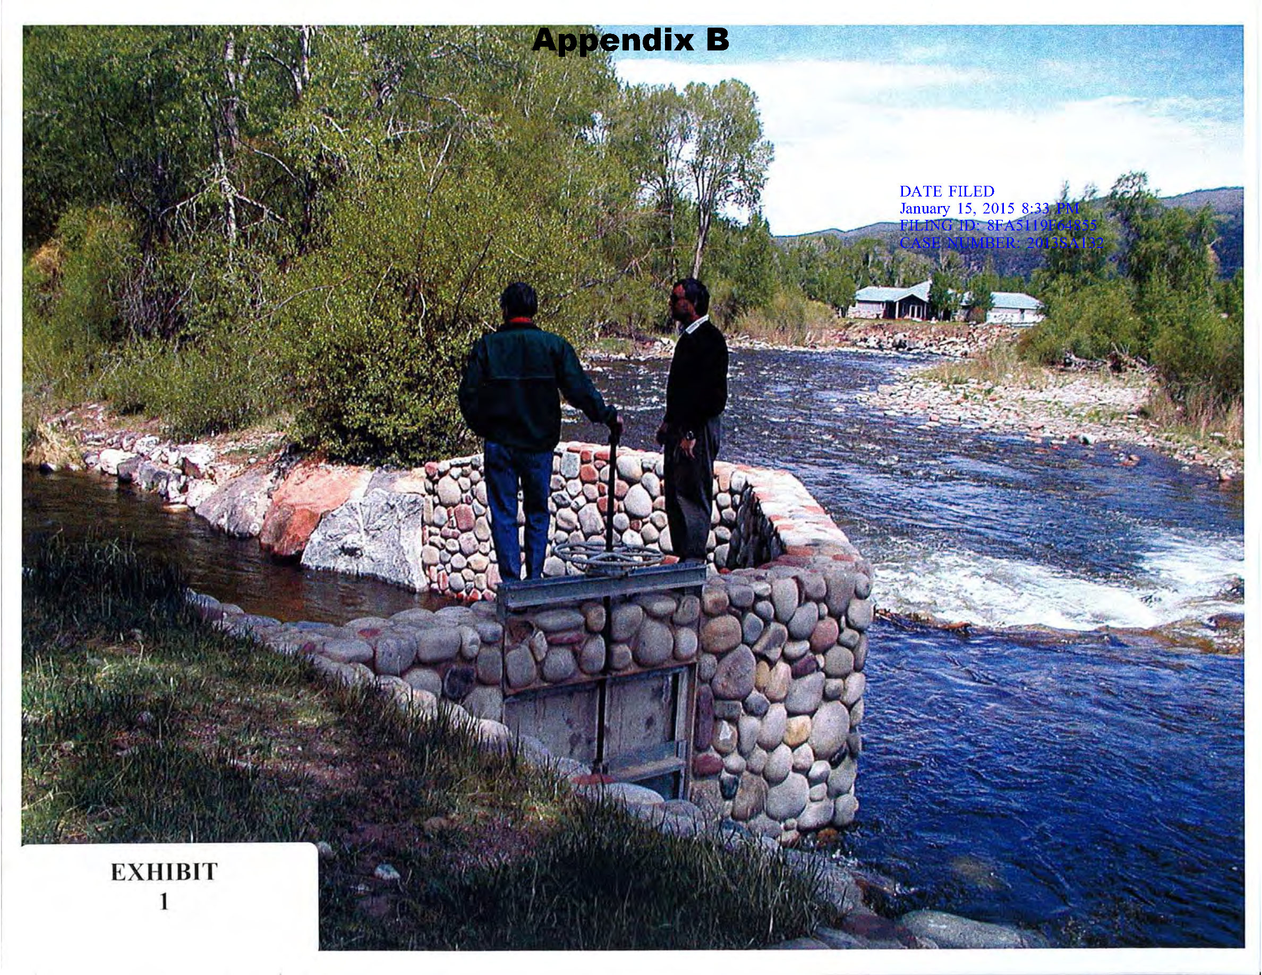
Unilateral Alterations by Landowner
Roaring Fork Club v. St. Jude’s Co. (2001)

Slide 16
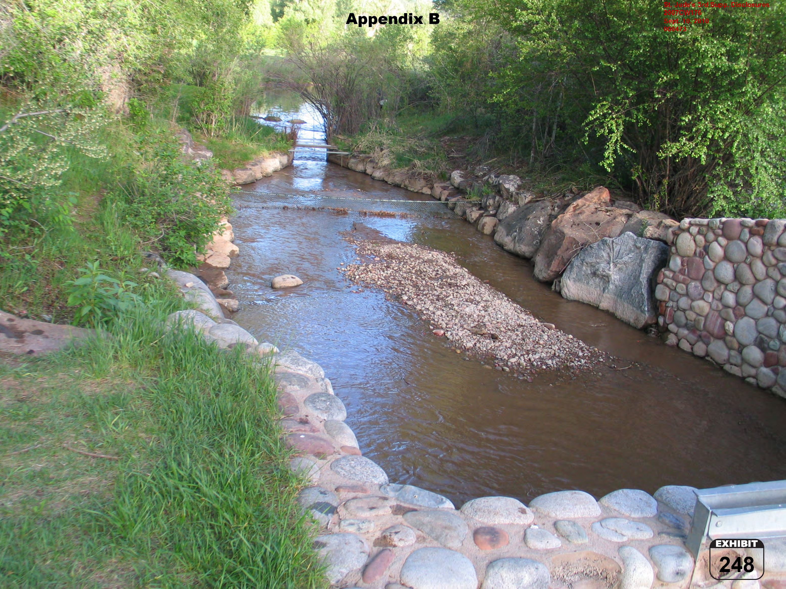

Slide 17
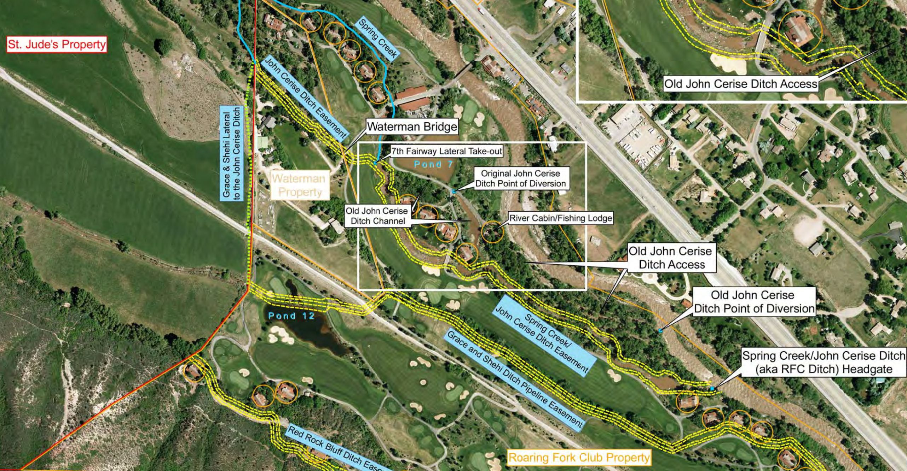

Slide 18
Unilateral Alterations by Landowner
New Rule (2001):
“the owner of property burdened by a ditch easement has no right to move or alter the easement without consent of the benefitted owner unless he first obtains a declaration of a court that such alterations will cause no damage to the benefitted owner.”

Slide 19
Restatement (Third) of Property § 4.8(3)
(adopted in Roaring Fork Club)
Unless expressly denied by the terms of an easement, ... the owner of the servient estate is entitled to make reasonable changes in the location or dimensions of an easement, at the servient owner's expense, to permit normal use or development of the servient estate, but only if the changes do not
  significantly lessen the utility of the easement,
  increase the burdens on the owner of the easement in its use and enjoyment, or
  frustrate the purpose for which the easement was created.

Slide 20
Potential Remedies for Alteration that Violates Restatement Test
Damages (actual, exemplary)
Restoration of the easement to its prior condition
Shift maintenance burdens and responsibilities
Other equitable relief

Slide 21
Harmless Self Help
Alterations that satisfy Restatement test, but were completed without permission or Court Order
Still a “trespass,” Glover v. Serratoga Falls LLC (Colo. 2021)
But, “Roaring Fork Club does not bar a burdened estate owner from engaging in self-help measures” Ute Water Conservancy Dist. v. Fontanari (Colo. Ct. Appeals, 2022)
Damages: Nominal? Exemplary?

Slide 22
Freese v. Tidd (Colo. 2015)
Owner of property burdened by irrigation ditch easement obtained declaratory judgment before making alterations
Used irrigation water in ditch for hydropower purposes
Terms and conditions in Decree sufficient to satisfy Restatement test.

