Slide 1
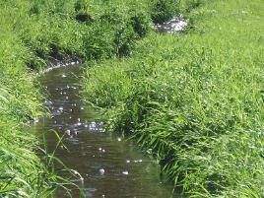
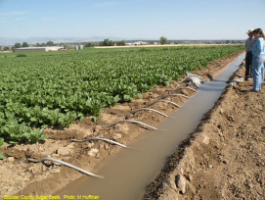

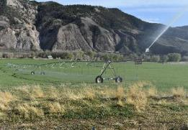
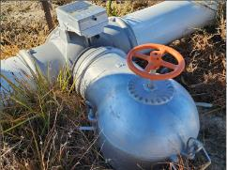
Colorado Cattlemen’s
Ag Water NetWORK
Phil Brink, Consulting Coordinator
“Helping to Keep Ag Water Connected with Ag Land”

Slide 2
2025-2026 Focus Areas:
Outreach and Information on Ag Water Issues
Securing Funding and Technical Assistance for Ag Water Projects

Slide 3
Funding for Agricultural Water Projects
Issues We’ll Cover:
Challenges / Barriers
How Do We Get Started?
Project Examples and Funding
Discussion and Wrap-up

Slide 4
What is the greatest barrier to making progress on irrigation improvements?
??

Slide 5
What is the greatest barrier to making progress on irrigation improvements?
72%
“Securing Adequate Funding and/or Cost-Share Matching Funds”

Slide 6
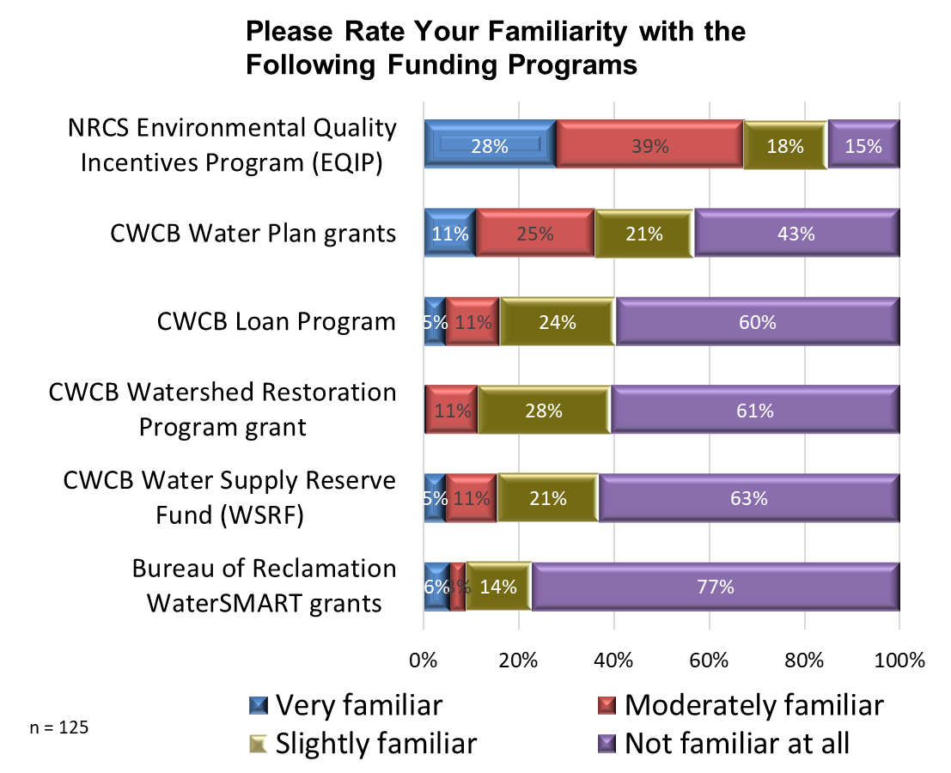
Lack of Familiarity leads to under- utilization

Slide 7
NRCS Environmental Quality Incentive Program (EQIP) –
Tailored to individual agricultural producers
Payment based on individual conservation practices
Typically 65% (+/-) cost share
Apply at USDA Service Center (NRCS and FSA)
Conservation District work group defines EQIP priorities
Can be matched with state and private funds
Eligible Practice examples: Irrigation efficiency and infrastructure, soil health, cross-fencing, streambank protection, stock-watering, etc.

Slide 8
Colorado Water Conservation Board (CWCB)
Funding Sources

Slide 9
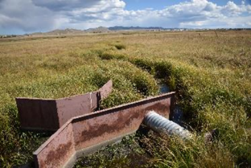
CWCB Water Plan Grant:
75% cost share for research & technical assistance.
50% cost share for on-the-ground projects.
Can be matched with non-CWCB grant funds.
Next application deadline: July 1, 2026
Projects that can be funded: infrastructure, ditch mapping, efficiency upgrades, feasibility studies, engineering, stream / river embankment stabilization.

Slide 10
CWCB Water Plan Grant – Examples

Slide 11
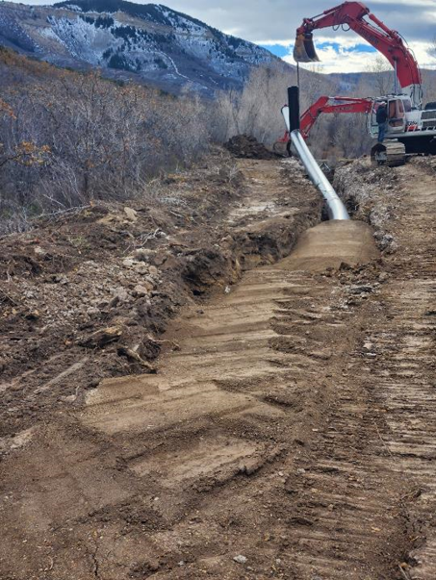
CCA Irrigation Improvement Catalyst Grant Project*
3 Conservation Districts:
Middle Colorado
Upper Arkansas
White River / Douglas Creek
* Water Plan grant

Slide 12
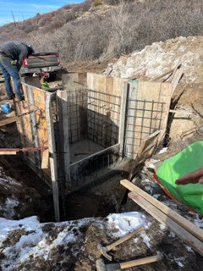
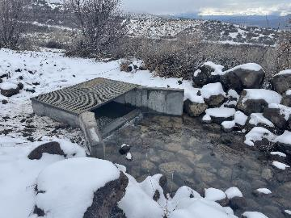
Middle Colorado project:
Funding
Amount Source
$22,000 CCA’s Catalyst Grant (Water Plan)
$50,000 Colorado River Cons. District
$100,000 CDAg Drought Resilience grant
$92,000 CWCB Loan at 2.5% for 20 years
$24,000 Covid Ag Relief Payment (CARP)
$103,000 NRCS EQIP
$3,000 NRCS – (TSP) (design)
$394,000

Slide 13
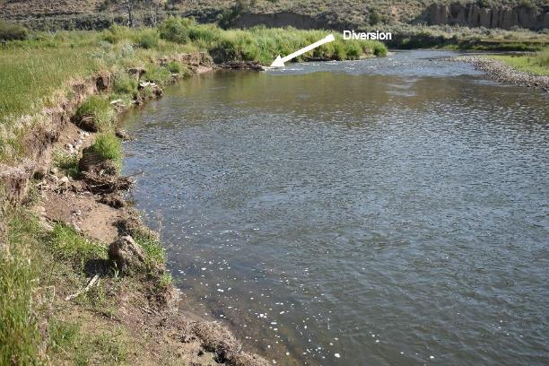
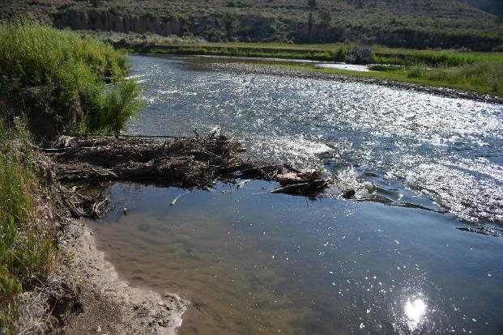
White River Projects:
Leveraged $22,000 in CCA Ag Water NetWORK Catalyst Funding (Water Plan grant) to accomplish 3 projects.
Project #1: Before

Slide 14
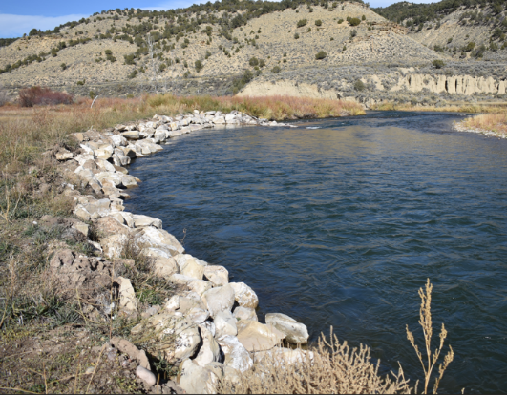
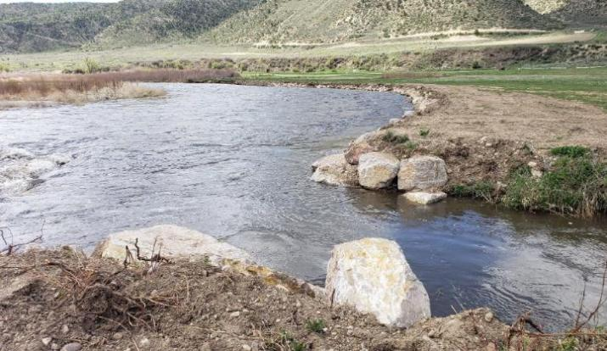
$ 8,630.25 CCA Catalyst Funding
$12,510.25 Landowner investment
$21,140.50 Total Project Cost
Project #1: After

Slide 15
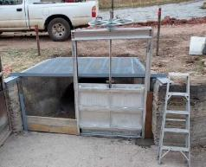
White River Projects
Before
Project 2: Replaced unsafe return flow gate and armoring around the structure and the adjacent flume to prevent further erosion.
$ 8,663.50 CCA Catalyst Funding (Water Plan)
$ 8,663.50 Ditch company investment
$17,327.00 Total Project Cost
After
*Administered by White River & Douglas Creek Conservation DIstrict and CCA Ag Water NetWORK

Slide 16
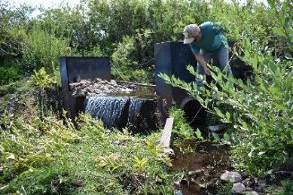
Custer County Conservation District:
Hired coordinator
Irrigation infrastructure assessments and reports to landowners
Secured 2 year WP grant funding
Rainbow Park Water Co.
Inventory ditch infrastructure
Build geo-database
Create website and pamphlet
CWCB | Rainbow Park Water Co.
Water Plan Grant | Cash Match | In- kind Match
$ 9,300 | $ 1,200 | $ 3,600

Slide 17
CWCB Water Supply Reserve Fund (WSRF) grant:
Basin funds for feasibility studies, design, infrastructure replacement or maintenance projects
25% match required
Can be matched with non-CWCB funds (ex. EQIP)
Typically 7 - 9 months to contract
Start with Basin Roundtable

Slide 18
CWCB Loan Program

Slide 19
CWCB Loan Program:
Funding for design, engineering and construction (Ditches, flood control, groundwater wells, reservoirs, etc.)
Low Interest for Ag projects (~ 2%)
Up to 30 years loan length
Can be used with any grant (state, federal, local, etc).
Typically 2 – 4 months to contract
$100,000 minimum loan request preferred

Slide 20
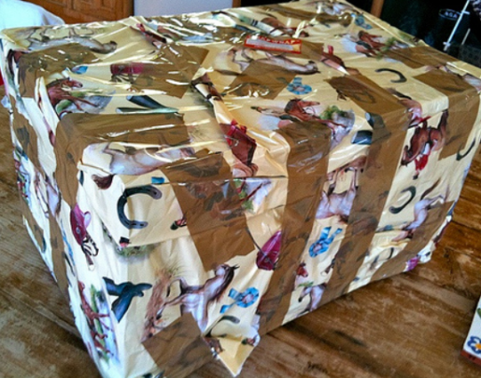
Wrap Up

Slide 21
Take homes on obtaining funding for your project:
Start early!
Envision what you want to accomplish
Are there multiple benefits?
Identify funding sources
Ensure you are eligible to apply
Where will Match $ come from?
Be ready to invest some time and money

Slide 22
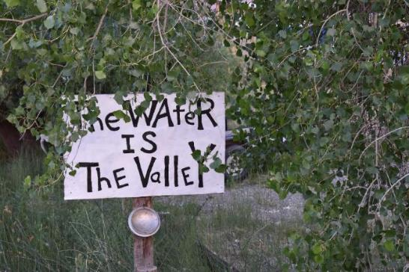

----- Questions? ---
www.agwaternetwork.org
Contact: Phil Brink (720) 887-9944 or phil@brinkinc.biz

