Slide 1
Water Administration in Colorado
CCA & CAWA Irrigators Workshop
January 16, 2026
Jason T. Ullmann, P.E.
State Engineer/Director

Slide 2

Water Resources
Water Conservation Board
Energy and Carbon Management Commission
Geological Survey
Parks and Wildlife
Reclamation, Mining and Safety
State Land Board
Forestry
Notes:
This slide is a breakdown of the various divisions with the Department of Natural Resources and how the Division of Water Resources fits within this group. Now I would like to show a short video that was released late last year that explains a bit about what we do. We aren’t usually out on social media or media much unless asked by the press, but we decided this last year that it is important to help educate Coloradoans about what we do as one of the oldest state agencies. SEO was created in 1881 and the position of water commissioner (irrigation commissioner) was before that in 1879

Slide 3
How many Divisions is DWR broken into?
7
How many Water Districts are in Colorado?
78
Notes:
How many water divisions are there in Colorado?

Slide 4
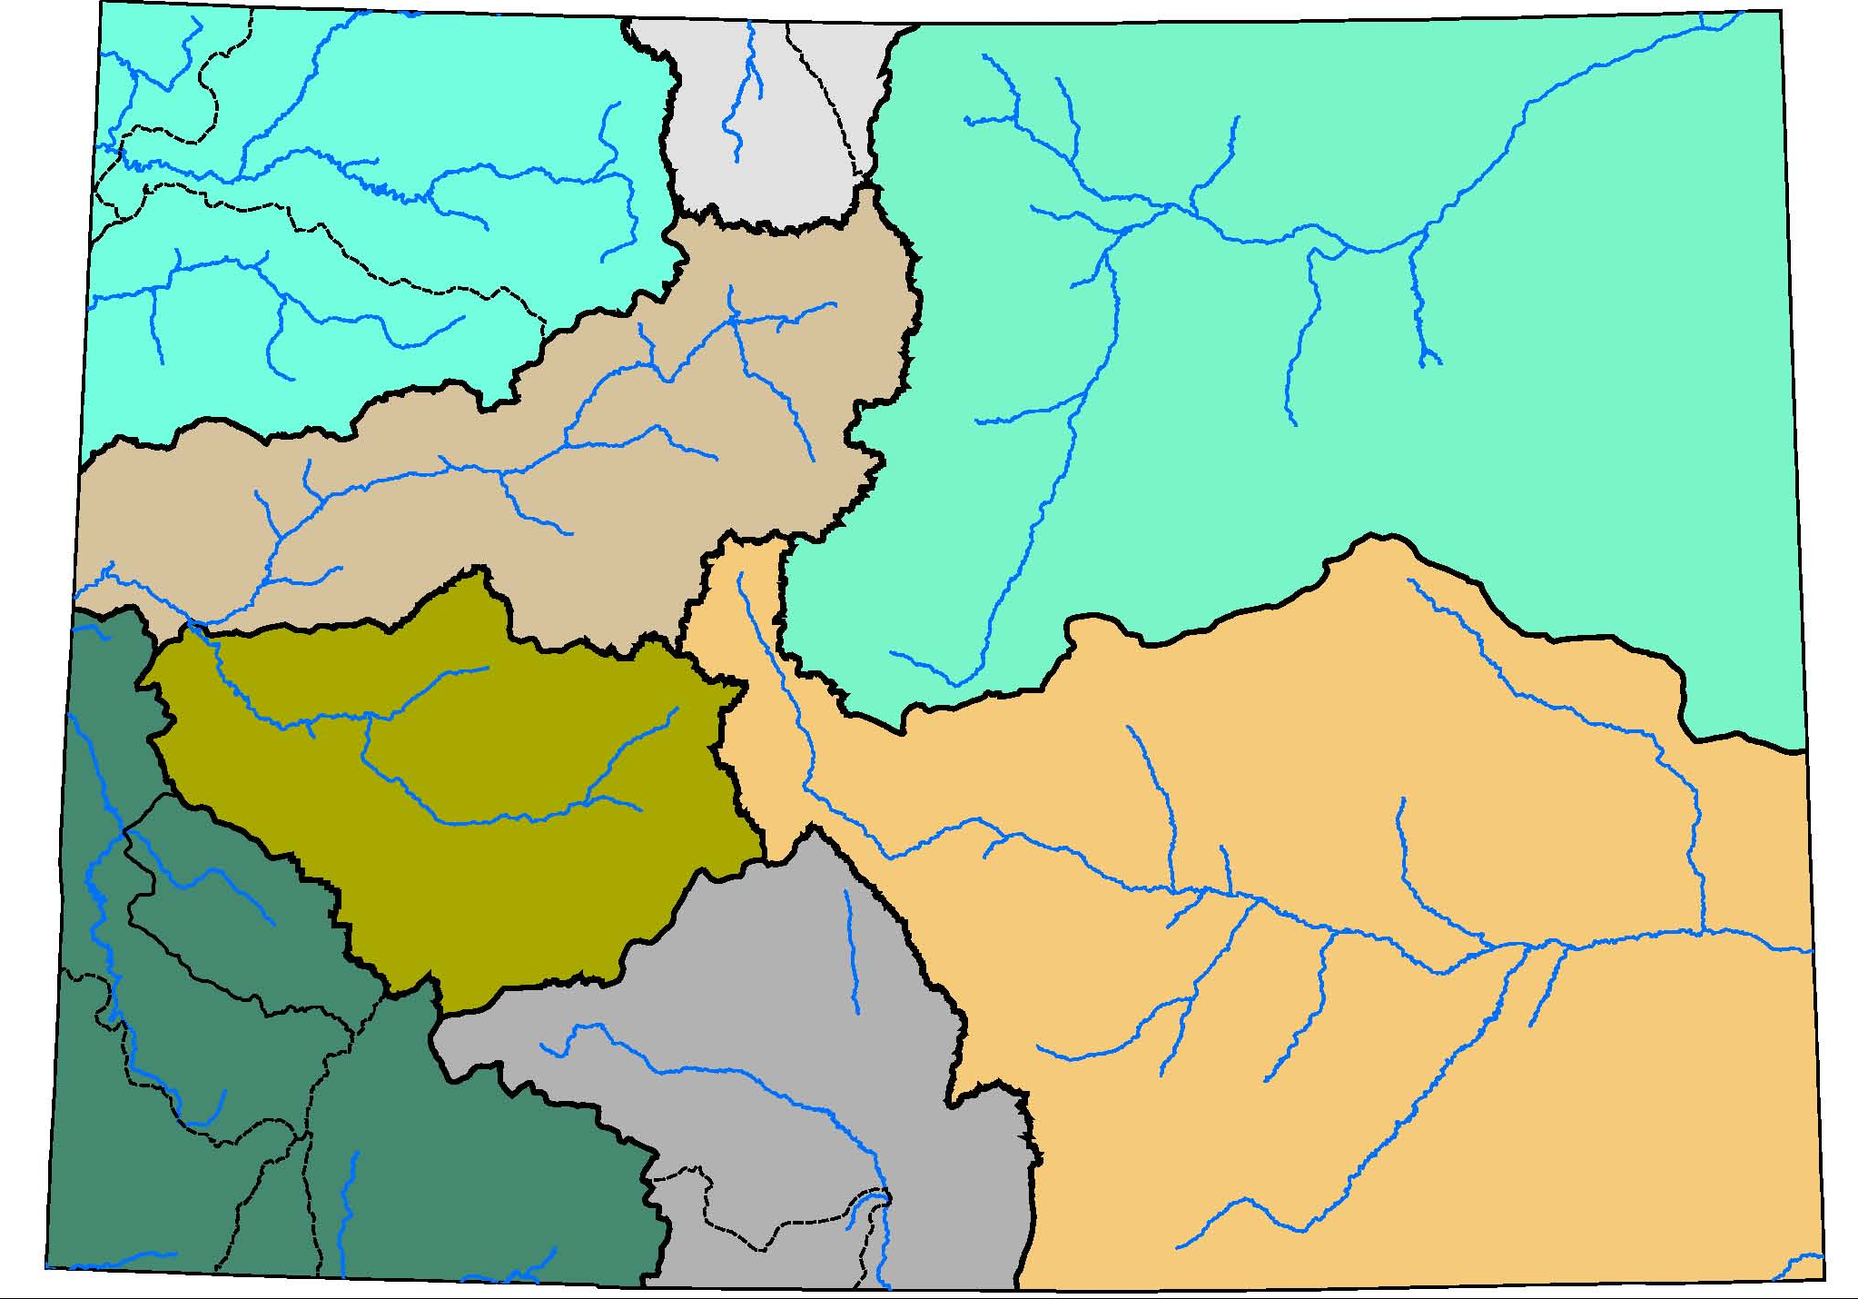
Green
North
Platte
Laramie
Yampa
White
South Platte
and
Republican
Colorado’s Major Basins and Subbasins
Colorado
Gunnison
San Miguel
Arkansas
Dolores
Rio Grande
Mancos
San Juan
Conejos
La Plata
Notes:
Now for the real lay of the land:
Colorado is the headwaters for four of our nation’s most important river systems.
The South Platte, a major tributary of the Missouri and a critical source of municipal and agricultural supply for the Colorado Front Range and Nebraska
The Arkansas, which is the major supply for Kansas
The Rio Grande, a critical source for New Mexico, Texas and Mexico
The Colorado River itself.
Sub-basins of the Colorado include:
Colorado Main-stem
The Yampa, White, Green
Gunnison
Southwest tributaries – San Juan, Piedra, Florida, Animas, La Platta, Mancos, Dolores, San Miguel

Slide 5
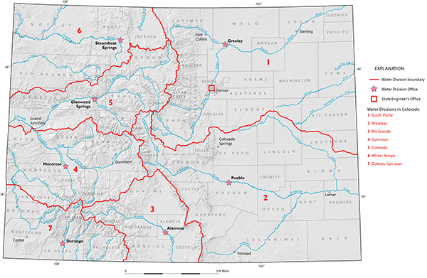
Colorado’s Water Divisions

Slide 6
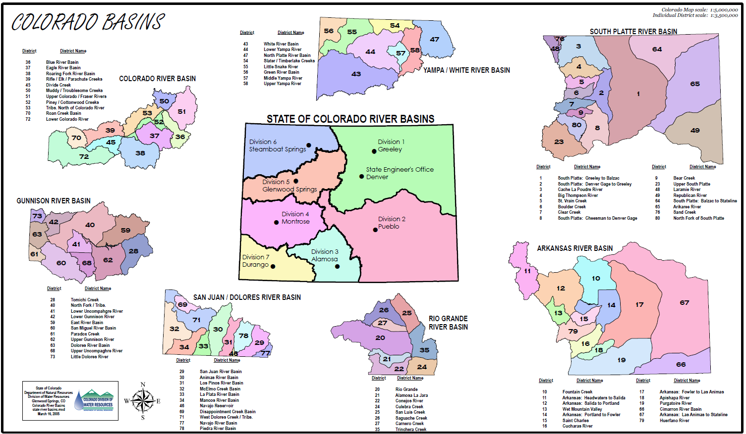
Colorado’s Water Divisions & Districts

Slide 7
How many Compacts does Colorado have with surrounding states?
9
Notes:
How many compacts does Colorado have with surrounding states?

Slide 8
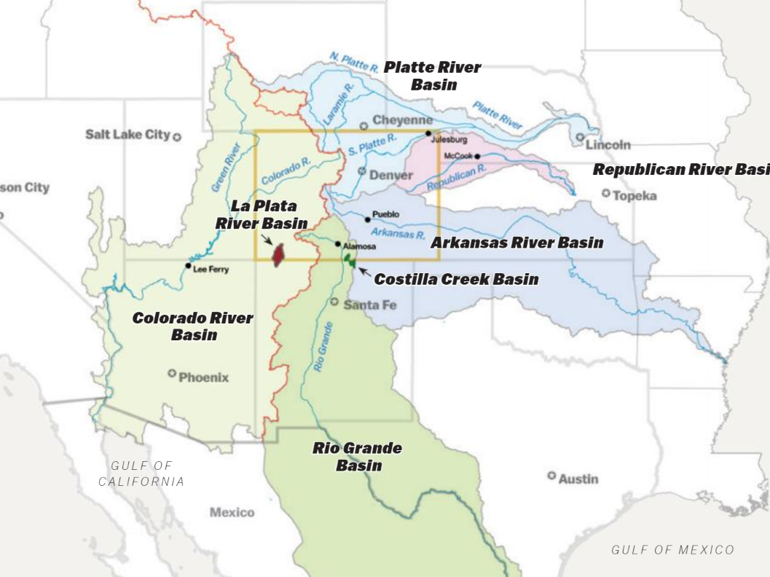
Interstate Obligations
1 Treaty with Mexico
  Rio Grande and Colorado
9 Interstate compacts
  Colorado River
  La Plata River
  South Platte River
  Rio Grande
  Republican River
  Costilla Creek
  Upper Colorado River
  Arkansas River
  Animas-La Plata Project
2 Supreme Court Decrees
  North Platte River
  Laramie River
2 Agreements
  Pot Creek MOU
  Little Snake MOA
Notes:
9 interstate compacts & 2 International Treaties (with Mexico) – THEY ARE ALL DIFFERENT
South Platte – 1923, Republican River – 1942, Arkansas River – 1948, Costilla Creek – 1944, Rio Grande – 1938, Colorado River – 1922, Upper Colorado River – 1948, La Plata River – 1922, Animas-La Plata Project – 1968, Mexican Treaty on the Rio Grande, Tijuana and Colorado Rivers – 1944, Convention with Mexico on the Rio Grande above Fort Quitman, TX - 1906
A compact is essentially a contract between two or more sovereign states to allocate (equitably apportion) a resource…in this case water. Compacts are agreed to by the legislatures of the states and approved by congress.
Water in Colorado goes to 19 states and to Mexico and we have 11 compacts or ‘equitable apportionments.
Why agree? It is an alternative to war or litigation.
What are the consequences of failing to meet our compact obligations – sued by our neighbors – US Supreme Court
Every compact is different. Is CO in compliance now? Yes

Slide 9
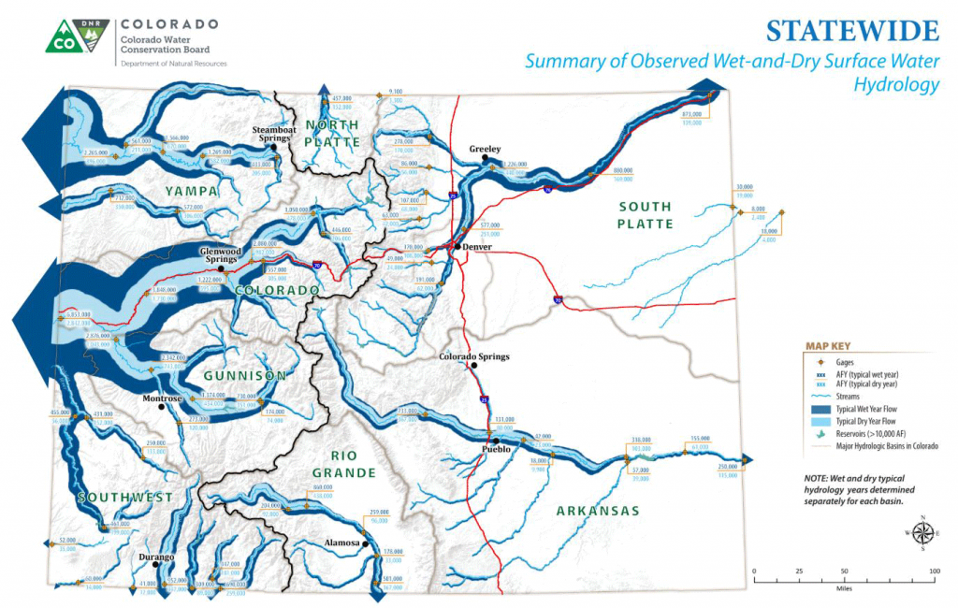
Notes:
This is a map similar to ones you probably have already been shown, but it shows the snake for each stream in both a wet and dry hydrology. As you can see, on the east slope in a dry hydrology shown in the light blue almost no water leaves the State…only what is required by the compacts on the South Platte, Arkansas, and Rio Grande Rivers. This makes DWR’s job difficult and has driven us to create tools to insure that we comply with the Compacts and Supreme Court decisions. This has included fallowing of significant land in the South Platte, instituting agricultural efficiency rules in the Arkansas, and creating subdistricts in the Rio Grande to deal with a declining aquifer conditions.

Slide 10
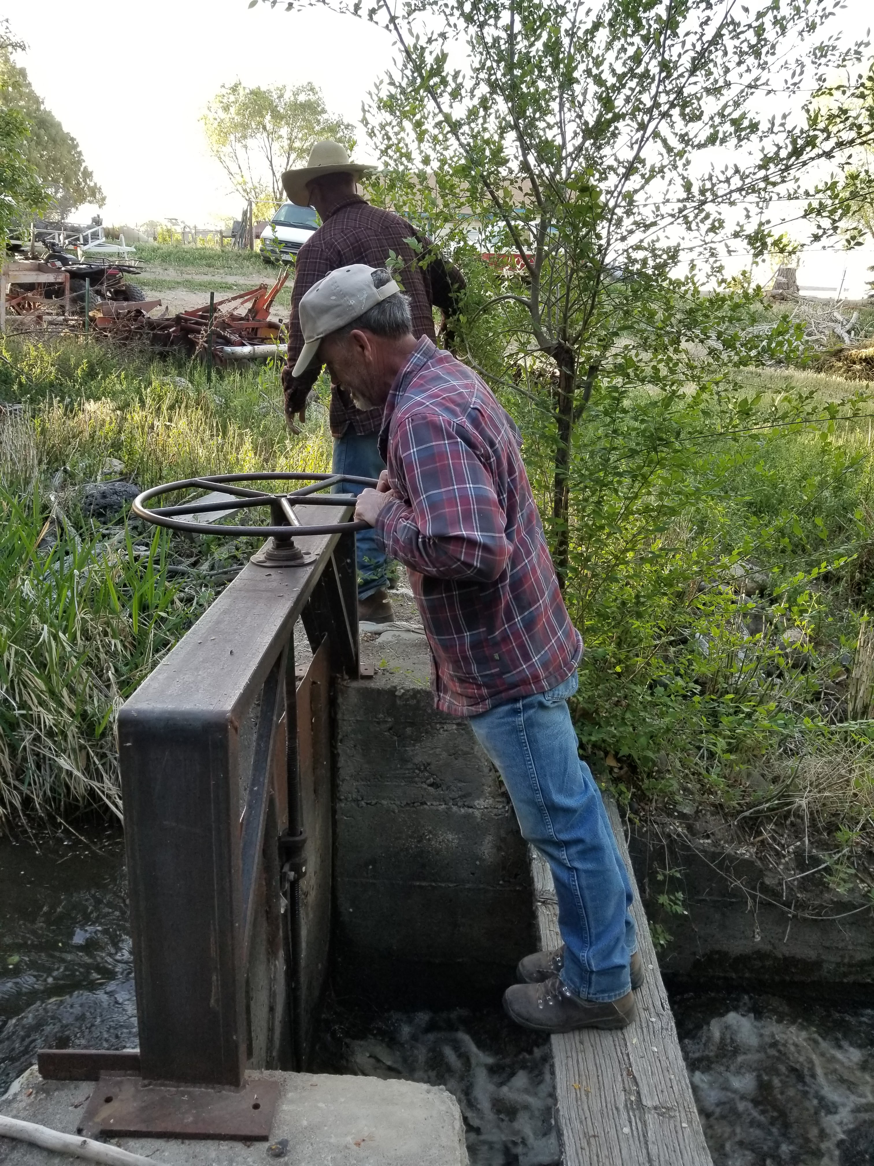
Historic Basis for Water Administration
Surface water administration
Adjudication act of 1879 – creates the position of Water Commissioner to distribute water in priority and enforce the Colorado Doctrine based upon principles in the Constitution & Statutes
Adjudication act of 1881 – creates Office of the State Hydraulic Engineer (SEO)
1887 – Superintendent of Irrigation (Division Engineers)
Notes:
By 1887 the fundamental structure for water administration is in place

Slide 11

STATUTES
      Section 37-92-501(1), C.R.S.
      “The state engineer and the division engineers shall administer, distribute, and regulate the waters of the state in accordance with the constitution of the state of Colorado, the provisions of this article”…
      ”no other official, board, commission, department or agency…has jurisdiction…”
      Balance – Maximize beneficial use while complying with interstate obligations and preventing injury
Notes:
Colorado’s constitution tells us that water of natural streams if the property of the people of Colorado.
The priority of use of water, when there isn’t enough for all, is based on older, more senior uses getting the first chance at use.
This is what we called the Priority System or Prior Appropriation.

Slide 12
Water Commissioner Responsibilities
Day to Day Administration
    Setting the call on the stream based on supply and demand
    Assuring diversions in priority for decreed uses without waste
    Assuring diversions are measured
    Delivery of augmentation and other water after assessing transit losses
    Operating exchanges
    Assuring other decree conditions in augmentation and change cases are complied with
Review of accounting and maintenance of diversion records
Notes:
General Duties of a Water Commissioner: Two thirds of the employees at DWR are water commissioners. Most of the statutes related to their work are found in C.R.S. ¶ 37-92-502. In water Division 4, this is a very hands on job. The water commissioners adjust headgates. In Division 1, much of the water use is recorded electronically and any monkeying with headgates without communicating with the water commissioner results in an upset of the system. Their duties include:
Day to Day Administration
Setting the call based on supply and demand
Assuring diversions are in priority for decreed uses and measured without waste
Delivery of augmentation water after assessing transit losses
Operating exchanges
Assuring other decree conditions are complied with
Review accounting and maintenance of diversion records
Field inspections for water court applications
Assisting the hydrographer with stream flow measurements

Slide 13
How many water rights does DWR administer?
173,000
Notes:
How many water rights are included in DWR’s database?

Slide 14
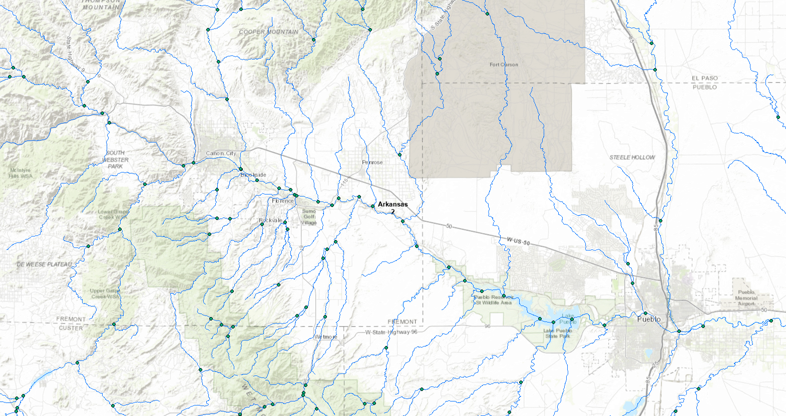
Canon City
Pueblo
Notes:
Here is a section of northeast Colorado from Longmont to Fort Collins and the Front Range to near Fort Morgan on the east. I want to demonstrate in a more visual way what those 173,000 administered water rights look like.

Slide 15
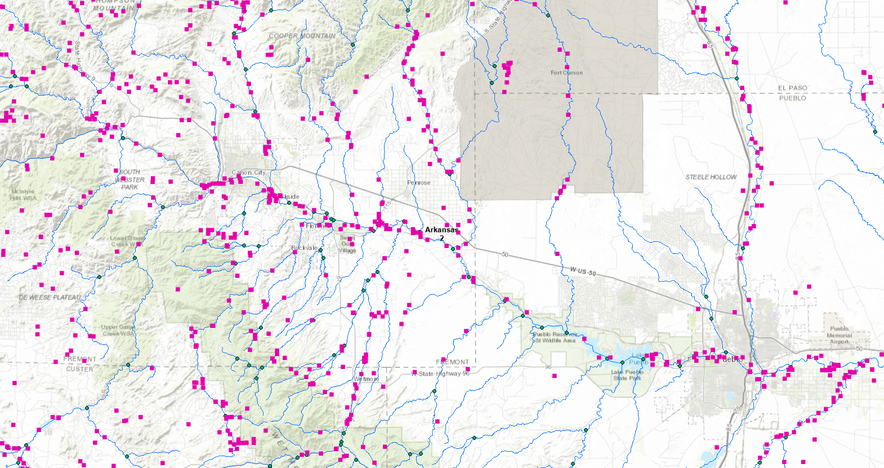
Notes:
Here is that same map with all surface water structures as pink dots…

Slide 16
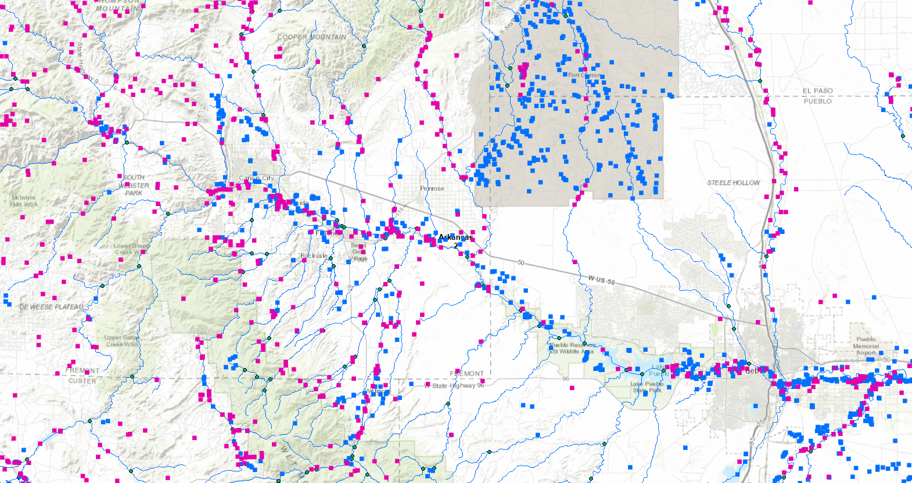
Notes:
Here is that same map with all surface water structures as pink dots…

Slide 17
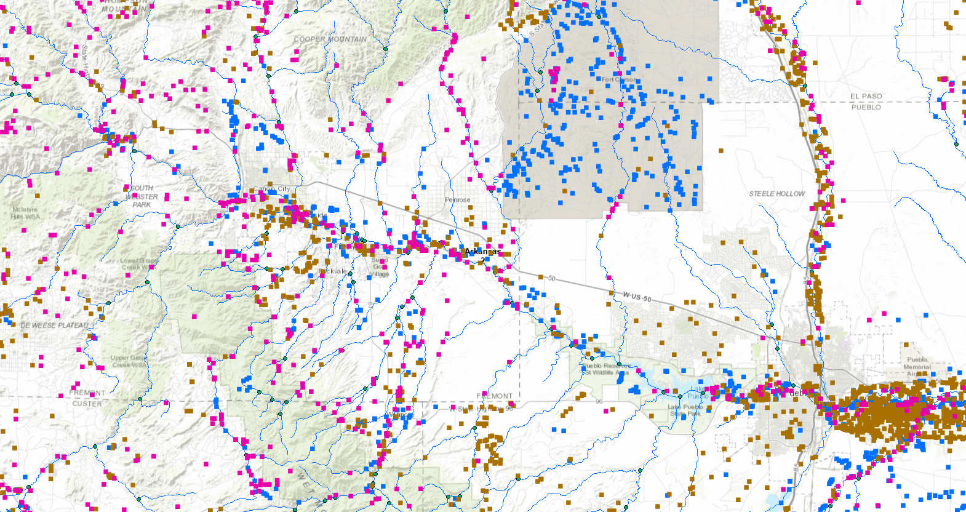
Notes:
Here is that same map with all surface water structures as pink dots…

Slide 18
What is a “Call” & what does it mean?
Free River – the supply of water in the river exceeds the demand for water by all decreed water users
Call – the demand for water by a user
Call Recognized and Administered by DWR – determination by the Water Commissioner of the most junior right that may divert when the supply of water in the river is less than the demand on the river by all decreed water users (also known as “the Call”)
Note: These definitions are not found in statute, but are working definitions in DWR. The primary statute that water administration occurs under is 37-92-502, C.R.S.
Notes:
General Duties of a Water Commissioner: Two thirds of the employees at DWR are water commissioners. Most of the statutes related to their work are found in C.R.S. 37-92-502. In water Division 4, this is a very hands on job. The water commissioners adjust headgates. In Division 1, much of the water use is recorded electronically and any monkeying with headgates without communicating with the water commissioner results in an upset of the system. Their duties include:
Day to Day Administration
Setting the call based on supply and demand
Assuring diversions are in priority for decreed uses and measured without waste
Delivery of augmentation water after assessing transit losses
Operating exchanges
Assuring other decree conditions are complied with
Review accounting and maintenance of diversion records
Field inspections for water court applications
Assisting the hydrographer with stream flow measurements

Slide 19
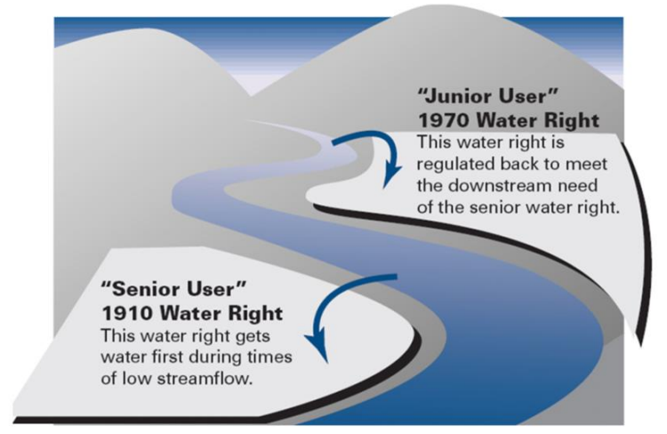
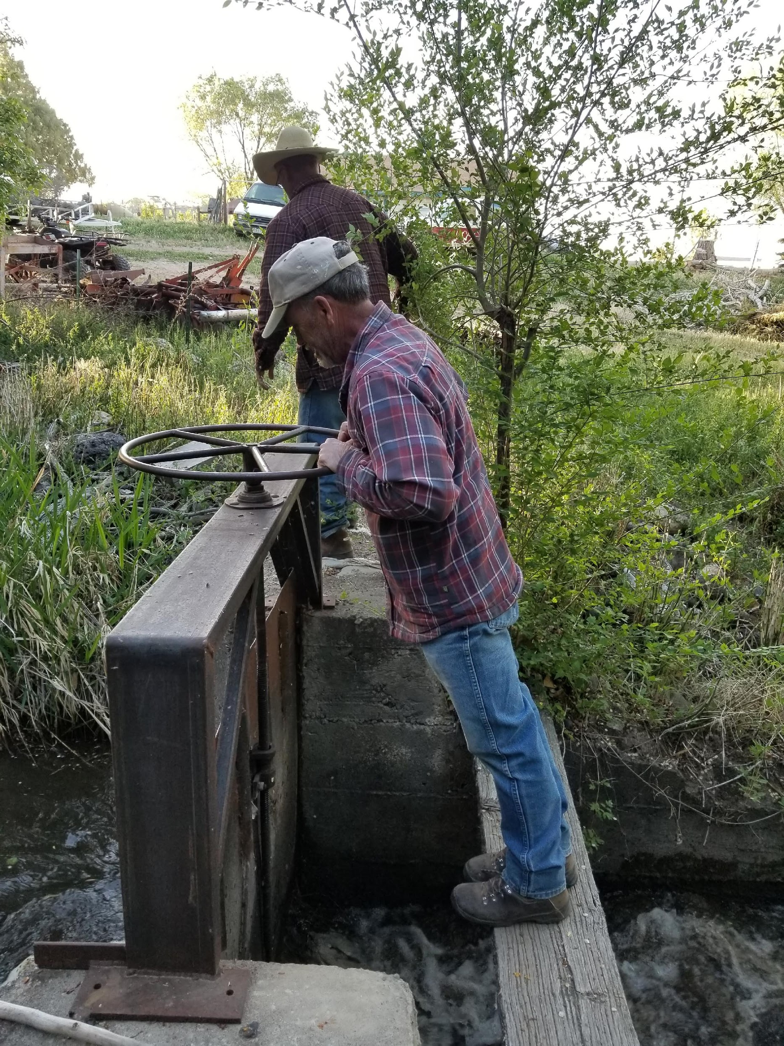
Prior Appropriation & Curtailing Junior Rights
Notes:
Here is the system visually.
When there isn’t enough water supply for all uses, only the most senior get to divert water, others must let it flow by without using it.

Slide 20
How Does A Commissioner Set The Valid Call For A Portion Of The River?
Determine river conditions (supply) from stream gaging stations
Determine the demand (calls) by various water right holders from water user contacts
Sets the valid call based on a comparison of river conditions (supply) and demand (calls) and knowledge of water gains/losses and travel times between points on the river
Can include evaluating exchange potential
Release of augmentation water

Slide 21
Conditions Commissioners Review Prior to Placing a Valid Call for a User
User must be in priority
Will water be used in accordance with decree terms and conditions?
Is water applied to beneficial use without waste?
Does structure have a headgate and an accurate measuring device?
Is the structure taking all the water that available at it’s headgate?
Can user get the water they are asking for without setting a call?
Will curtailing upstream junior water rights provide water to calling rights?

Slide 22
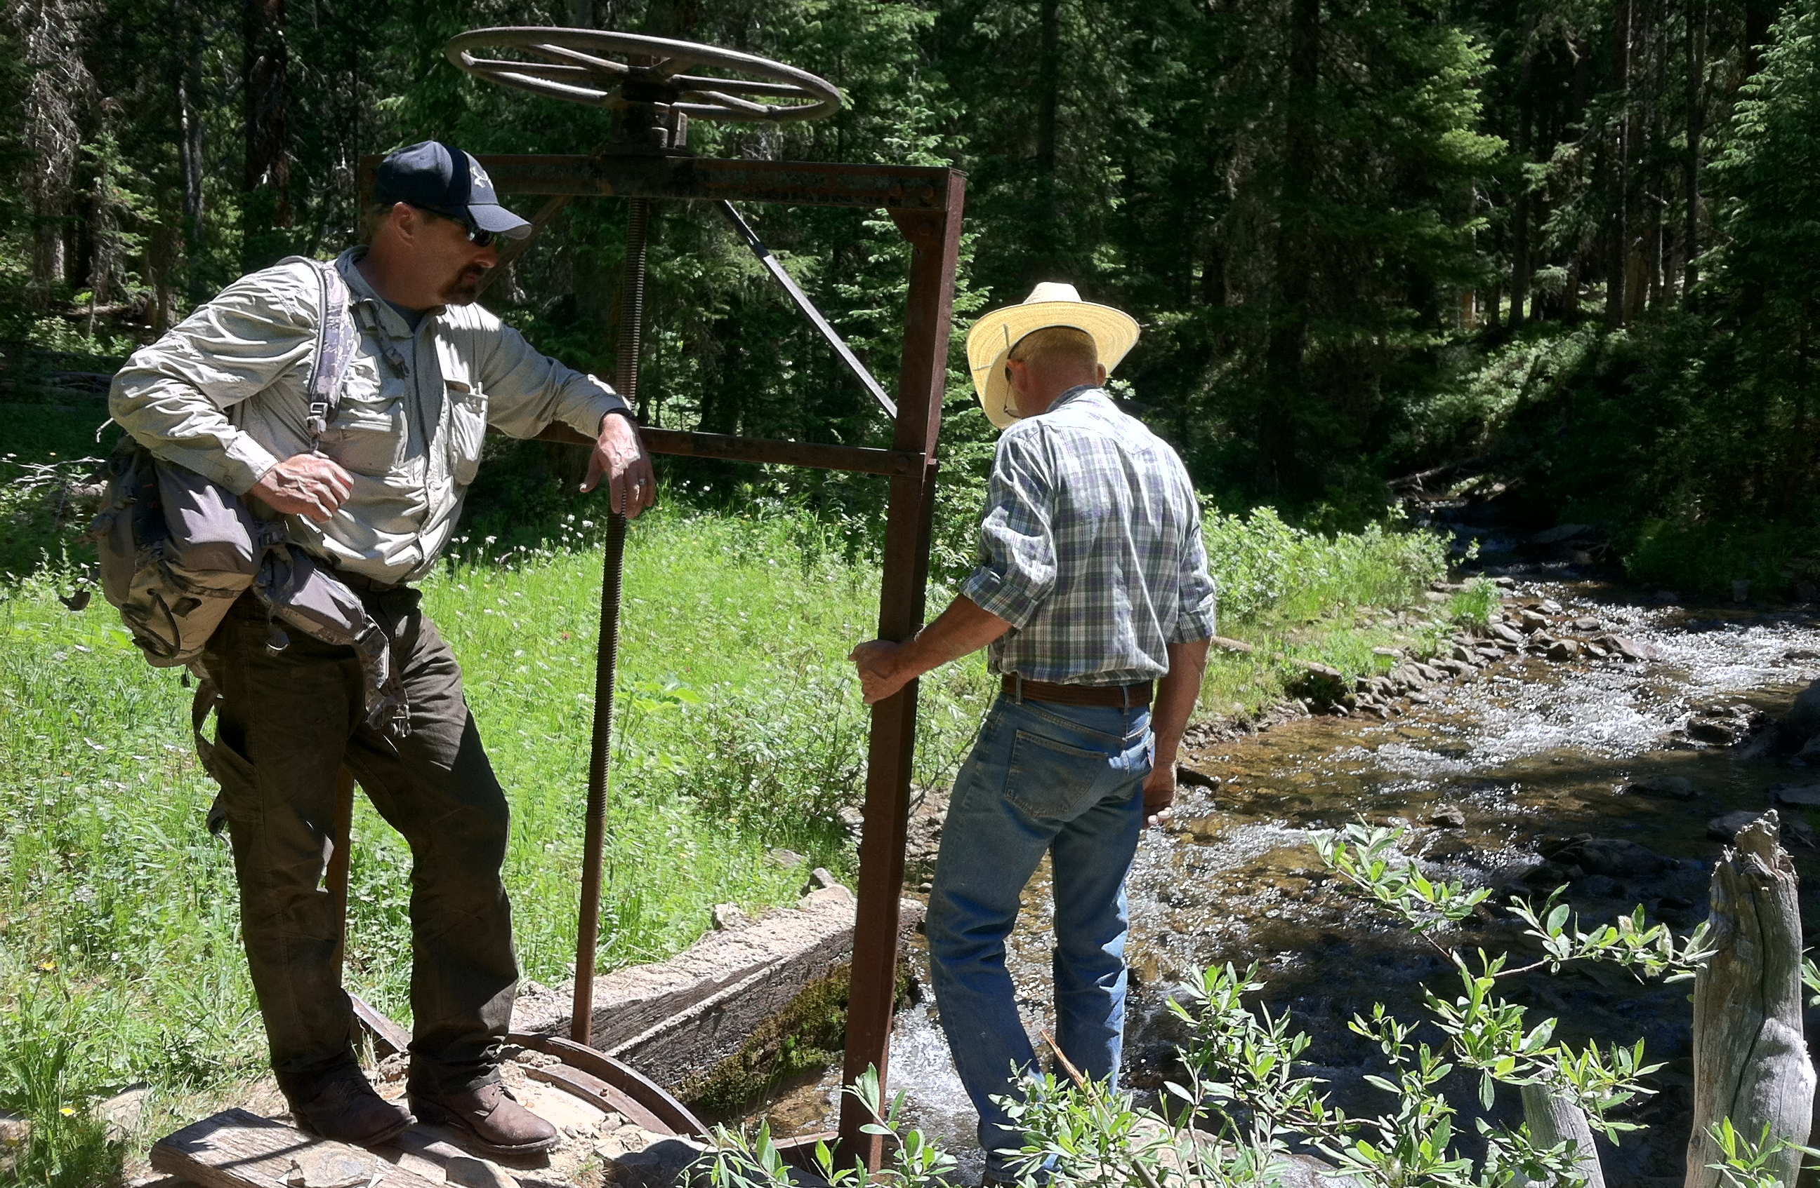
Water Administration

Slide 23
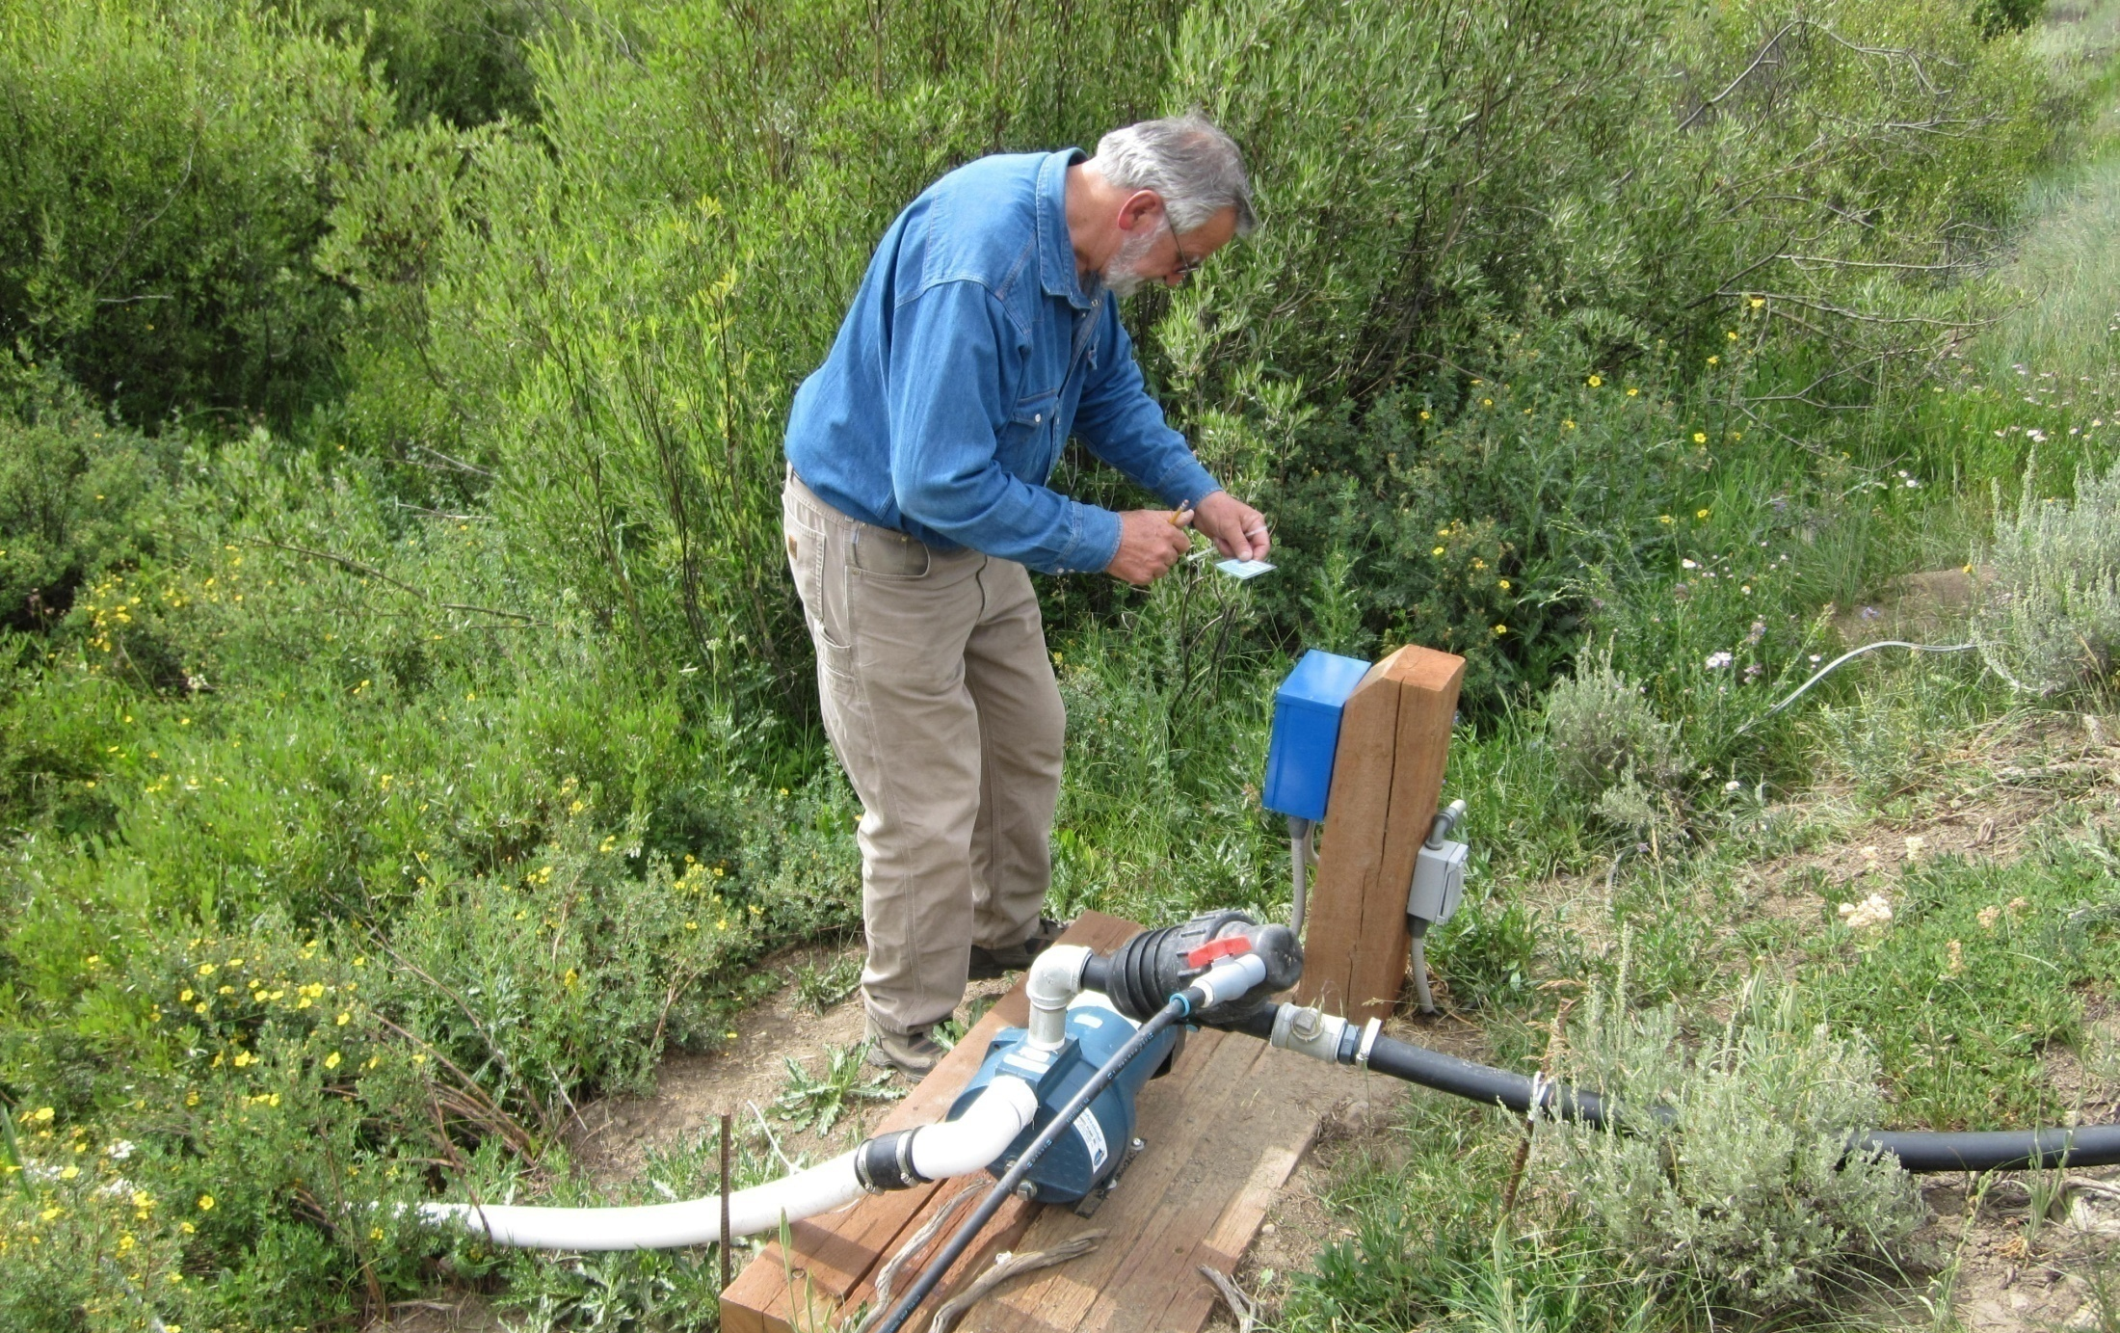
Water Administration

Slide 24
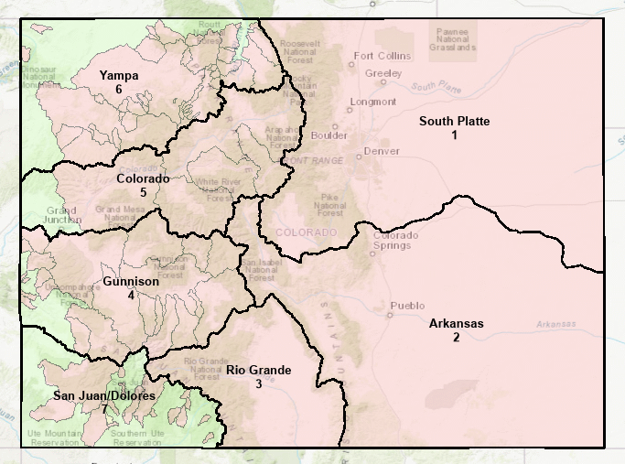

Slide 25


Changes of Water Rights
2
Water rights can be changed to new uses and locations and keep their senior date
1
Notes:
This is the historical use of two irrigation water rights. Each has a senior priority and thus is a reliable supply.

Slide 26
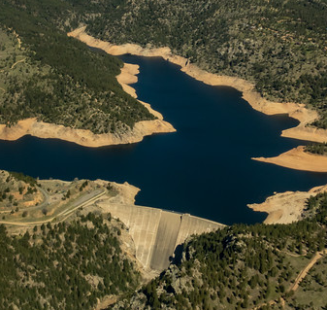
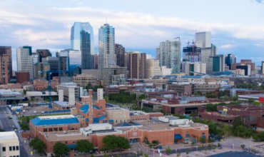
Changes of Use
2
4
Part of Irrigation Right #1 changed for Municipal Use
Reduce amount of land irrigated to provide water to the City.
Maintain return flow pattern (arrows 3 & 4)
Limit diversions to historical pattern to prevent expansion of use.
3
1
1

Slide 27
Changed water rights
Current Statutory Law:
C.R.S. 37-92-305(3)(a)
“…not injuriously affect the owner of or persons entitled to use water under a vested water right or a decreed conditional water right…”
C.R.S. 37-92-305(3)(d)
“…actual historical use during a representative study period…”
Complications
What is injury?
What is a representative study period?
What is justified non-use?
Notes:
General Duties of a Water Commissioner: Two thirds of the employees at DWR are water commissioners. Most of the statutes related to their work are found in C.R.S. ¶ 37-92-502. In water Division 4, this is a very hands on job. The water commissioners adjust headgates. In Division 1, much of the water use is recorded electronically and any monkeying with headgates without communicating with the water commissioner results in an upset of the system. Their duties include:
Day to Day Administration
Setting the call based on supply and demand
Assuring diversions are in priority for decreed uses and measured without waste
Delivery of augmentation water after assessing transit losses
Operating exchanges
Assuring other decree conditions are complied with
Review accounting and maintenance of diversion records
Field inspections for water court applications
Assisting the hydrographer with stream flow measurements

Slide 28
Augmentation Plans
Definition from WRDA (1969) Act:
“…increase the supply of water available for beneficial use…by the development of new or alternate means or points of diversion, by a pooling of water resources, by water exchange projects, by providing substitute supplies of water, by the development of new sources of water, or by any other appropriate means…”
C.R.S. 37-92-305(8)
Consider injury caused by out-of-priority diversions
Allows continuation of diversions
Provide replacement water in time, location, and amount.
Notes:
General Duties of a Water Commissioner: Two thirds of the employees at DWR are water commissioners. Most of the statutes related to their work are found in C.R.S. ¶ 37-92-502. In water Division 4, this is a very hands on job. The water commissioners adjust headgates. In Division 1, much of the water use is recorded electronically and any monkeying with headgates without communicating with the water commissioner results in an upset of the system. Their duties include:
Day to Day Administration
Setting the call based on supply and demand
Assuring diversions are in priority for decreed uses and measured without waste
Delivery of augmentation water after assessing transit losses
Operating exchanges
Assuring other decree conditions are complied with
Review accounting and maintenance of diversion records
Field inspections for water court applications
Assisting the hydrographer with stream flow measurements

Slide 29
Plan for Augmentation
Diverting 10 cfs
Augmentation Water Delivery 10 cfs
Able to divert full water right
Notes:
The junior water user may be either a well or a surface water user. Either way, it may continue to divert if it provides a source of augmentation water to the stream.
I want the consortium to be aware that one way that produced water could typically be reused is as a source of augmentation water. So, the consortium can think of uses within the oil field, or irrigation, etc. but augmentation is a type of use that allows for other uses.

Slide 30
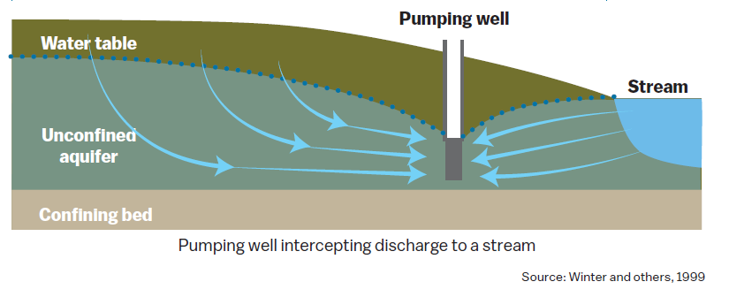
Groundwater
Water is tributary - Connected to streams unless proven otherwise or categorized as a different type of water under the law
Notes:
If you pump a well in Colorado, the assumption is that it will cause a reduction in streamflow. The reduction in streamflow is called a depletion. When a well is pumped, it may take a period of days for the impact to fully reach the stream, or it may take years.

Slide 31
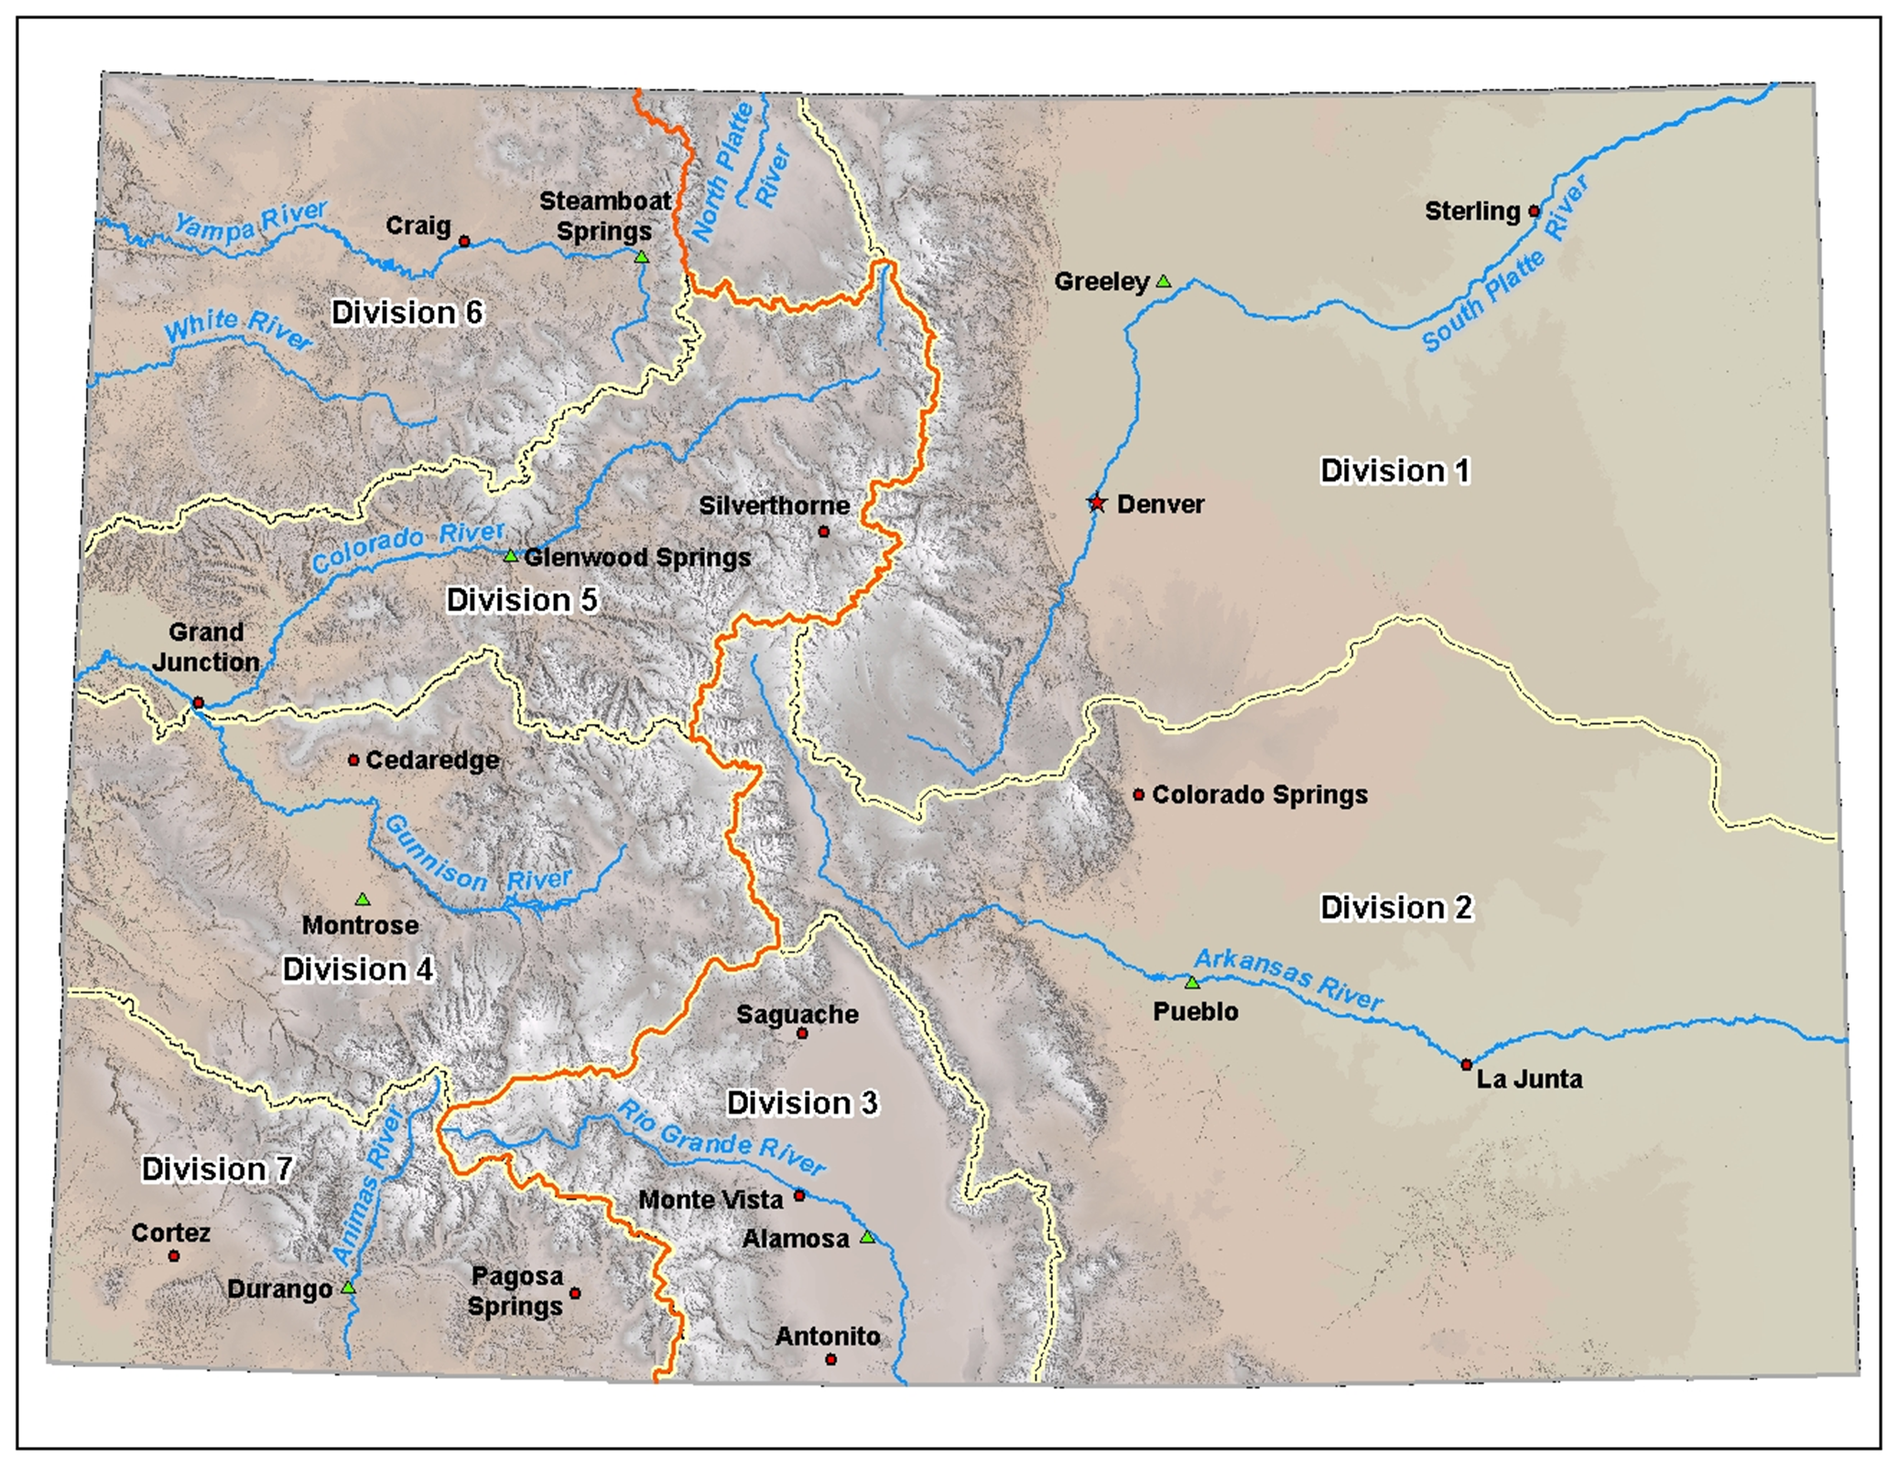
Groundwater Use
Aquifers
Alluvial
Bedrock
Fractured Granite
Ogallala
Confined/Unconfined

Slide 32
History of Well Permitting
Late 1800’s – Early 1900’s
No rural electrification, surface water more plentiful
Surface/ground water connection “understood” but not administered
1930’s – 1950’s
Significant groundwater development due to drought & surface overappropriation
Rural electrification
No permitting or administration
Notes:
General Duties of a Water Commissioner: Two thirds of the employees at DWR are water commissioners. Most of the statutes related to their work are found in C.R.S. ¶ 37-92-502. In water Division 4, this is a very hands on job. The water commissioners adjust headgates. In Division 1, much of the water use is recorded electronically and any monkeying with headgates without communicating with the water commissioner results in an upset of the system. Their duties include:
Day to Day Administration
Setting the call based on supply and demand
Assuring diversions are in priority for decreed uses and measured without waste
Delivery of augmentation water after assessing transit losses
Operating exchanges
Assuring other decree conditions are complied with
Review accounting and maintenance of diversion records
Field inspections for water court applications
Assisting the hydrographer with stream flow measurements

Slide 33
History of Well Permitting
Permitting Authority
1953 – Senate Bill 120
  Provide for CWCB Well Permittting
1957 – Senate Bill 113
  SEO authority, some exemptions
1965 – Senate Bill 367
  Ground Water Management Act
  Authority to deny a well permit
1969 – Water Rights Determination & Administration Act
  Incorporated tributary pumping into prior appropriation system
  Allowed exemptions “Exempt”/”Non-exempt” terminology
Notes:
General Duties of a Water Commissioner: Two thirds of the employees at DWR are water commissioners. Most of the statutes related to their work are found in C.R.S. ¶ 37-92-502. In water Division 4, this is a very hands on job. The water commissioners adjust headgates. In Division 1, much of the water use is recorded electronically and any monkeying with headgates without communicating with the water commissioner results in an upset of the system. Their duties include:
Day to Day Administration
Setting the call based on supply and demand
Assuring diversions are in priority for decreed uses and measured without waste
Delivery of augmentation water after assessing transit losses
Operating exchanges
Assuring other decree conditions are complied with
Review accounting and maintenance of diversion records
Field inspections for water court applications
Assisting the hydrographer with stream flow measurements

Slide 34
Well Permitting, Related Rules
Hydrologic Basin Rules (Divisions)
Designated Basin Rules
Denver Basin Rules
Statewide Nontributary Ground Water Rules
Produced Nontributary Ground Water Rules
Notes:
General Duties of a Water Commissioner: Two thirds of the employees at DWR are water commissioners. Most of the statutes related to their work are found in C.R.S. ¶ 37-92-502. In water Division 4, this is a very hands on job. The water commissioners adjust headgates. In Division 1, much of the water use is recorded electronically and any monkeying with headgates without communicating with the water commissioner results in an upset of the system. Their duties include:
Day to Day Administration
Setting the call based on supply and demand
Assuring diversions are in priority for decreed uses and measured without waste
Delivery of augmentation water after assessing transit losses
Operating exchanges
Assuring other decree conditions are complied with
Review accounting and maintenance of diversion records
Field inspections for water court applications
Assisting the hydrographer with stream flow measurements

Slide 35
Well Permitting
Statutory Authority
Outside Designated Basins
  C.R.S. 37-90-137(1)f
  C.R.S. 37-92-602(3)(b)
Inside Designated Basins
  C.R.S. 37-90-107 – Groundwater Commission
  C.R.S. 37-90-105 – State Engineer, small capacity wells
  e, time of use, point of diversion
Notes:
General Duties of a Water Commissioner: Two thirds of the employees at DWR are water commissioners. Most of the statutes related to their work are found in C.R.S. ¶ 37-92-502. In water Division 4, this is a very hands on job. The water commissioners adjust headgates. In Division 1, much of the water use is recorded electronically and any monkeying with headgates without communicating with the water commissioner results in an upset of the system. Their duties include:
Day to Day Administration
Setting the call based on supply and demand
Assuring diversions are in priority for decreed uses and measured without waste
Delivery of augmentation water after assessing transit losses
Operating exchanges
Assuring other decree conditions are complied with
Review accounting and maintenance of diversion records
Field inspections for water court applications
Assisting the hydrographer with stream flow measurements

Slide 36
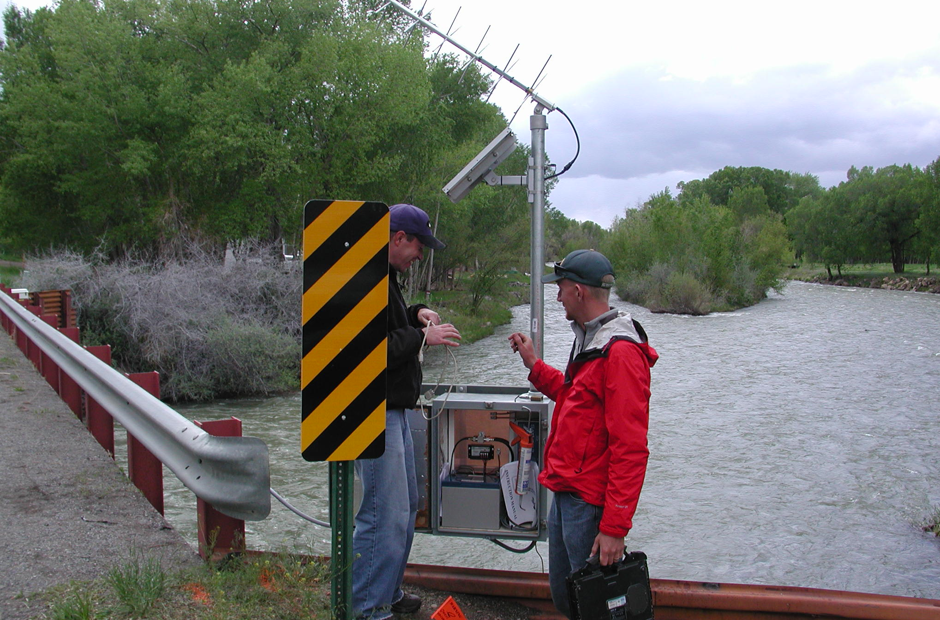
Stream Measurement
Notes:
Steam flow measuring is very important…critical in fact to administering many decrees.

Slide 37
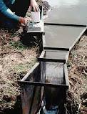
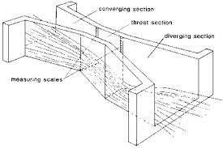
Measuring Diversions
The Parshall Measuring Flume

Slide 38
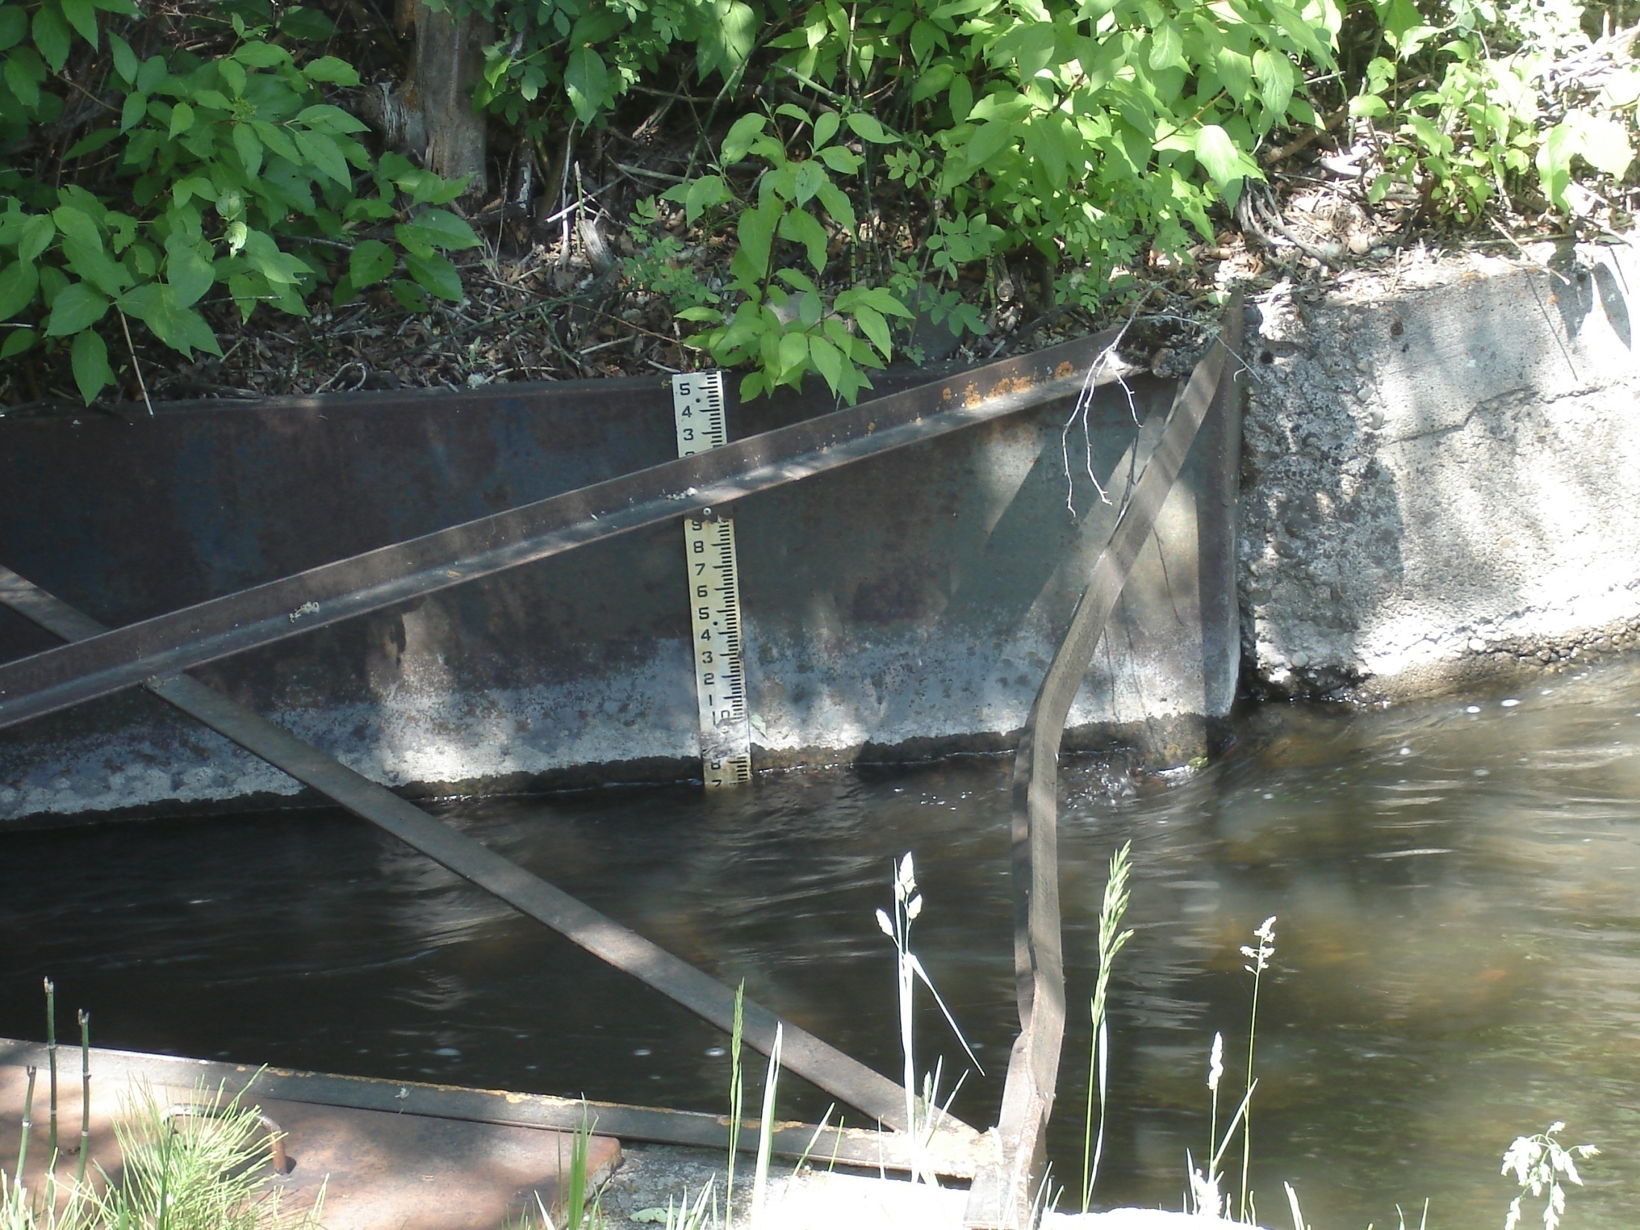

Slide 39
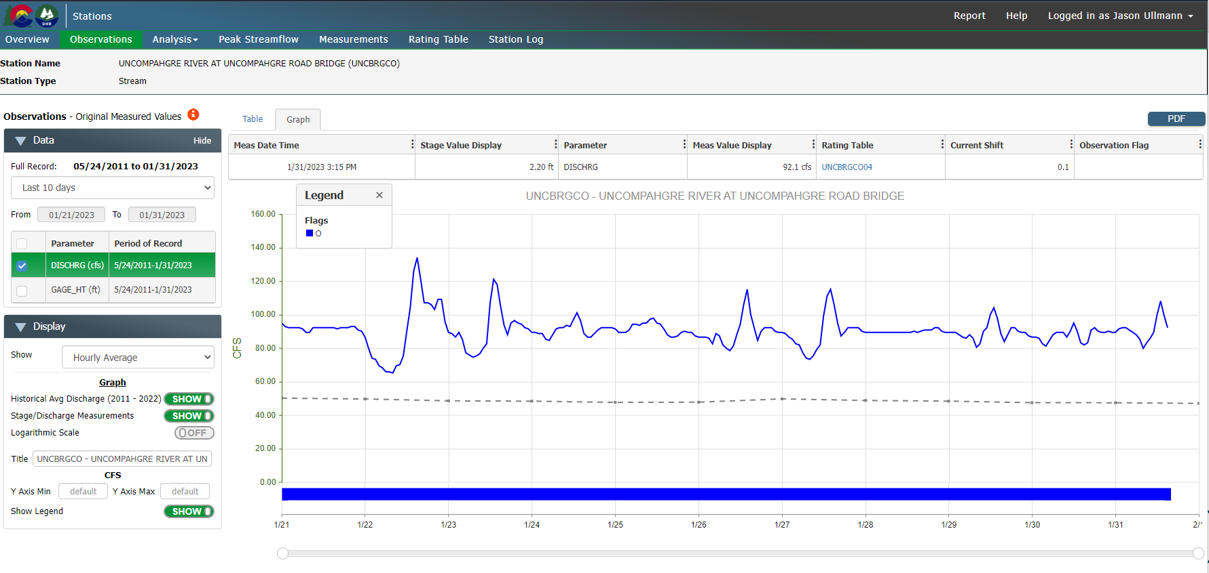
Setting the Call - Reviewing Supply
Notes:
First thing that the commissioner and DWR do when receiving a call is to review the supply available using index gages.
This gage is the Uncompahgre at Uncompahgre Road Bridge, which is an indicator of what supply is available to the M&D Canal, which is the main canal in the UVWUA system.
Shows 92 cfs, so water commissioner would estimate from releases at Ridgway how much of that is Ridgway storage water and how much is natural flow
Once that is known the commissioner would go back through their records of diversions above the call location to see how much each diversion was taking and add that in to estimate the total supply

Slide 40
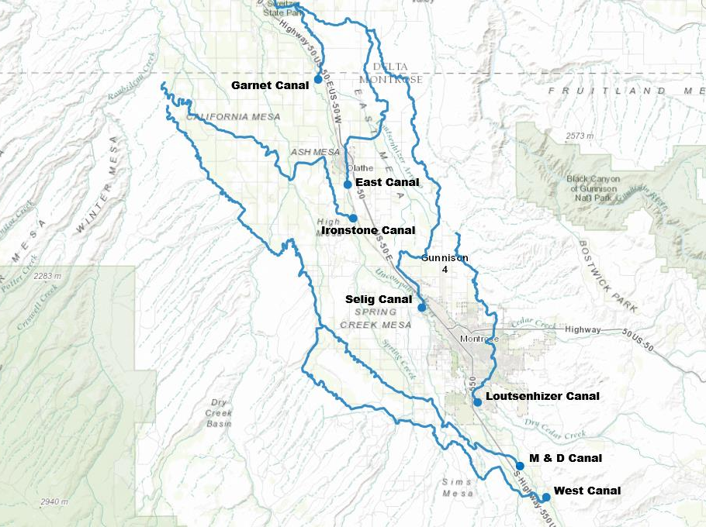
Gunnison Tunnel

Slide 41
Review Priority List
NO. | Ditch Name | Admin. No. | Stream | Amount | Ditch Cum. | System Total | System Actual | Flume
81 | Wood Perry | 11809.00000 | D | 3.928 | 3.949 | 231.107 | 220.710 | 2'
78 | Brown | 11828.00000 | U - T (F) | 1.000 | 1.625 | 232.107 | 220.710 | 3'
79 | Rocky No. 1 | 11828.00000 | U - T (F) | 1.000 | 1.000 | 233.107 | 220.710 | 1'
80 | Stanton | 11840.00000 | U - A | 1.250 | 1.250 | 234.357 | 221.960 | 9"
81 | Lew Creek | 11840.00000 | C (TM) | 3.125 | 3.125 | 237.482 | 221.960 | 1'
82 | Ridgway | 11840.00000 | D | 2.000 | 2.000 | 239.482 | 223.960 | 30"
83 | Sibert | 11840.00000 | D | 1.000 | 1.000 | 240.482 | 224.960 | 18"
84 | Alkali No. 2 | 11901.00000 | C | 4.000 | 4.000 | 244.482 | 228.960 | 3'
** | M&D Canal | 12150.00000 | U - B | 100.000 | 127.820 | *** | *** | ***
85 | Shortline D Cow Creek | 12174.00000 | C | 2.000 | 2.000 | 245.832 | 230.960 | 18"
86 | Mayol Lateral | 12174.00000 | D | 2.000 | 2.000 | 247.832 | 232.960 | 2'
87 | Hosner Rowell | 12183.00000 | D | 7.500 | 12.500 | 255.332 | 240.460 | 2'
88 | Moody | 12205.00000 | U - A | 1.250 | 6.695 | 256.582 | 241.710 | 3'
89 | Taft | 12239.00000 | C (F) | 0.625 | 0.625 | 257.207 | 241.710 | 18"

Slide 42
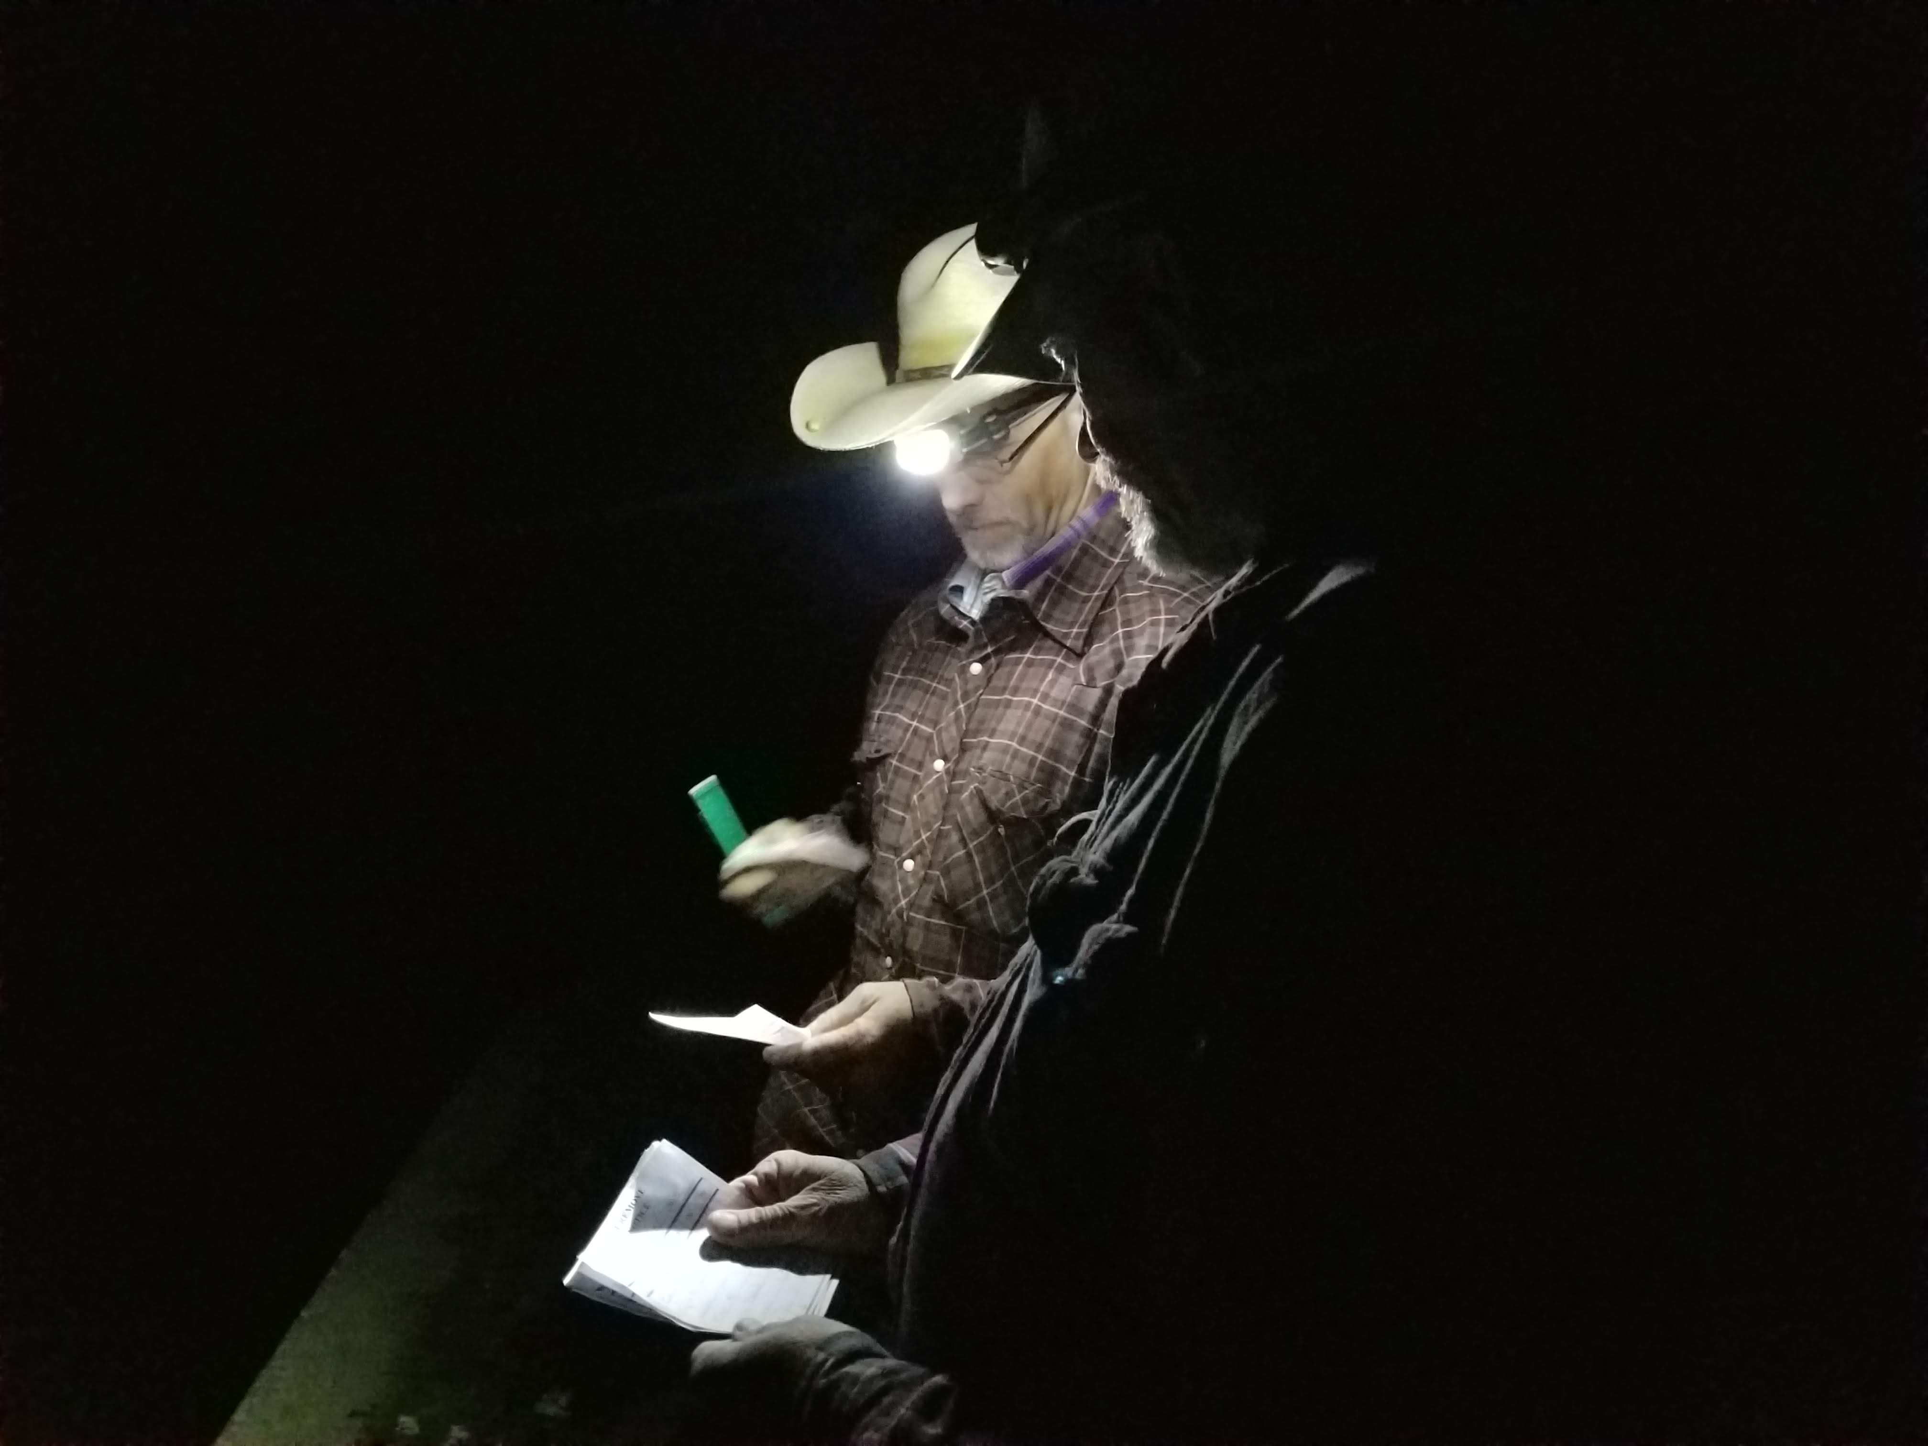

Slide 43
What is an Exemption?
Water features or uses that statute allows regardless of the priority system or the impact on senior water rights.
  Exempt Well Permits
  Fire Suppression Ponds
  Livestock Water Tanks & Erosion Control Ponds
  Minor Stream Restoration Activity
  Futile Call Determination

Slide 44
Typical Exempt Well Permits
Parcel of 35 acres or more
Up to 3 houses
Irrigation of up to 1 acre of home lawn & garden
Domestic animals, poultry, livestock on a farm or ranch
Parcel less than 35 acres
Household use only (outside Designated Basins)
Only eligible for pre-June 1, 1972 parcels or subdivision exemptions
Commercial Exempt
Indoor drinking & sanitary use only in a business
New permits only for pre-June 1, 1972 parcels, 35+ acres, or subdivision exemptions
Livestock
New permits only for pre-June 1, 1972 parcels, 35+ acres, or subdivision exemptions

Slide 45
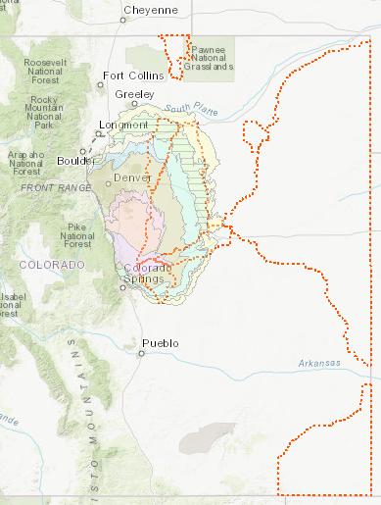
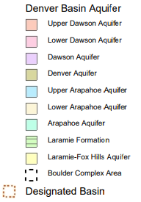
Well Permit Exceptions Differ in Areas with Special Groundwater Regulations
Denver Basin Aquifers
Designated Basins

Slide 46
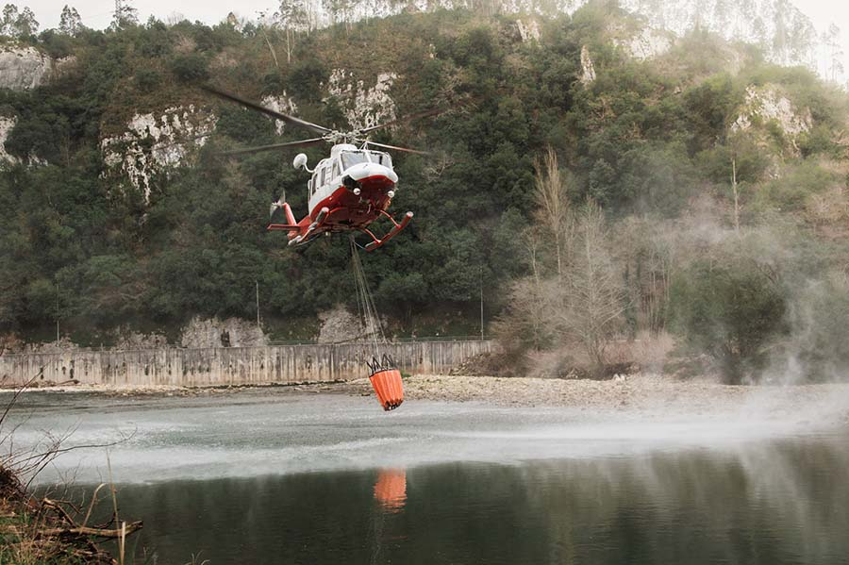
Fire Suppression Ponds
SB22-14 – Specific ponds may be designated as “Fire Suppression Ponds”
Ponds that store and evaporate water
Essential for protection of public safety when fighting fires in emergencies
ACTION REQUIRED
County staff must follow the process and apply to State Engineer to designate ponds

Slide 47
Fire Suppression Pond Requirements
No more than 30 acres total per county
Each Fire Suppression Pond is less than 6 acres
Fire Suppression Pond existed in 1972
Readily accessible by firefighting entity
In location with an elevated threat of fire risk
In area without timely or adequate access to water supplies
Consult DWR’s Beginner’s Guide to Fire Suppression Ponds for more details

Slide 48
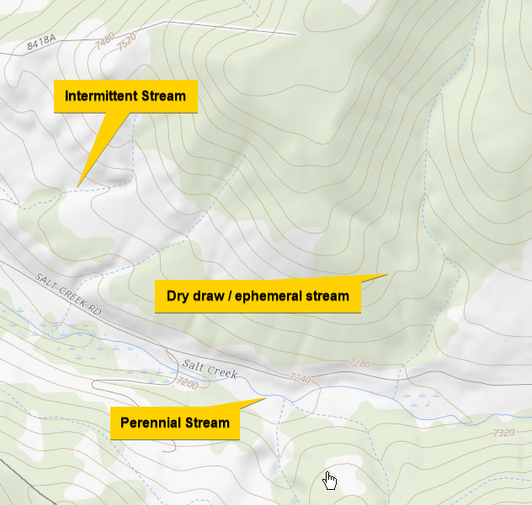
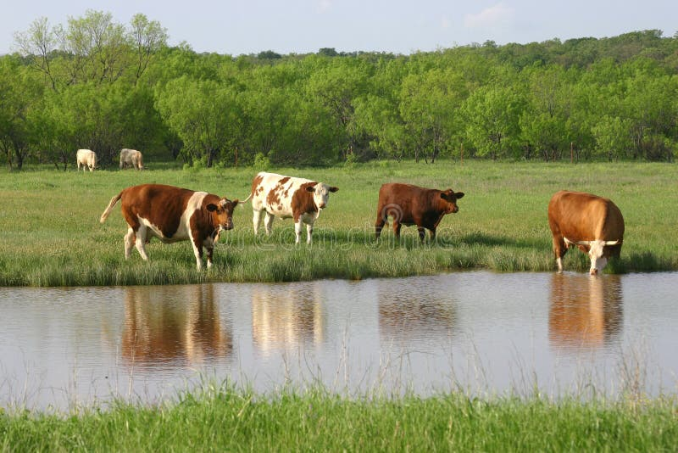
Livestock Water Tanks and Erosion Control Ponds
Stream must be “normally dry”
Size limits
Need to register with DWR
Notes:
Requirement for stream to be “normally dry”, size limits, need to register with DWR

Slide 49
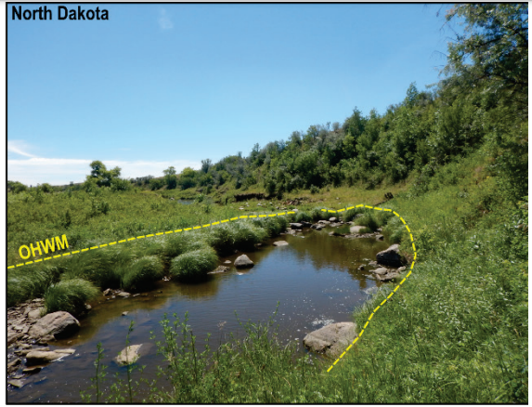
Minor Stream Restoration Activity - SB23-270
Allowances Include:
Stabilizing the banks or substrate of a natural stream with hard, bioengineered, or natural materials that, under less than extreme flow conditions, allow water to flow downstream,
do not cause the water level to exceed the ordinary high water mark,
And may incidentally increase surface area of the natural stream

Slide 50
Futile Call Determinations – Section 37-92-502(2)(a), C.R.S.
Determination that curtailment of a junior water right does not “cause water to become available to such senior priorities at the time and place of their need”
“Each diversion shall be evaluated and administered on the basis of the circumstances relating to it and in accordance with provisions of this article and court decrees adjudicating and confirming water rights.”
“The materiality of injury depends on all factors which will determine in each case the amount of water such discontinuance will make available to such senior priorities at the time and place of their need.”
Such factors include:
  “Current and Prospective volumes of water in and tributary to the stream”
  “Distance and type of stream bed between diversion points”
  “Various velocities of this water, both surface and underground”
  “Probable duration of the available flow”

Slide 51
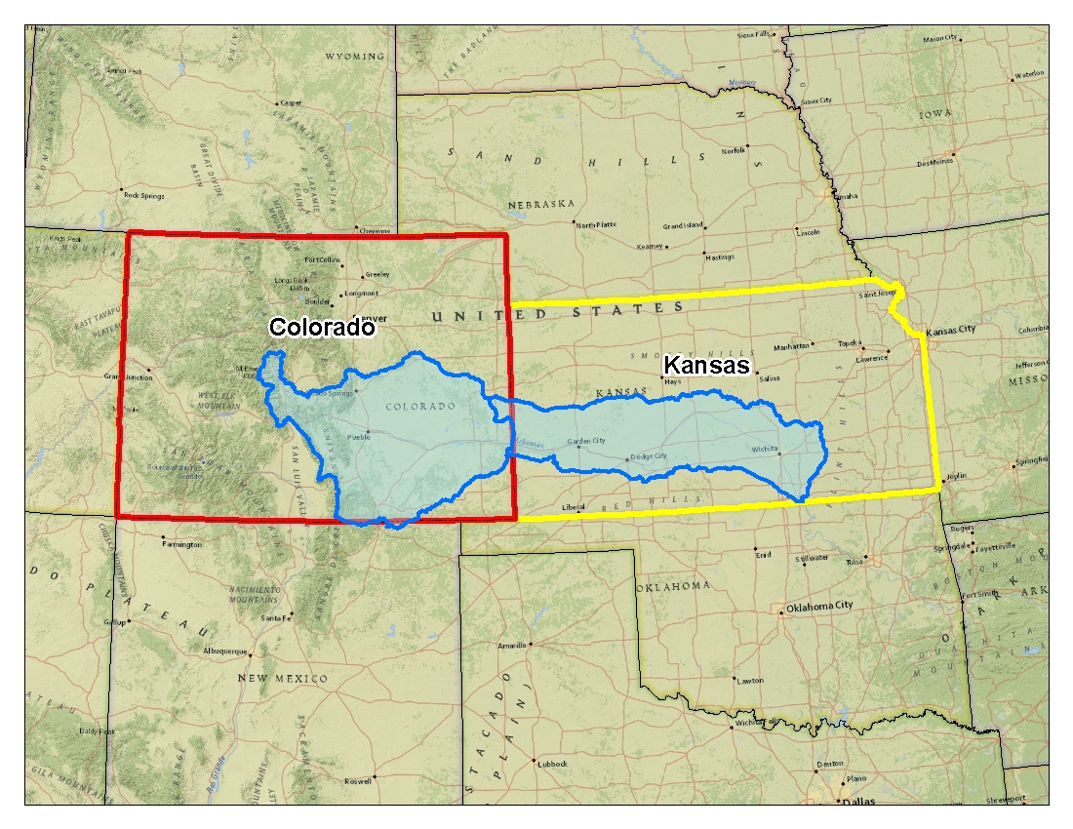
Arkansas River Compact
Signed in 1948
ARCA – CWCB Commissioner
SEC – Work out engineering issues, CWCB, DWR & KS
No unreplaced post-compact depletions
“Conservation” Storage in John Martin split 60% CO, 40% KS
Per settlement post compact depletion model (HI model) determines state line impacts
Impacts evaluated on 10-year running average

Slide 52
Arkansas Litigation History
KS v. CO – 1907
  Establishes doctrine of equitable apportionment…rejects both states absolute claims
1928 Compact Negotiated, but never ratified
KS v. CO – 1943
  Acknowledges CO increased use, but denies KS request for injunction
  Encourages states to complete a compact
KS v. CO – 1985 to 2009
  1995 – CO has violated compact through increased pumping
  2001 – Court awards monetary damages & directs further proceeding
  2009 - Decree approves settlement of remaining issues and defining how CO will comply going forward
Notes:
Maximize lawful beneficial use….the water administration role is the primary role, but not the only role we serve
Water Administration (37-92-501, C.R.S.)
Water Court Participation
Orders & Enforcement (37-92-502 & 503, C.R.S.)
Measurement – Hydrography
Groundwater Permitting
Administrative Approvals (SWSP, IWSA, Exchanges, Plans)
Abandonment (37-92-401, C.R.S.)
Tabulation (37-92-401, C.R.S.)
Groundwater Commission–Designated Basins
Interstate Compact Compliance
Public Safety
Dam Safety (37-87-105 & 107, C.R.S.)
Board of Examiners for Well Construction and Pump Installation (37-91-101 to 113, C.R.S.)
Rulemaking (37-80-104 & 37-92-501, C.R.S)

Slide 53
Arkansas Rules
Arkansas Irrigation Improvement Rules
  Established to comply with Article IV-D of the Compact in 2009
  Rule 8 & 10 - Established process for application to improve irrigation practices….i.e. flood to sprinkler
Arkansas Rules for Diversion of Tributary Groundwater (Use Rules)
  Promulgated in 1996 and established that all post compact wells (1948) cannot divert tributary groundwater without a replacement plan
  Established process to apply for replacement plans in Rule 14
Notes:
Maximize lawful beneficial use….the water administration role is the primary role, but not the only role we serve
Water Administration (37-92-501, C.R.S.)
Water Court Participation
Orders & Enforcement (37-92-502 & 503, C.R.S.)
Measurement – Hydrography
Groundwater Permitting
Administrative Approvals (SWSP, IWSA, Exchanges, Plans)
Abandonment (37-92-401, C.R.S.)
Tabulation (37-92-401, C.R.S.)
Groundwater Commission–Designated Basins
Interstate Compact Compliance
Public Safety
Dam Safety (37-87-105 & 107, C.R.S.)
Board of Examiners for Well Construction and Pump Installation (37-91-101 to 113, C.R.S.)
Rulemaking (37-80-104 & 37-92-501, C.R.S)

Slide 54
Additional Complexities
Augmentation Plans with recharge
  Some plans include recharge areas where water is recharged and lagged recharge replaces lagged depletions. These calculations are done with complicated models and accounting.
  Can include recharge ponds or recharge through ditch system
Re-use
  Some entities have decrees allowing them to recapture their WWTP return flows and reuse them.
Fully Consumable Water
  Any water imported into a basin can be re-used to extinction as it was not native to that stream and the water rights in the basin of import are therefore not entitled to it.

Slide 55
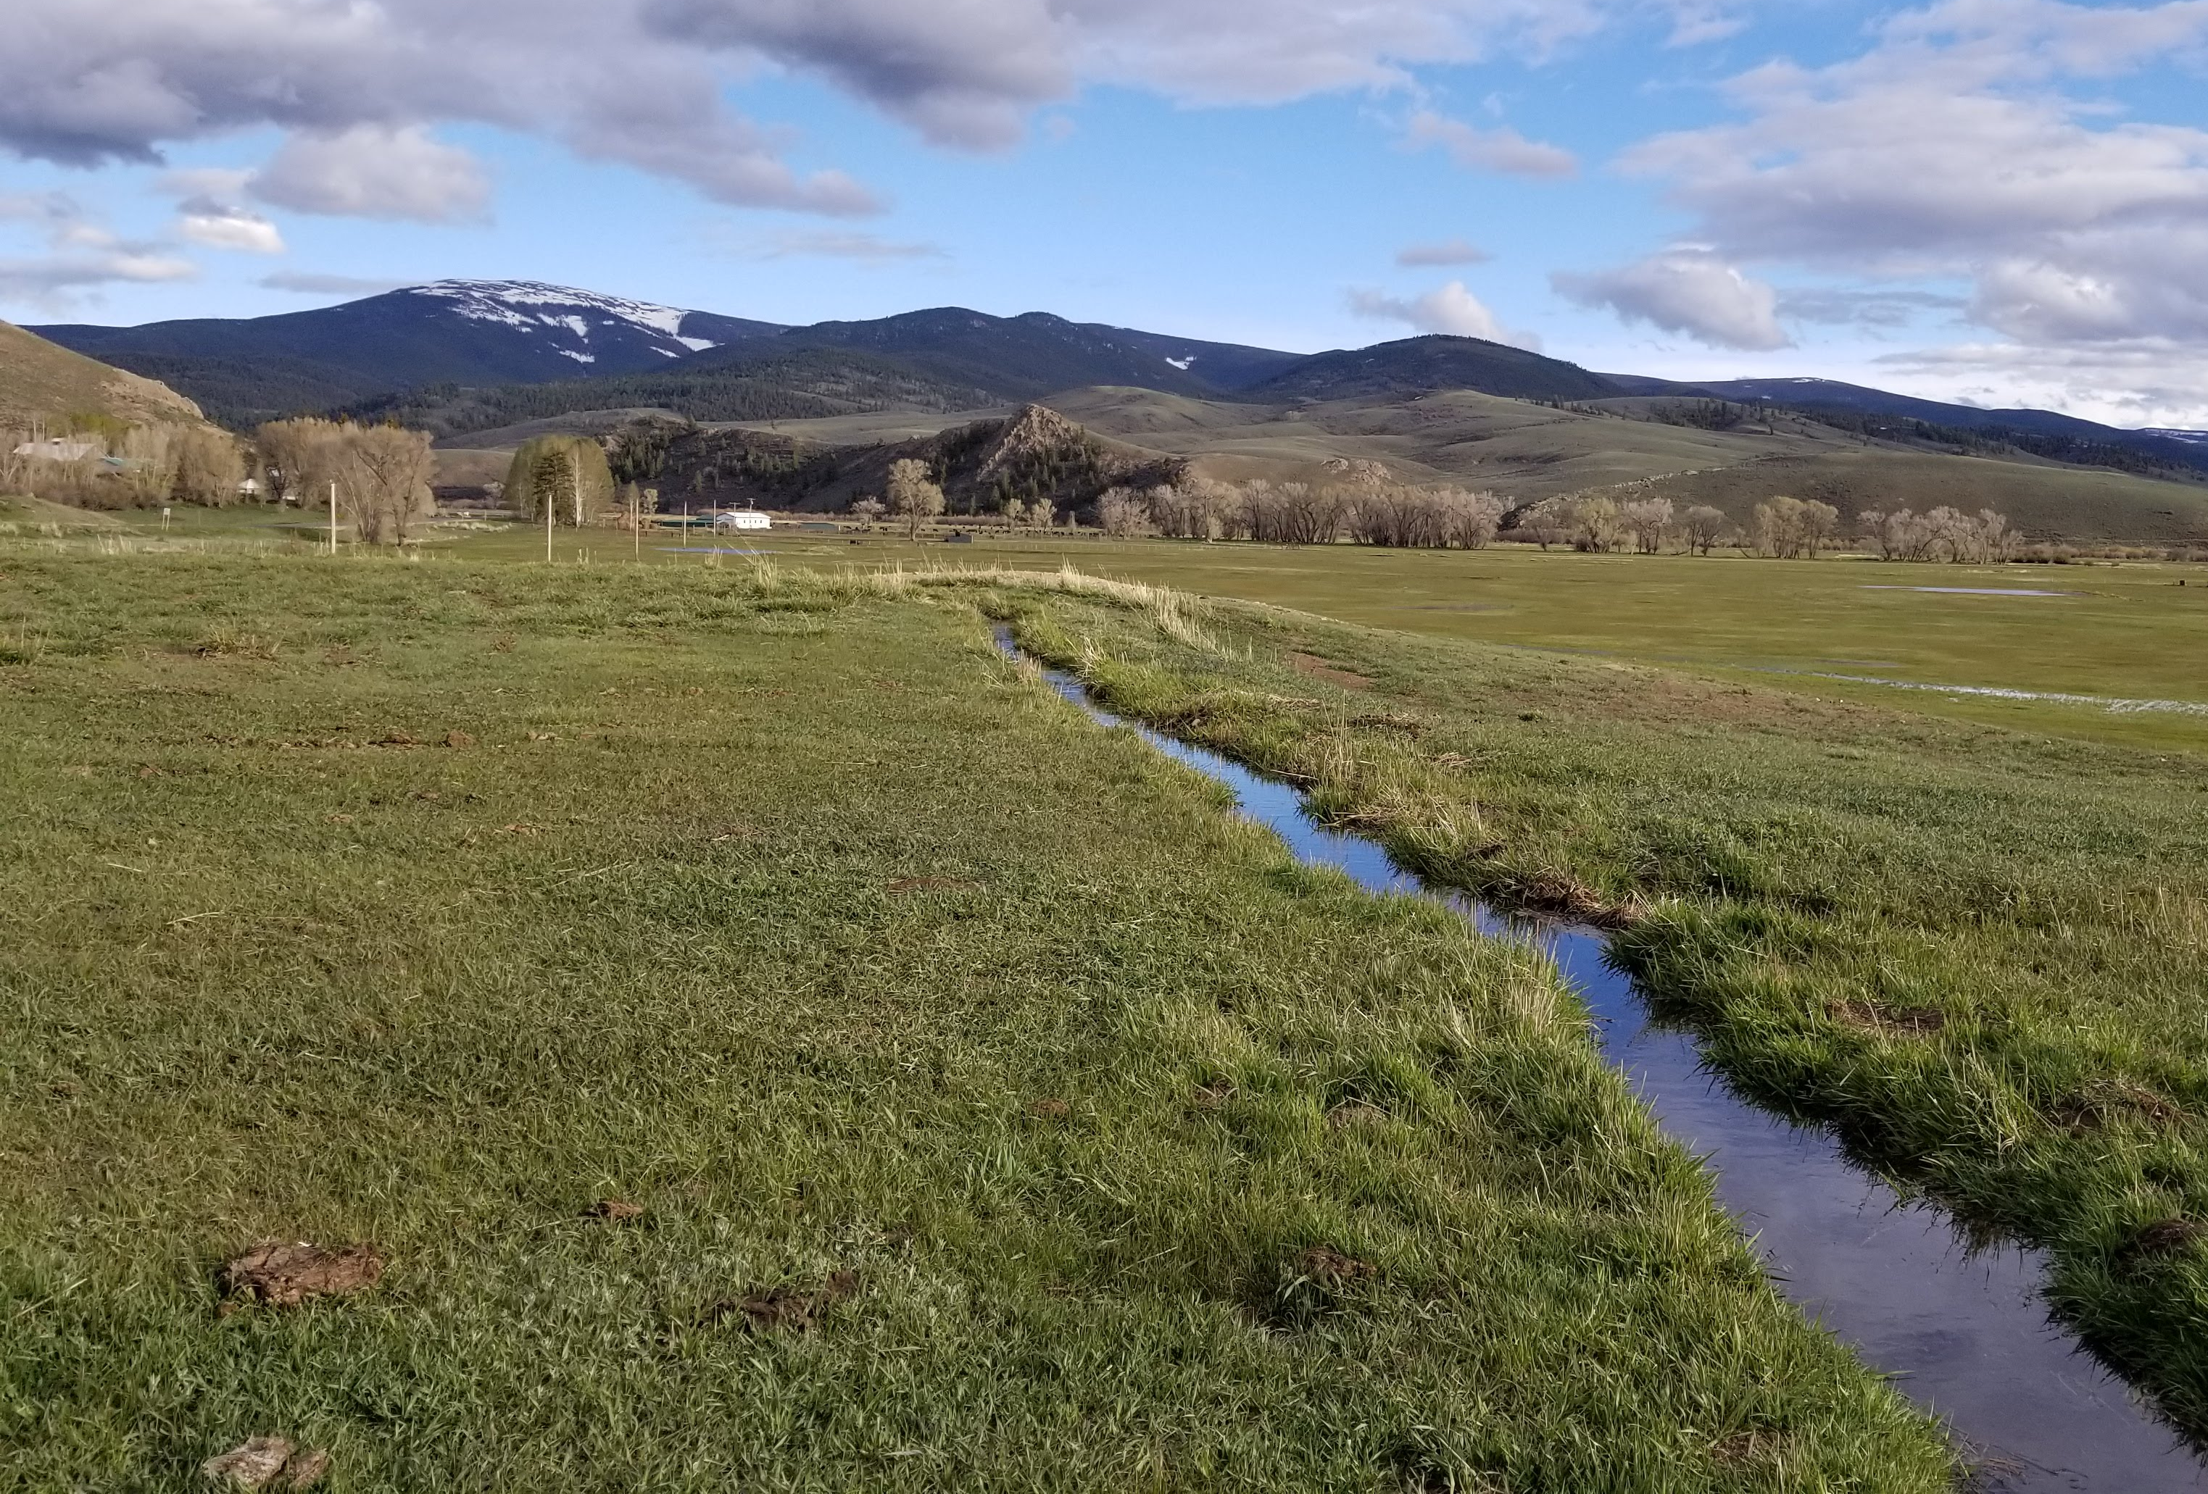
Nothing has Changed!
He who expects the letter of the law in relation to irrigation to be executed with the perfection of clockwork, and that infallible results will be obtained, has a small conception of the tangled web of difficulties in the way, and meager knowledge of the uncertainties of the element to be manipulated.
J.P. Maxwell, Colorado State Engineer, 1890
Notes:
I hope I have given all of you an idea of some of the intricate complexities involved in administering the priority system and integrating that with complying with compacts with surrounding states. In those discussions its easy to gloss over issues that are very contentious and difficult to solve with clichés. We can say that the Front Range should just stop watering lawns, well, that eliminates a buffer where they can institute water restrictions and save water in bad years. It also involves broaching the very sensitive subject of potentially overriding local control for land use regulations. These discussions are happening at CWCB, but it isn’t as easy as some of the cliché statements would suggest. I want to encourage all of you to do what you have done today and take time to learn more than just skin deep knowledge and consider all points of view.

Slide 56
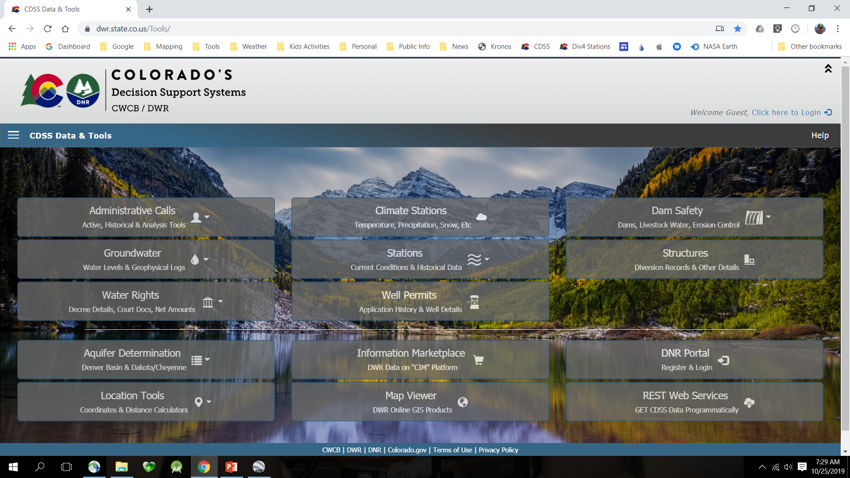

Slide 57
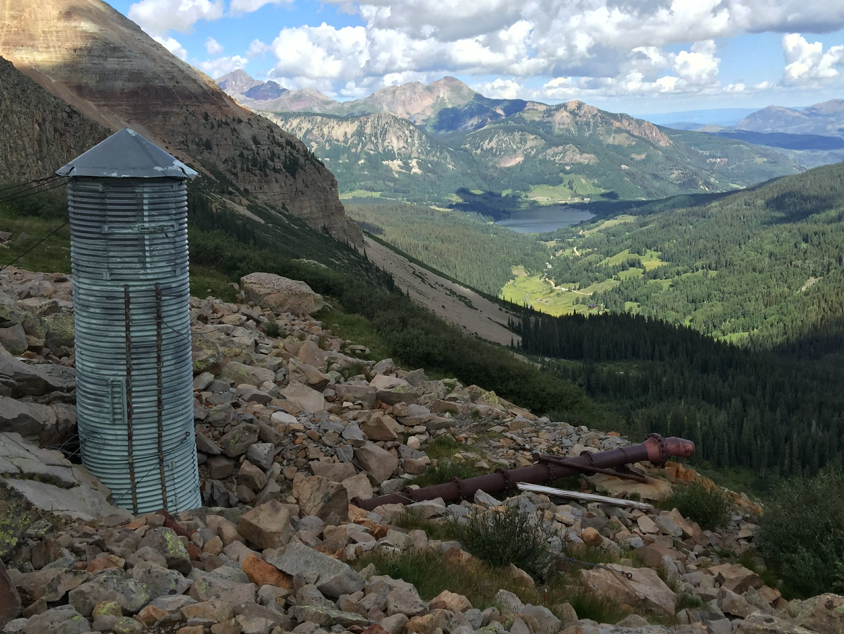
Questions

