Slide 1
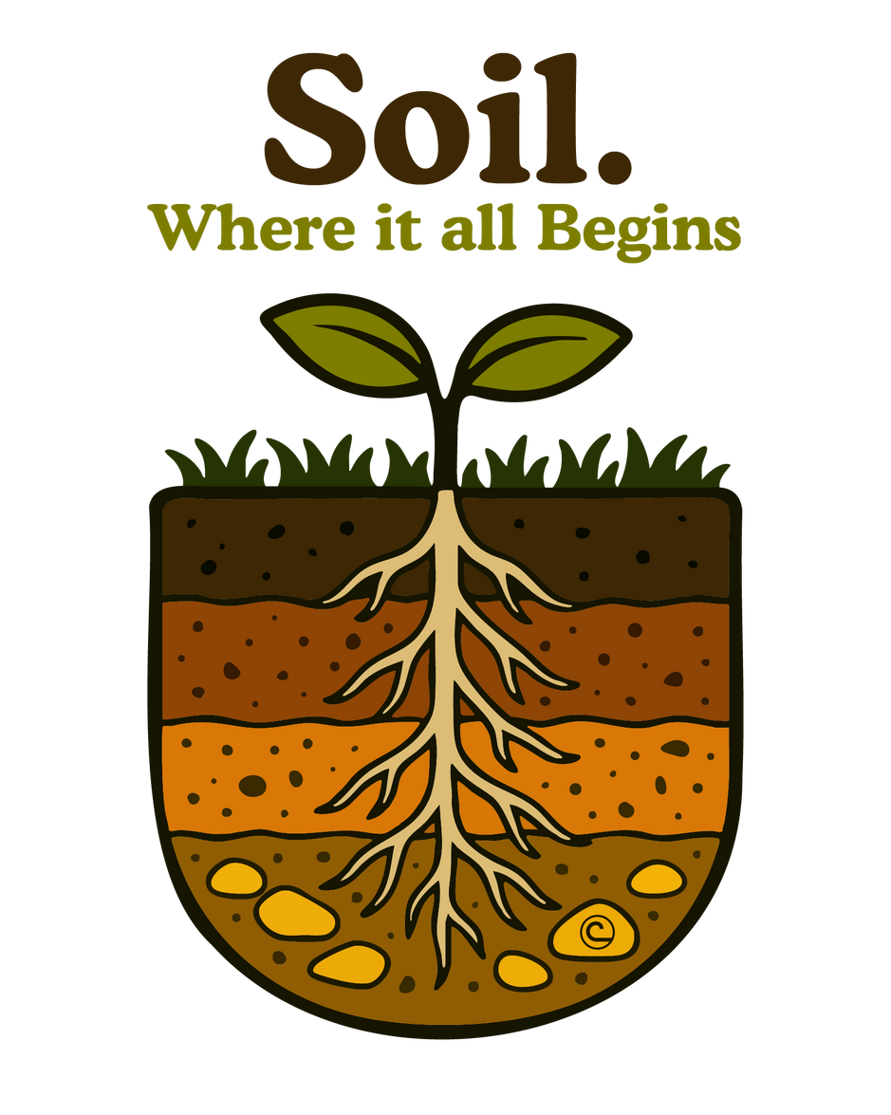
National Association of Conservation Districts
2026 Stewardship Celebration
Notes:
Introduction
Explain that the National Association of Conservation Districts represents local districts across the United States.
This presentation connects students with the people who protect land, water, and wildlife in their communities.
Encourage students to share what they already know about soil or conservation.

Slide 2



Let’s start by telling you who we are, and a little about how our journey brought us into your classroom.
National Association of Conservation Districts 2026 Stewardship Celebration

Slide 3
INTRODUCTION
DISTRICT NAME AND
CONTACT INFORMATION SLIDE
Notes:
Introduction
Explain that the National Association of Conservation Districts represents local districts across the United States.
This presentation connects students with the people who protect land, water, and wildlife in their communities.
Encourage students to share what they already know about soil or conservation.

Slide 4
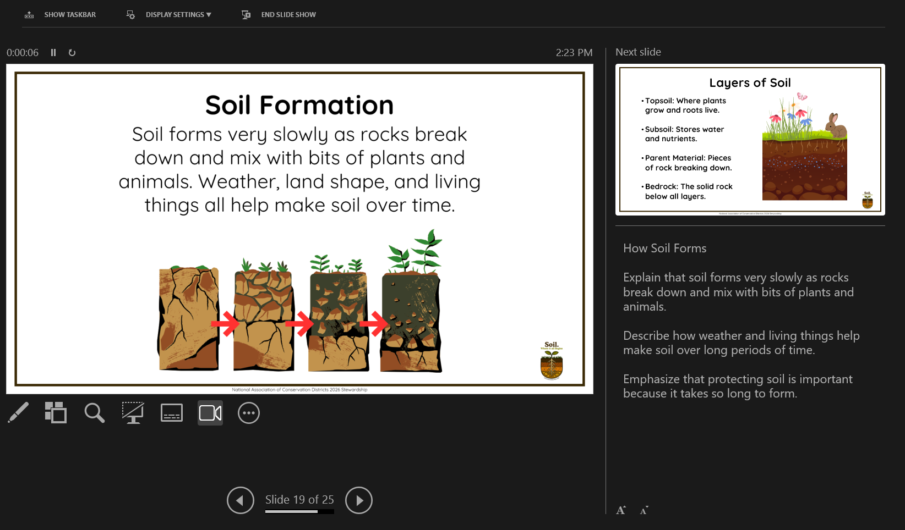
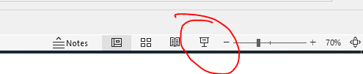
Delete this slide after editing prior to presentation or sending to teachers for classroom use.
Please note that in the editor view the presentation may have elements that appear to be crowded or distorted. Once the presentation is in the presenter view, the elements will correct themselves and the notes section will show up for the presenter.

Slide 5





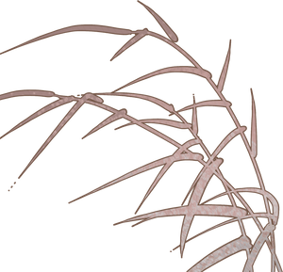



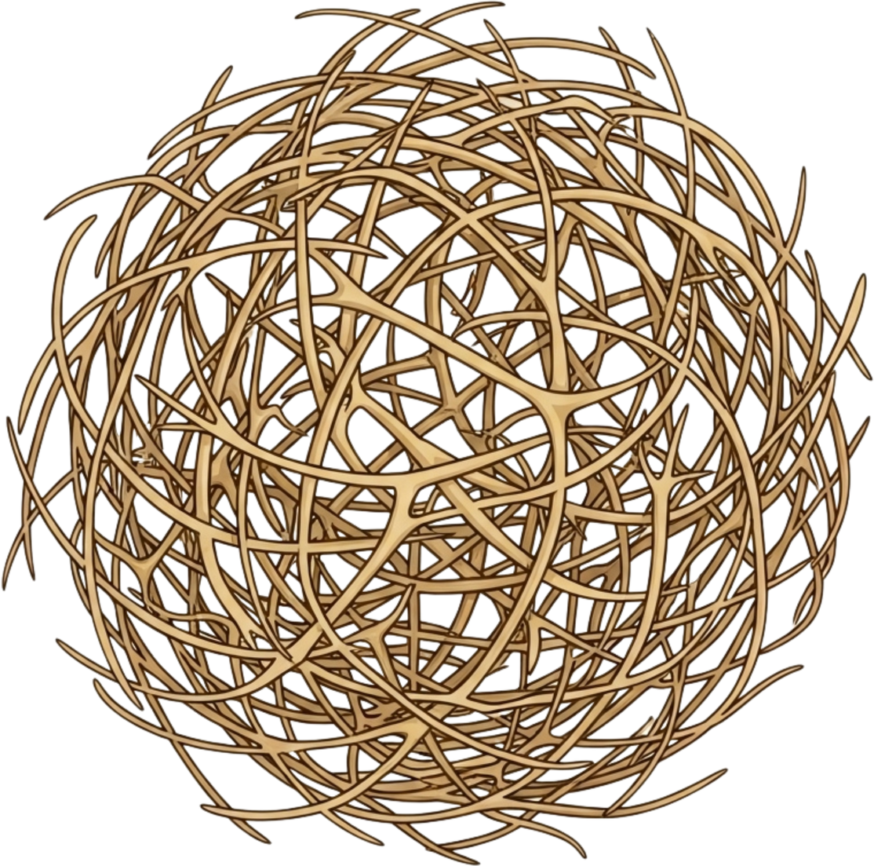
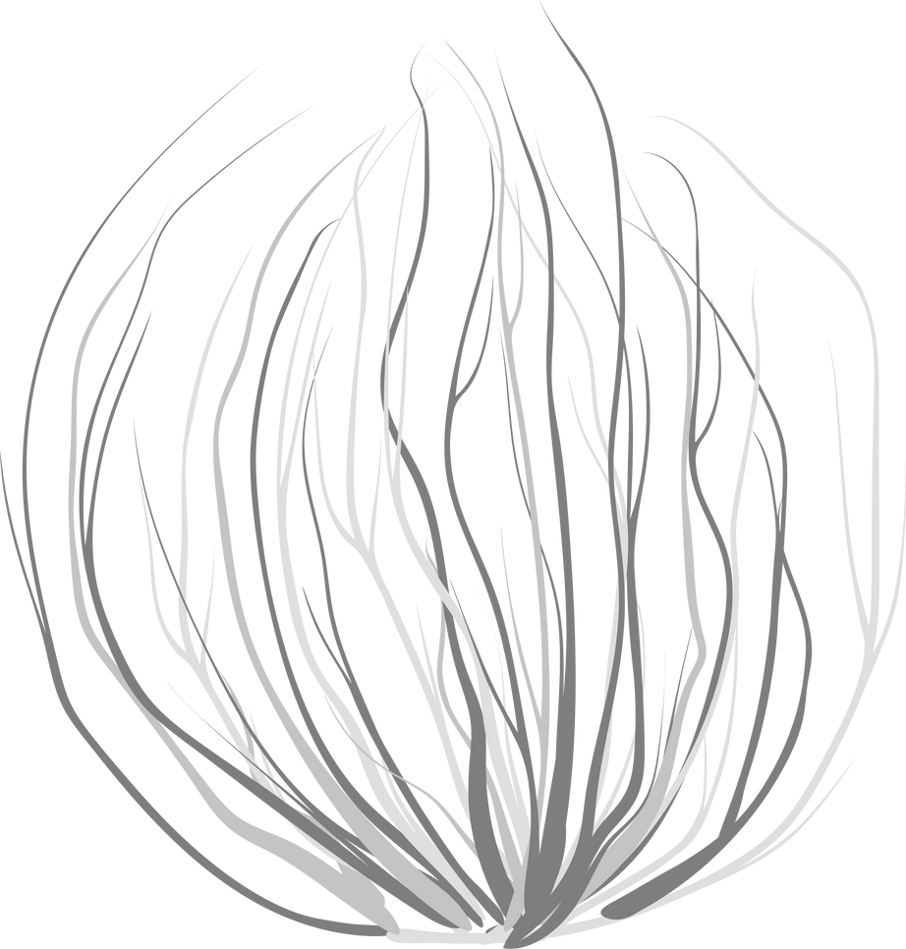
Conservation districts began many years ago when we learned that caring for the land was important for everyone.
In the 1930s, large windstorms called the Dust Bowl blew away huge amounts of soil because conservation was not yet widely understood and many people did not realize how important it was to protect the soil. Without healthy soil, crops could not grow, and animals lost their homes.
National Association of Conservation Districts 2026 Stewardship Celebration
Notes:
Origins of Conservation Districts
Describe the Dust Bowl as a time when windstorms blew away unprotected soil.
People did not yet understand soil conservation, which affected farms and wildlife.
Ask students what they think happens when soil is lost.

Slide 6
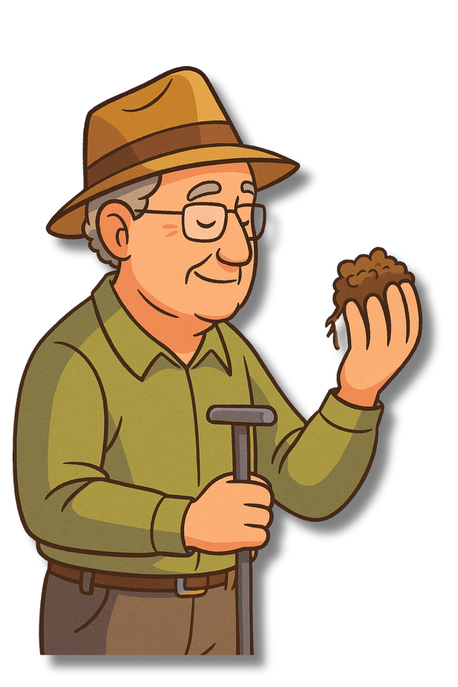
To fix the problem, farmers and neighbors worked together with the government to start conservation districts. Led by soil scientist Hugh Hammond Bennett and the newly formed Soil Conservation Service, communities met to plan better ways to protect the land, prevent erosion, plant windbreaks, and manage water more carefully.
These new conservation districts provided local support and guidance, helping farmers restore their soil, rebuild the land, and bring farming back in a healthier, more sustainable way.
The Soil Conservation Service (SCS) was created in 1935 to help farmers protect their land from erosion and restore soil after the Dust Bowl. It later became the
Natural Resources Conservation Service (NRCS),
which continues working with conservation districts and landowners to protect soil, water, and other natural resources.
National Association of Conservation Districts 2026 Stewardship Celebration
Notes:
Founding and Role of SCS/NRCS
Introduce Hugh Hammond Bennett, known as the Father of Soil Conservation.
Explain how he helped create the Soil Conservation Service, now called NRCS.
Emphasize that farmers and communities worked together with government support to restore the land.

Slide 7


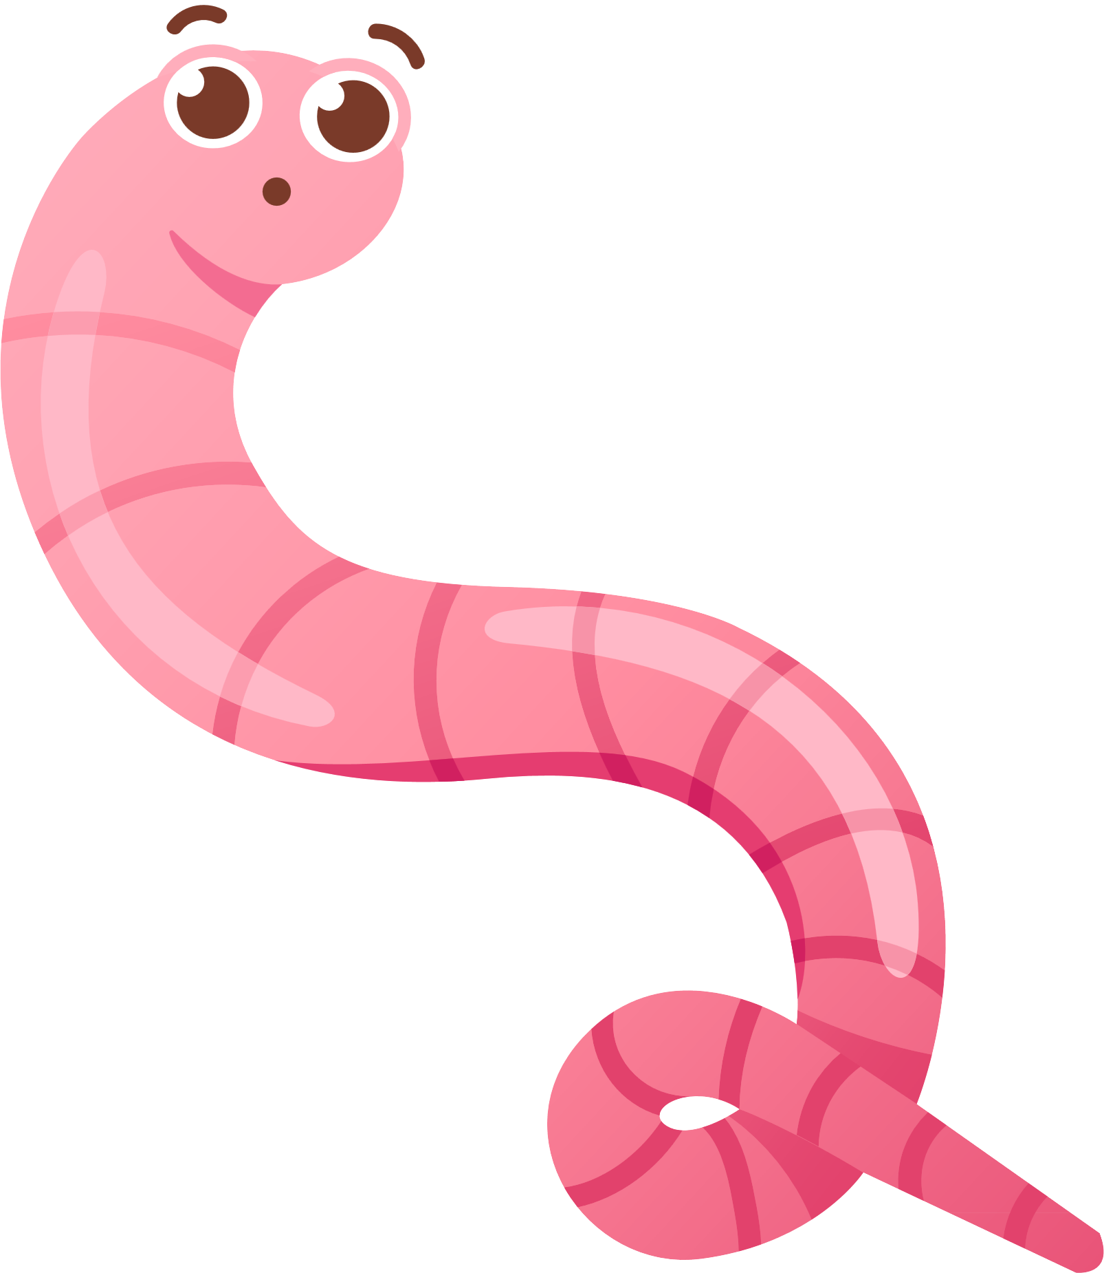
The lessons learned during the Dust Bowl shaped how we care for the land today. Farmers choose to take part in conservation programs because they care about protecting the land for the future. These programs are voluntary, meaning farmers join by choice and may receive help or guidance to make conservation easier. They use best management practices such as planting cover crops, managing water wisely, and reducing erosion to keep soil healthy.
By working with their local conservation districts, farmers help protect natural resources for future generations while keeping their land productive and sustainable.
Let’s research it!
What year was your local conservation district established?
National Association of Conservation Districts 2026 Stewardship Celebration
Notes:
Lessons from the Dust Bowl
Explain that modern conservation programs are voluntary, meaning farmers choose to participate.
Describe best management practices such as planting cover crops, managing water wisely, and reducing erosion.
Invite students to share ways they could care for land or plants where they live.

Slide 8
Conservation districts are local because every community’s land, water, and wildlife are different. Local people know their own challenges best.
Being locally led means the people who live and work on the land make the decisions. They work together to find solutions that fit their region, ensuring conservation practices are practical, effective, and built to last.
Today, you can find conservation districts hard at work in their communities teaching others how to protect the land so that farms, wildlife, and families can stay healthy and strong.
TIMELINE:
1935: Congress passed the Soil Conservation Act, which established the Soil Conservation Service to address soil and moisture loss.
1937: The first conservation district, the Brown Creek Soil and Water Conservation District, was established in North Carolina.
1939: Governors were encouraged to pass state-level legislation to create local conservation districts.
National Association of Conservation Districts 2026 Stewardship Celebration
Notes:
Timeline
Review the main events that led to the creation of conservation districts.
Explain that being locally led means people in the community decide what works best for their land.
Discuss why local leadership helps create stronger, lasting conservation solutions.

Slide 9

Conservation districts in the United States and its territories are represented by the
National Association of Conservation Districts, (NACD), which provides national leadership, education and outreach materials, leadership training and advocacy support for their locally led conservation work.
Notes:
NACD Overview and 2026 Theme
Explain that NACD supports and connects conservation districts nationwide.
Introduce the 2026 theme, “Soil. Where It All Begins.”
Ask students why soil might be the best place to start learning about natural resources.

Slide 10
Each year, a national theme such as soil, water, or habitats sparks creativity and action across the country. The theme inspires hands-on lessons, outdoor projects, and community events that help people discover the importance of conservation.
IN 2026 WE CELEBRATE SOIL!
The thematic phrase “Soil. Where It All Begins.” reminds us that everything starts with healthy soil. Soil grows our food, filters our water, supports wildlife habitats, and provides the foundation for our communities. Without soil, there would be no farms, forests, or places for humans and animals to thrive.
This theme helps us remember that caring for soil is the first step in protecting all of our natural resources and keeping the land healthy for the future.
National Association of Conservation Districts 2026 Stewardship Celebration
Notes:
2026 Theme
Introduce the 2026 theme, “Soil. Where It All Begins.”
Ask students why soil might be the best place to start learning about natural resources.

Slide 11

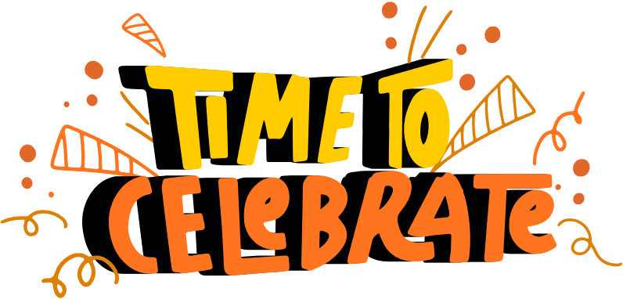
The NACD Stewardship Program is a year-round effort to explore, understand, and protect our natural resources. It brings communities together across the country to learn how soil, water, air, plants, and wildlife are connected and how each of us can make a difference in keeping them healthy and thriving.
Since 1955, this program has centered around the annual Stewardship Week celebration, which is held from the last Sunday in April through the first Sunday in May.
During Stewardship Week, conservation districts across the United States and its territories encourage communities, schools, and families to take part in events that protect soil, water, and wildlife and promote the wise use of natural resources.
National Association of Conservation Districts 2026 Stewardship Celebration
Notes:
Stewardship Program
Share that the NACD Stewardship Program takes place all year and encourages everyone to protect soil, water, air, and wildlife.
Explain that Stewardship Week is celebrated from the last Sunday in April through the first Sunday in May.
Encourage participation in local events or classroom activities that promote conservation.

Slide 12

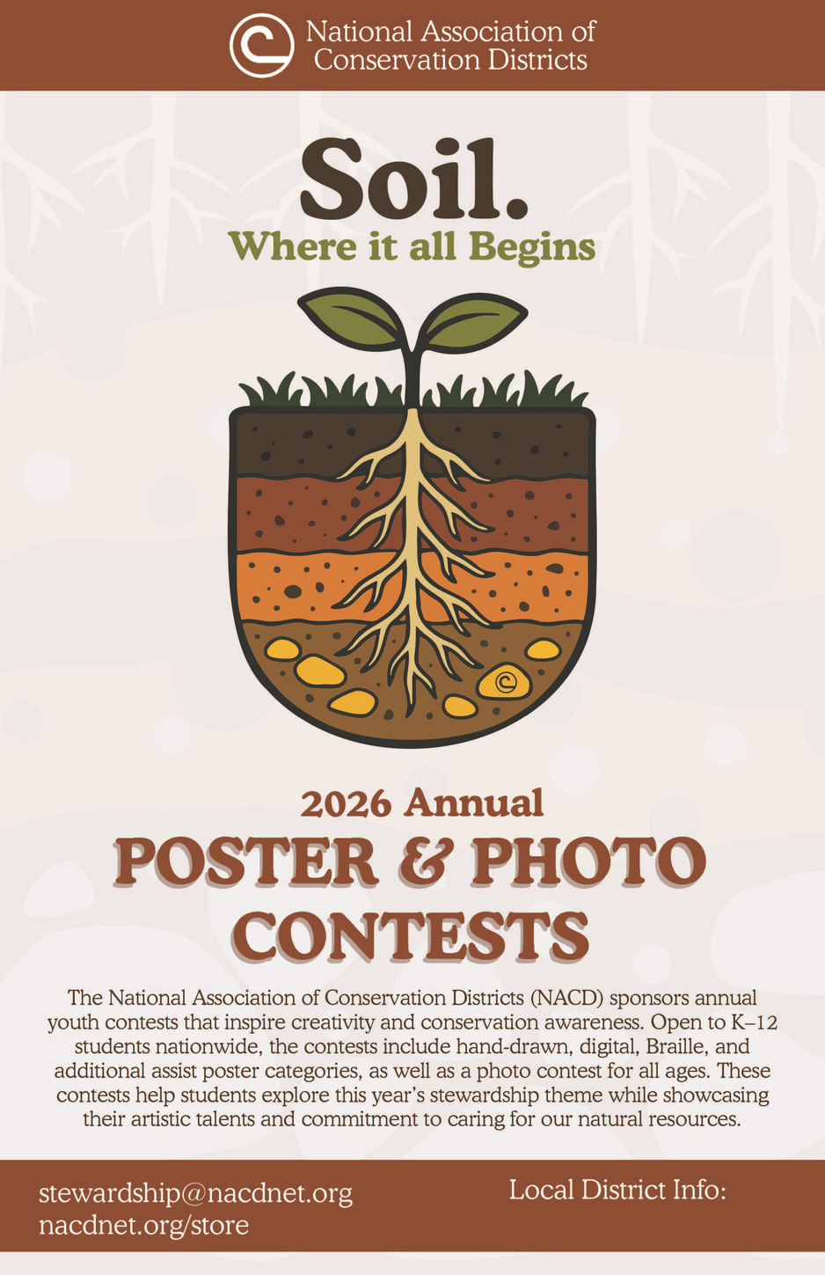
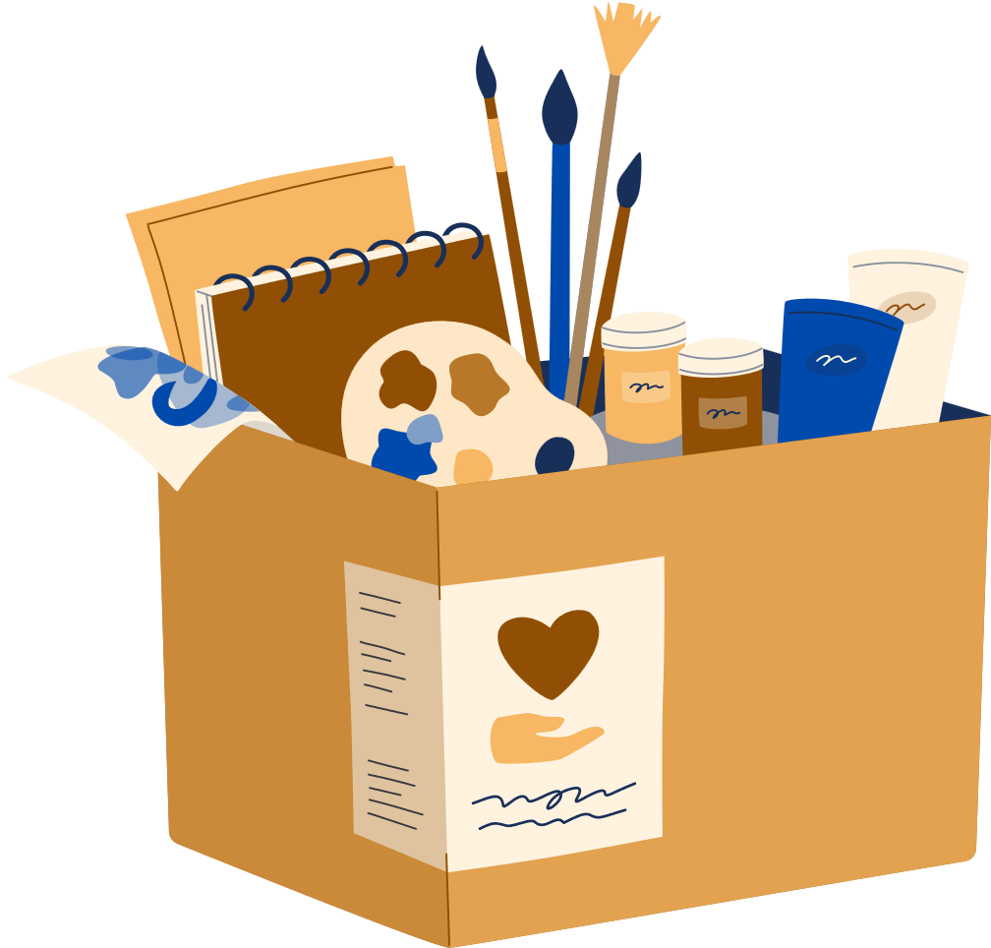
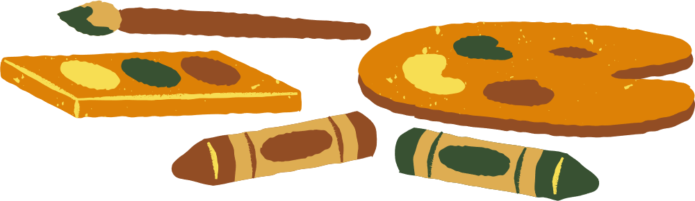
POSTER CONTEST
One of the most popular ways to celebrate is through the NACD Poster Contest. Each year, students create posters that reflect the national stewardship theme, showing what conservation means to them.
The contest encourages creativity while helping students learn how soil, water, air, plants, and wildlife work together to support life.
Winning posters can advance from local to state and national levels for recognition.
National Association of Conservation Districts 2026 Stewardship Celebration
Notes:
Poster Contest Overview
Explain that the NACD Poster Contest lets students express what conservation means to them.
Winning posters can move from local to state and national levels. Encourage creativity and focus on the theme.

Slide 13
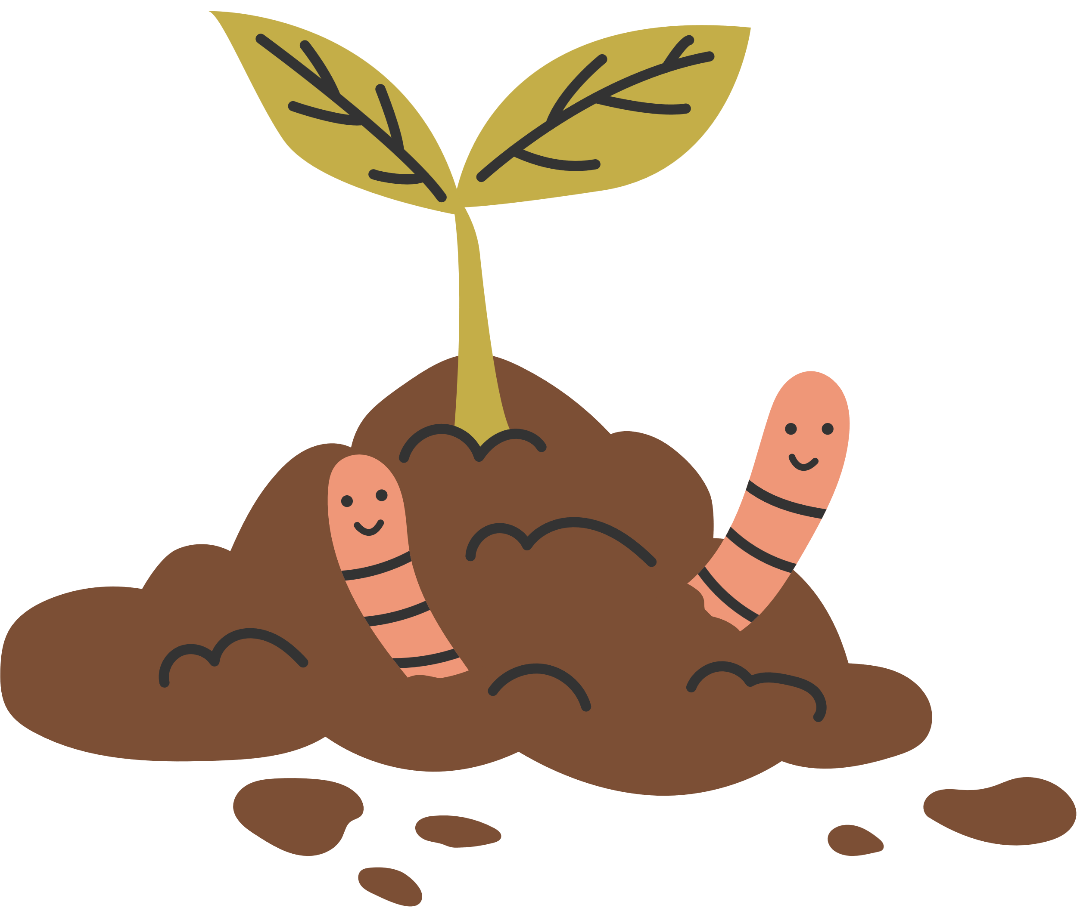
What Makes a Good Poster?
A good poster is creative, clear, and connects to the year’s stewardship theme. It should grab attention, share a strong message about conservation, and be easy to understand without using too many words. Use bold colors, neat drawings, and your own ideas to show what the theme means to you.
Remember, your poster should help others learn why caring for our natural resources is important!
National Association of Conservation Districts 2026 Stewardship Celebration
Notes:
What Makes a Good Poster
Review what makes an effective poster.
Clear message, bold colors, and original artwork.
Remind students that their posters teach others about the importance of protecting natural resources

Slide 14
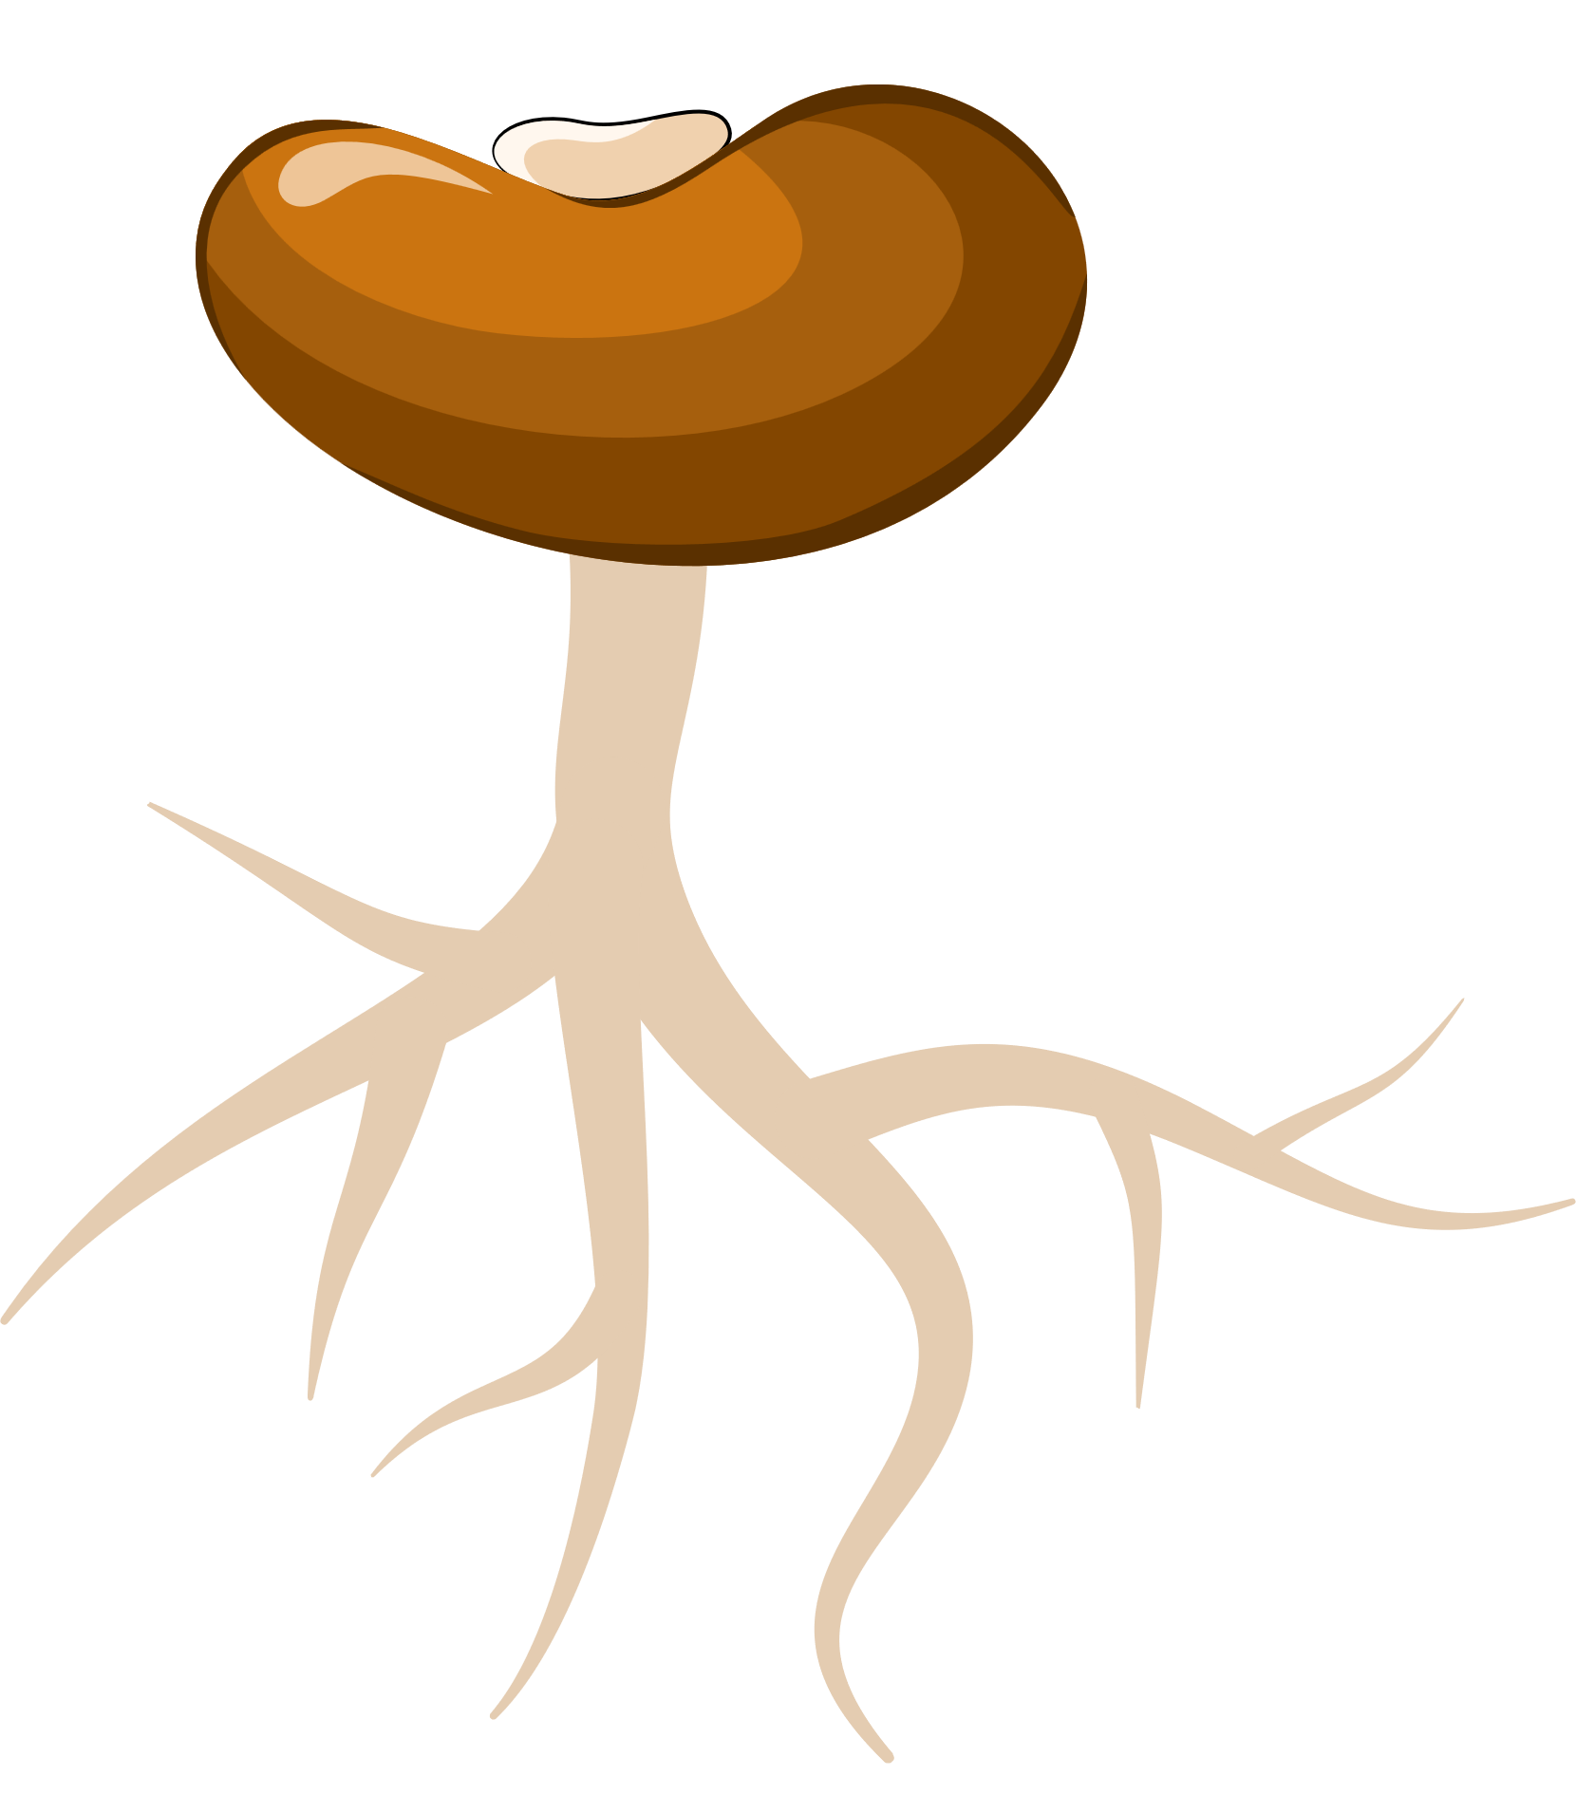
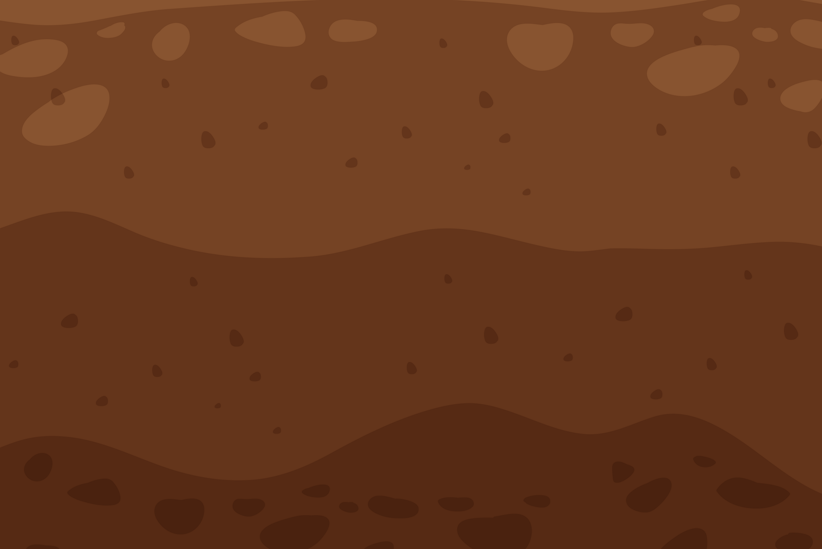
RULES TO FOLLOW
The poster must reflect the 2026 stewardship theme and title.
All artwork must be original and created by the student.
All mediums accepted. Minimum size is 8.5" x 11".
Do not include students names, school names, or identifying information on the front of the poster.
Posters are judged on conservation message, visual effectiveness, originality, and universal appeal.
Entries are first judged locally, with winners advancing to state and then national levels.
Contact your local district for specific deadlines and entry forms.
National Association of Conservation Districts 2026 Stewardship Celebration
Notes:
Rules to Follow
Go over poster size requirements and emphasize that all artwork must be original.
Explain that judging is based on the conservation message, creativity, and how clearly the poster connects to the theme.

Slide 15
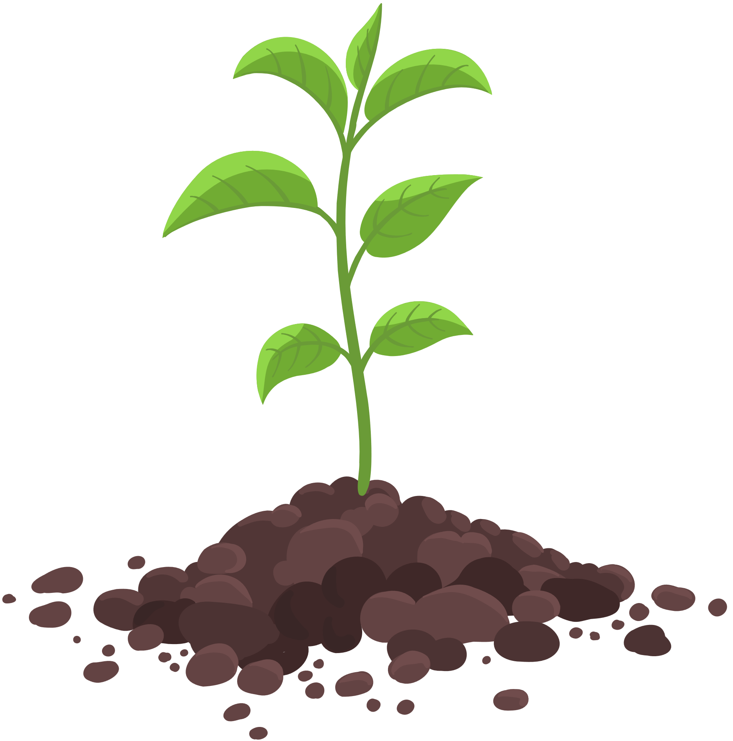

2026 POSTER CONTEST CATEGORIES
Hand-Drawn: Created with markers, crayons, paint, colored pencils, or other traditional art materials.
Digital (Graphic Arts): Created using digital drawing or graphic design software.
Braille: Designed for blind/low vision students who create tactile posters using Braille or raised materials that can be felt.
Additional Assist: For students who require support to complete their posters, ensuring accessibility.
REVIEW CONTEST RULES AND DETAILED INFORMATION
OR DOWNLOAD THE CONTESTS RULES AT HTTPS://WWW.NACDNET.ORG/CONTESTS/
National Association of Conservation Districts 2026 Stewardship Celebration
Notes:
Poster Categories
Describe the four categories of entries:
Hand-Drawn
Digital
Braille
Additional Assist.
Reinforce that the contest welcomes every student, including those who need support or use different materials.

Slide 16



LOCAL DISTRICT CONTEST INFORMATION:
National Association of Conservation Districts 2026 Stewardship Celebration
Notes:
Local Contest Information
Provide your local conservation district’s contact information and entry deadlines.
Encourage students to submit their posters early and reach out with any questions.

Slide 17
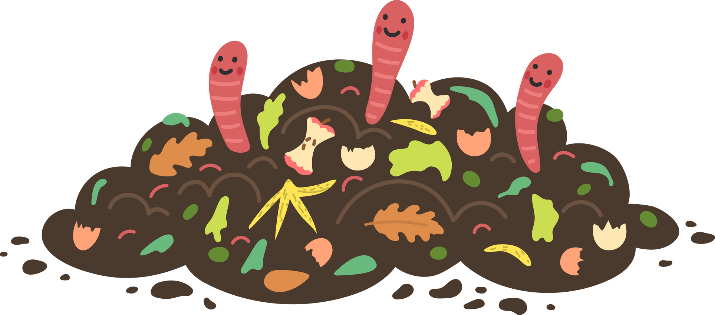
What Is Soil?
Soil is more than dirt. It’s made of minerals, air, water, and organic matter (bits of plants and animals). It’s alive with tiny organisms that help plants grow and keep the land healthy.
National Association of Conservation Districts 2026 Stewardship Celebration
Notes:
What is Soil
Explain that soil is a mix of minerals, water, air, and organic matter.
Emphasize that soil is alive and filled with organisms that help plants grow.
Ask students to think about what might happen if soil becomes unhealthy.

Slide 18
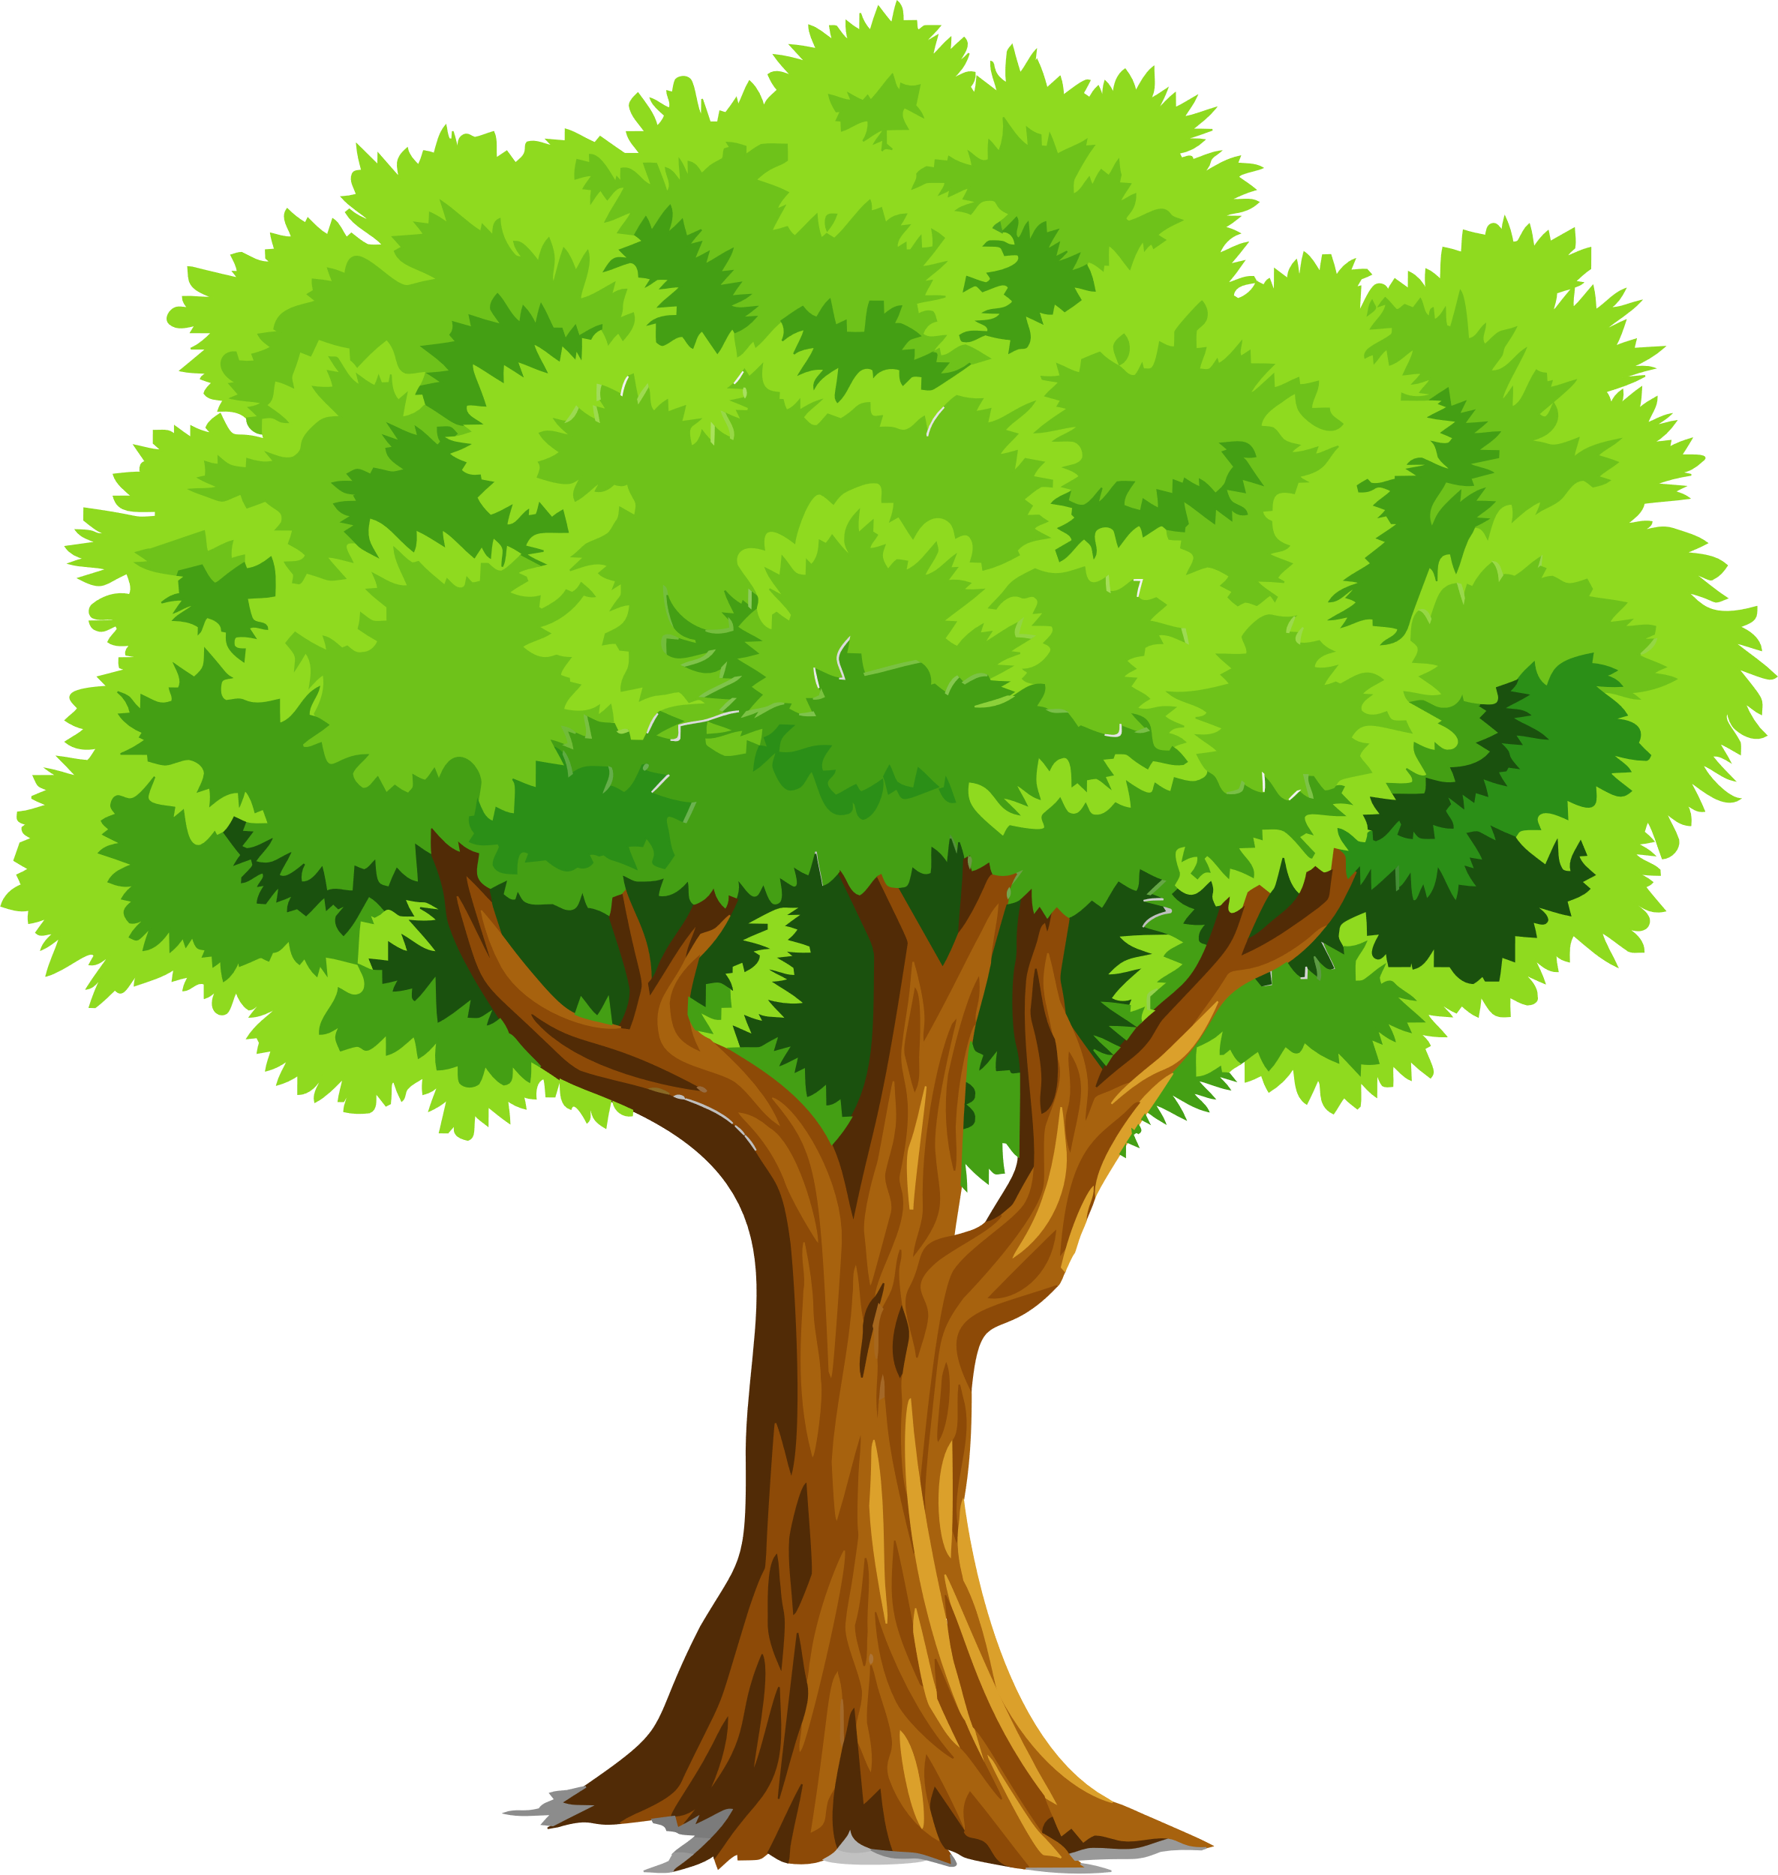
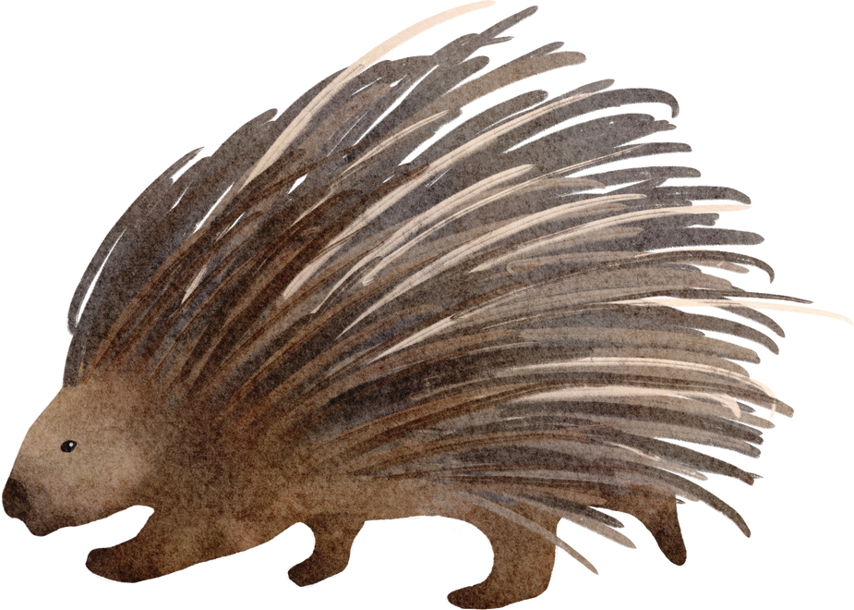
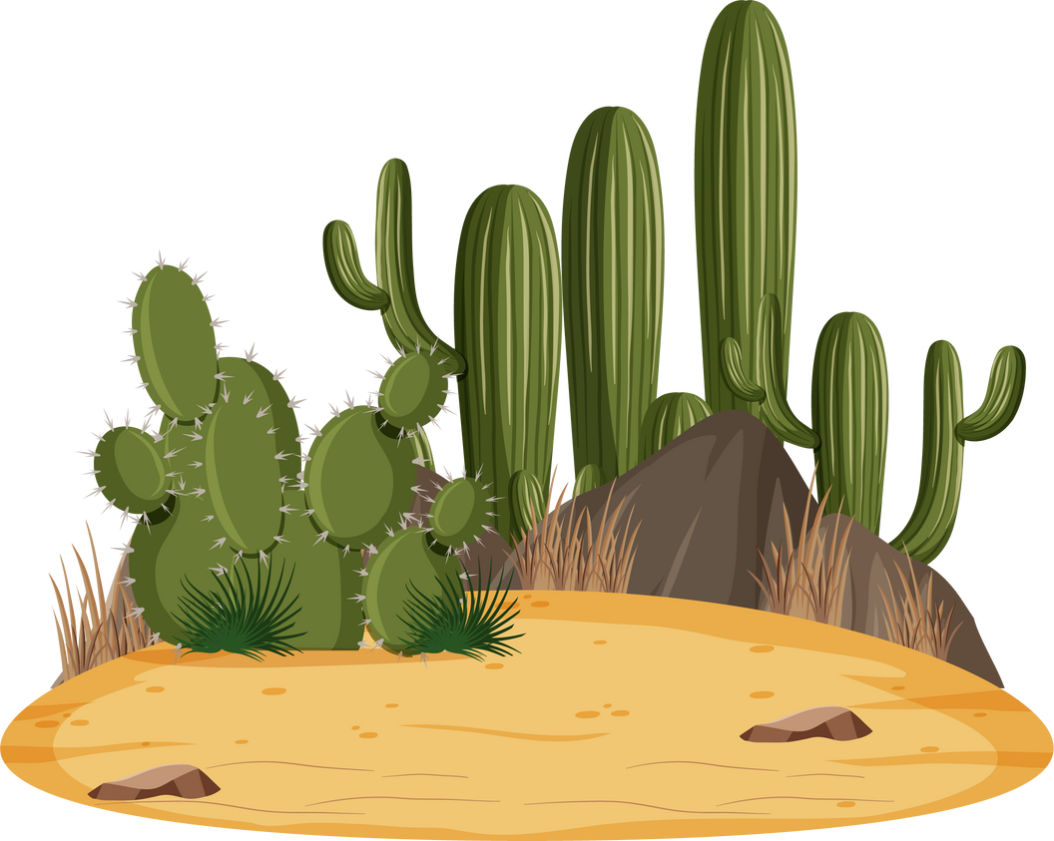

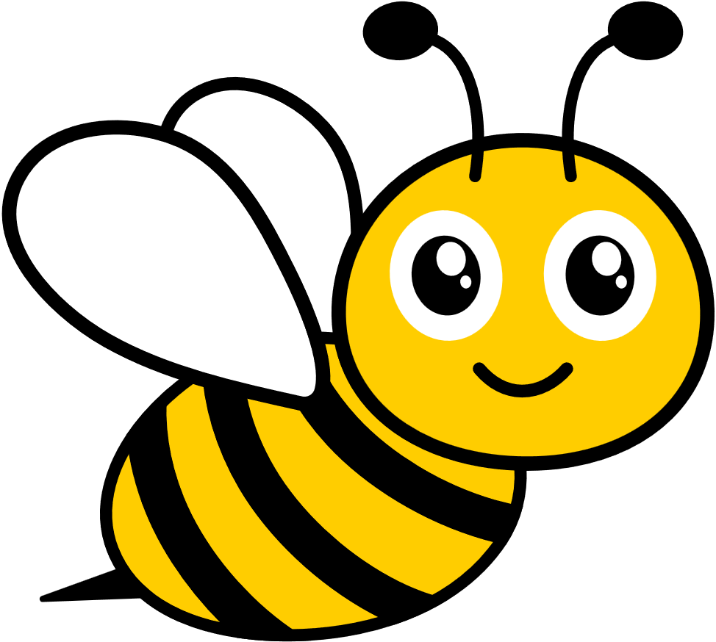

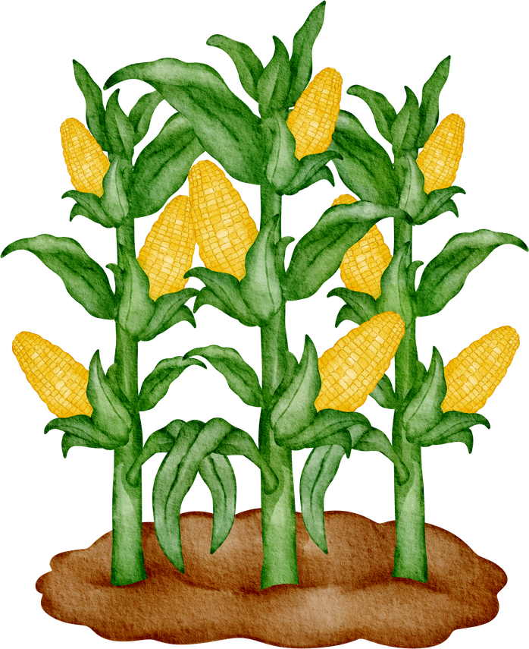

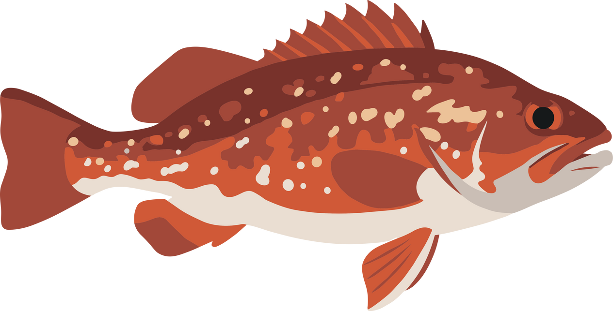

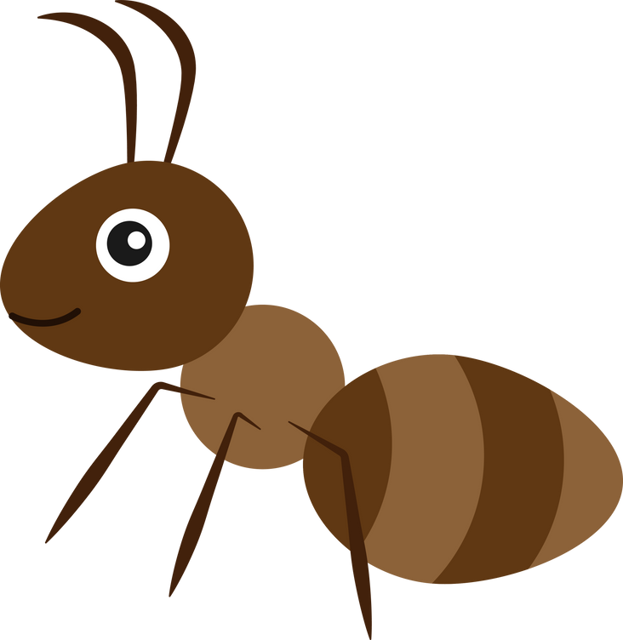
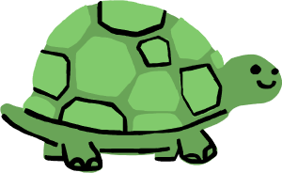
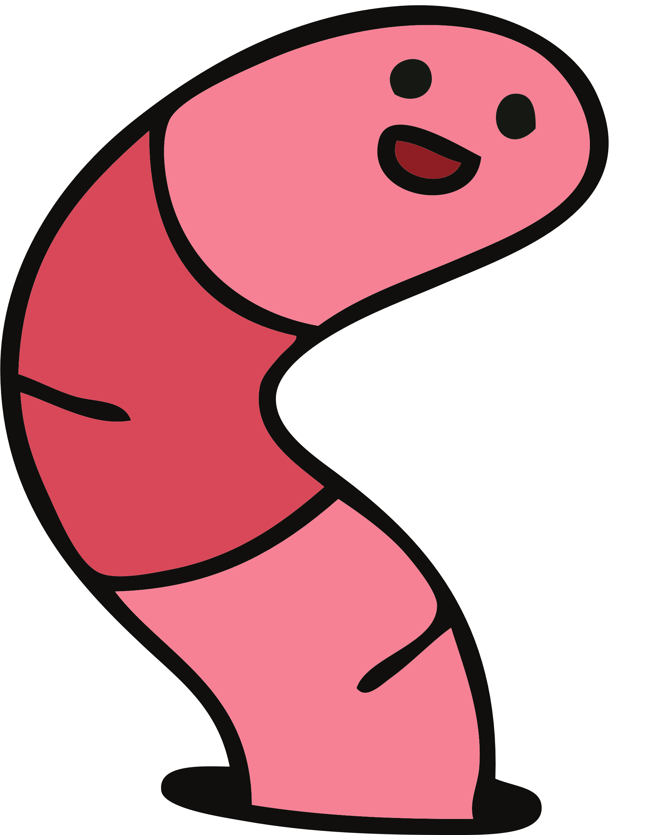
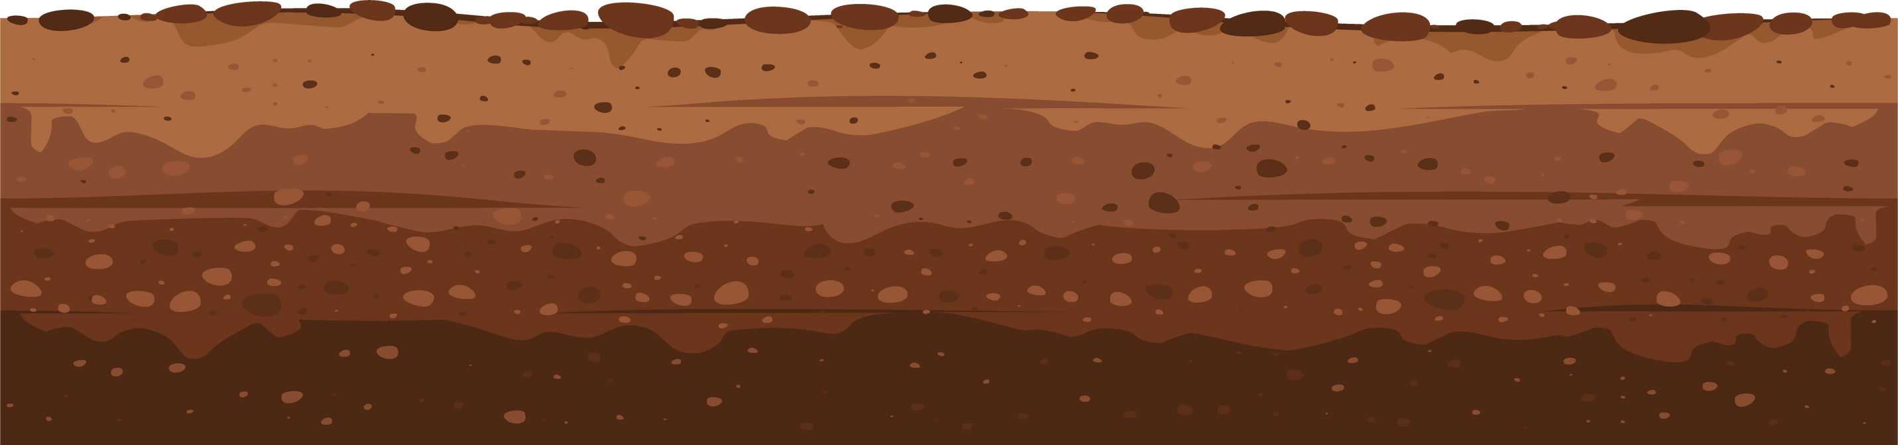
Why Soil Matters
Soil is the foundation of life across every landscape, whether coastal, desert, forest, island, or grassland.
Soil connects ecosystems by supporting vegetation, storing and filtering water, and providing the structure that sustains biodiversity and human communities.
National Association of Conservation Districts 2026 Stewardship Celebration
Notes:
Soil and Ecosystems
Describe how soil supports ecosystems by storing and filtering water and providing nutrients.
Discuss how soil connects to forests, farms, and cities.
Encourage students to name examples of local habitats that depend on soil.

Slide 19
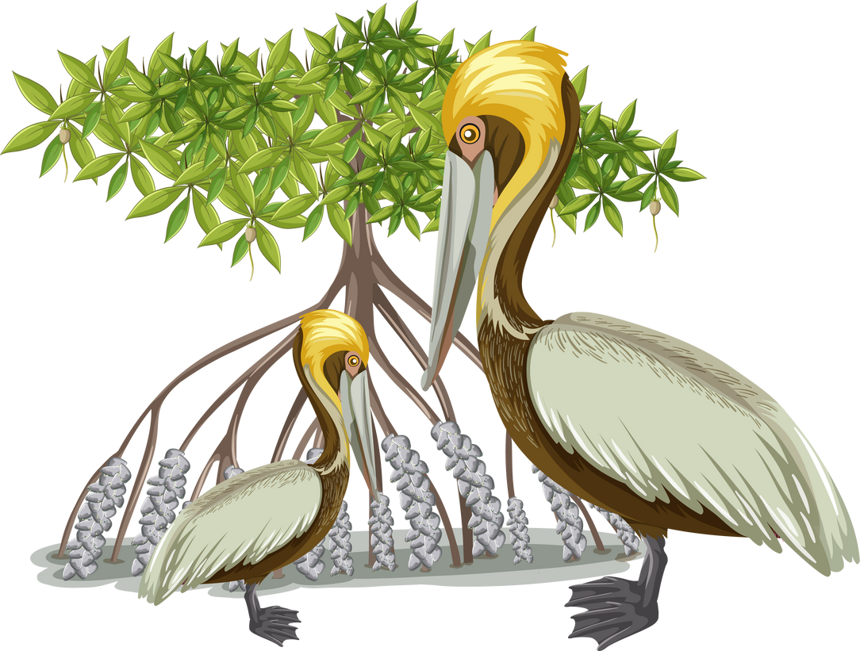
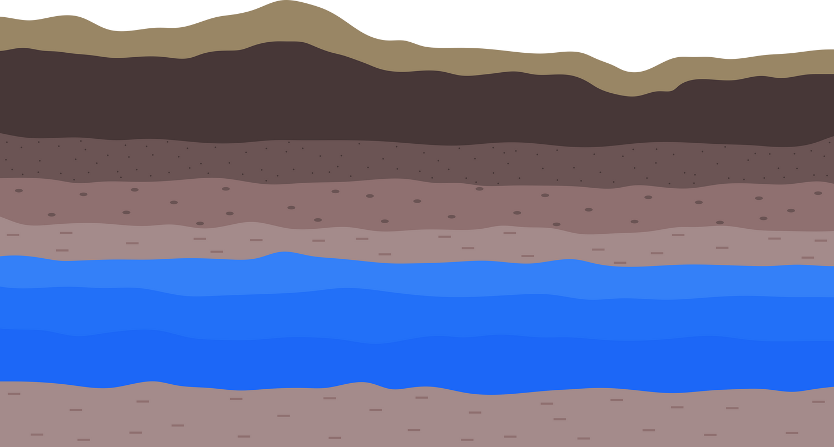
Wait. What? The Ocean and Desert have sand!
Both the ocean and the desert rely on soil because it connects and supports their ecosystems by carrying nutrients and clean water to the sea, while storing moisture and anchoring life in dry landscapes.
How the Ocean Relies on Soil
Soil filters and cleans water before it flows into rivers and oceans.
Nutrients from soil feed tiny ocean plants called plankton.
Coastal soils support wetlands and mangroves that protect shorelines and wildlife.
How the Desert Relies on Soil
Soil stores water deep underground for plants and animals.
It anchors roots and prevents sand from blowing away.
Healthy desert soil supports plants that provide food and shelter for wildlife.
National Association of Conservation Districts 2026 Stewardship Celebration
Notes:
Soil in Different Environments
Explain that both the ocean and the desert rely on soil.
Coastal soil supports wetlands and mangroves that protect shorelines, while desert soil stores water and supports plants that feed animals.
Highlight that soil connects all ecosystems across the planet.

Slide 20
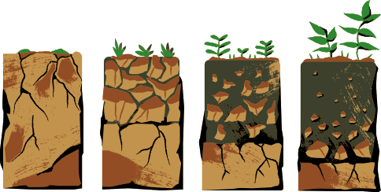

Soil Formation
Soil forms very slowly as rocks break down and mix with bits of plants and animals. Weather, land shape, and living things all help make soil over time.
National Association of Conservation Districts 2026 Stewardship Celebration
Notes:
How Soil Forms
Explain that soil forms very slowly as rocks break down and mix with bits of plants and animals.
Describe how weather and living things help make soil over long periods of time.
Emphasize that protecting soil is important because it takes so long to form.

Slide 21
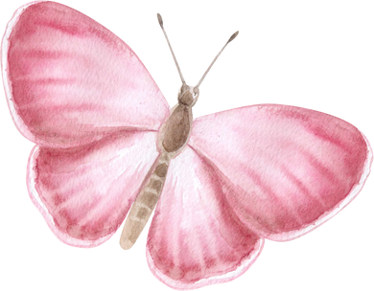
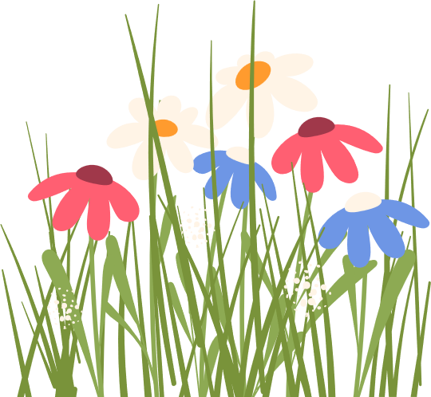
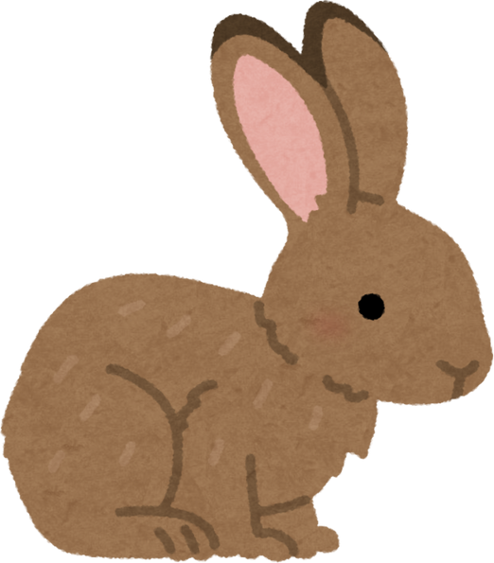
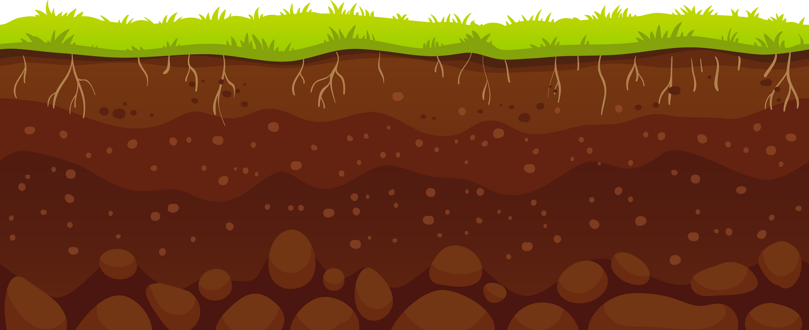

Layers of Soil
Topsoil: Where plants grow and roots live.
Subsoil: Stores water and nutrients.
Parent Material: Pieces of rock breaking down.
Bedrock: The solid rock below all layers.
National Association of Conservation Districts 2026 Stewardship Celebration
Notes:
Layers of Soil
Describe each soil layer: topsoil, subsoil, parent material, and bedrock.
Layers of Soil: There are four main layers of soil, called horizons. Each layer looks different and has a special role in supporting life.
Topsoil is the top layer where plants grow and roots spread out. It is dark in color because it contains decomposed organic matter called humus, which gives it nutrients. Earthworms, insects, and microorganisms live here and help keep the soil loose and healthy. This layer holds most of the nutrients plants need and is where seeds germinate.
Subsoil lies below the topsoil and is lighter in color because it has less organic matter. It contains minerals that have washed down from the topsoil through rainwater. Roots from trees and deep plants may reach into this layer to find stored water and minerals.
Parent Material is a mix of partially broken rock, sand, and clay that forms the base of soil development. It influences the soil’s texture and type—whether it’s sandy, loamy, or clay-rich. Over time, weathering and biological activity break this material down to form new soil.
Bedrock is the solid rock layer found beneath all the other layers. It doesn’t support plant life directly, but it slowly breaks down through weathering, providing minerals that become part of the soil above it.
For visual learning, show a soil profile diagram or create a classroom soil jar using a clear container filled with sand, clay, leaves, and small rocks to represent each layer. Discuss how rainwater moves through each layer and how nutrients travel from top to bottom.

Slide 22
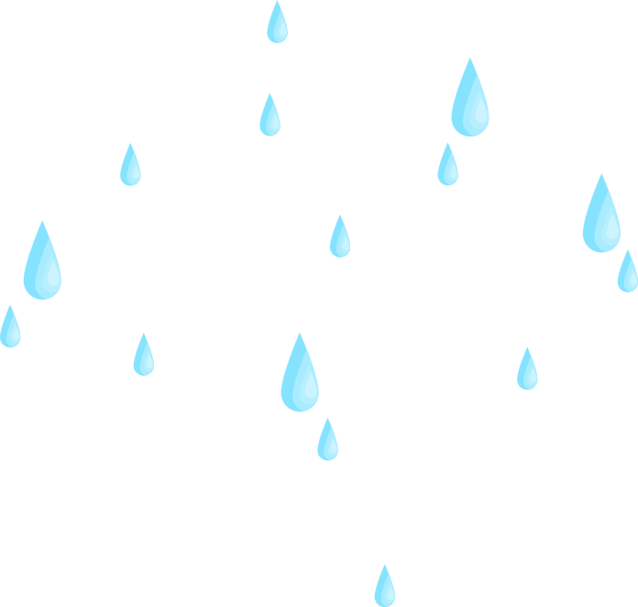

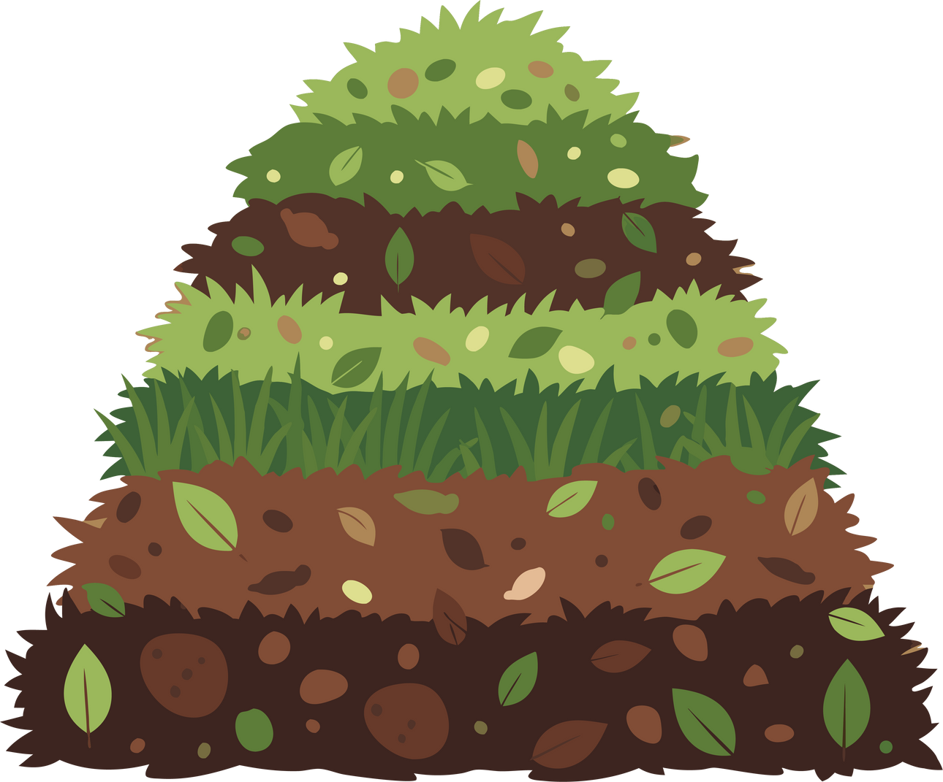




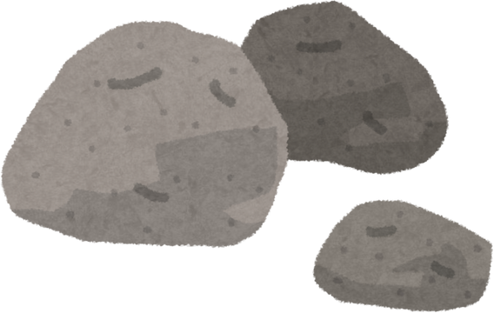
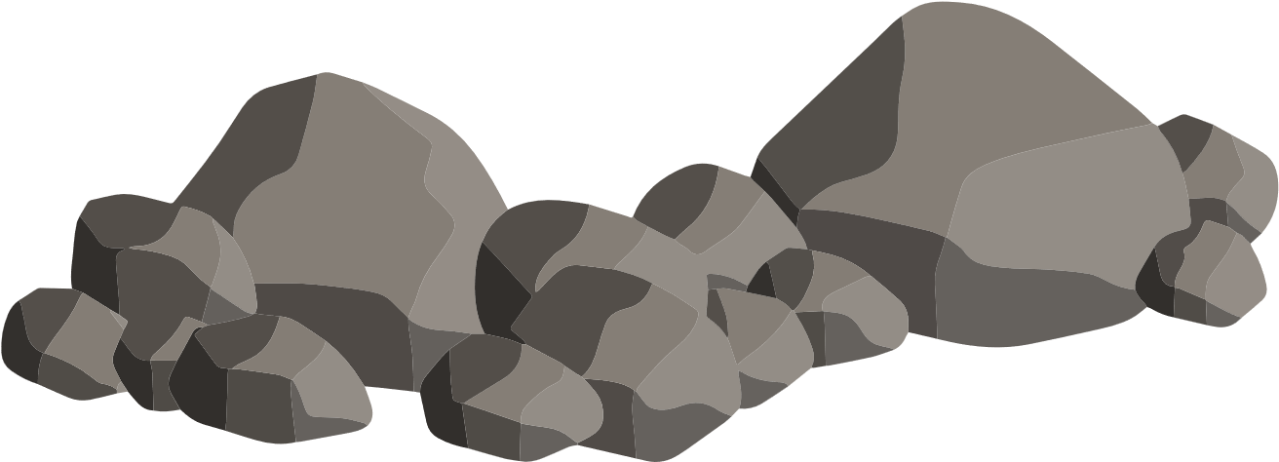
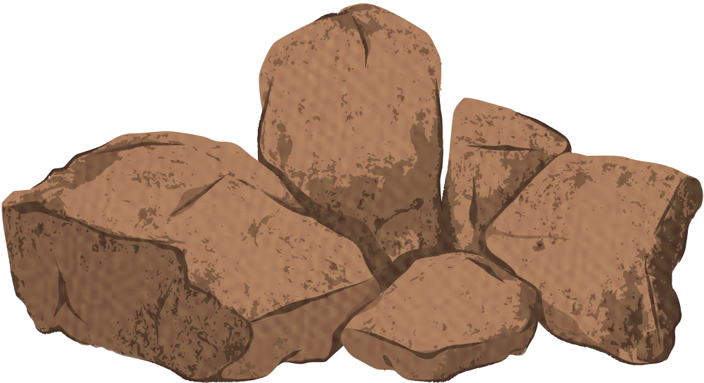
DECOMPOSITION
Topsoil forms through the decomposition of organic matter as dead plants and animals break down and mix with small pieces of rock.
Rain and weather help this process, creating rich, dark soil full of nutrients that support new plant growth.
National Association of Conservation Districts 2026 Stewardship Celebration
Notes:
Decomposition
Explain that topsoil forms through the decomposition of dead plants and animals mixing with rock.
Rain and weather help break these materials down, creating rich, dark soil that supports plant growth.

Slide 23


Healthy soil means healthy food, clean water, and strong communities.
Soil IS where it all begins.
How can you help care for the soil where you live?
National Association of Conservation Districts 2026 Stewardship Celebration
Notes:
Caring for Soil
Encourage students to think about ways to care for soil such as planting trees, composting, or preventing erosion.
Connect soil health to clean water, food, and healthy communities.

Slide 24
Class Discussion or Review Activity
What are Conservation Districts, and why were they created?
How does the National Association of Conservation Districts support local districts?
What happened during the Dust Bowl, and what did people learn from it?
Who was Hugh Hammond Bennett, and what was his role in soil conservation?
Give examples of Best Management Practices used by farmers.
Why are natural resources important to protect?
What does it mean for a district to be locally led?
Explain the meaning of the thematic phrase “Soil. Where It All Begins.”
What is Stewardship Week, and when is it celebrated each year?
What is the purpose of the NACD Poster Contest?
How does decomposition help form topsoil?
What is parent material, and why does it matter for soil formation?
How do organisms help create soil?
How does soil help the ocean and the desert?
National Association of Conservation Districts 2026 Stewardship Celebration
Notes:
Class Discussion or Review
Use the discussion questions to guide review and reinforce understanding.
Have students work in pairs or groups to answer and discuss.
Encourage them to connect what they learned about soil and conservation to their own community.

Slide 25
Answer Key
What are Conservation Districts, and why were they created?
Conservation districts were created in the 1930s to help people protect soil and water after the Dust Bowl. They work locally to promote conservation and prevent erosion.
How does the National Association of Conservation Districts support local districts?
NACD provides leadership, education, and resources to help local districts share information, teach conservation, and protect natural resources.
What happened during the Dust Bowl, and what did people learn from it?
In the 1930s, strong winds and poor farming practices caused the soil to blow away. People learned that healthy soil must be protected through conservation.
Who was Hugh Hammond Bennett, and what was his role in soil conservation?
Hugh Hammond Bennett was known as the “Father of Soil Conservation.” He led efforts to create the Soil Conservation Service and taught farmers how to protect soil.
Give examples of Best Management Practices used by farmers.
Examples include planting cover crops, rotating crops, building terraces, and using grass buffers to prevent erosion and protect water.
Why are natural resources important to protect?
Natural resources like soil, water, air, and plants are what we need to grow food, have clean water, and live healthy lives.
National Association of Conservation Districts 2026 Stewardship Celebration
Notes:
Answer Key
Review answers as a group or let students check their responses together.
Reinforce the idea that healthy soil supports life everywhere and that everyone plays a role in protecting it.

Slide 26
Answer Key
What does it mean for a district to be locally led?
It means the people who live and work in the community make decisions about conservation based on their land and local needs.
Explain the meaning of the thematic phrase “Soil. Where It All Begins.”
It means that everything we depend on starts with healthy soil.
What is Stewardship Week, and when is it celebrated each year?
Stewardship Week is the national kickoff for the conservation theme, held from the last Sunday in April through the first Sunday in May each year.
What is the purpose of the NACD Poster Contest?
The contest helps students share what they learn about conservation through art while promoting the yearly stewardship theme.
How do organisms help create soil?
Worms, insects, roots, and bacteria mix the soil and add nutrients through decomposition, helping it stay loose and healthy for plants to grow.
How does soil help the ocean and the desert?
Soil filters and cleans water before it reaches the ocean and provides nutrients for sea life. In deserts, it stores water and supports plants and animals that live in dry conditions.
National Association of Conservation Districts 2026 Stewardship Celebration
Notes:
Answer Key
Review answers as a group or let students check their responses together.
Reinforce the idea that healthy soil supports life everywhere and that everyone plays a role in protecting it.

